Slide 1
Outline
Whole Genome Assembly
How it works
How to make it work (exercises)
Synteny alignments
How it works
How to make it work (exercises)
Transcriptome assembly (RNA-Seq)
How it works
How to make it work (exercises)
Open questions & future directions

Slide 2
Sequence alignment: a historic perspective
Comparative Genomics is based on sequence homology
Sequence homology requires sequence alignment
Sequence alignment as old as genomics (Smith, Waterman) 1981

Slide 3
Sequence alignment: a historic perspective
Comparative Genomics is based on sequence homology
Sequence homology requires sequence alignment
Sequence alignment as old as genomics (Smith, Waterman) 1981
Algorithms well predate genomics (signal processing etc.)

Slide 4
Local vs. Global alignment
Local alignment:
align two sequences head-to-toe
Maximize matches/minimize mismatches & gaps
=> In essence: how to insert gaps
ATA_GGAAAAGAAGAATTAAATTGAACAGT_TTACAATTAATGACTGTATTA
||| || | ||||||||| |||||||| || ||| ||| || ||||
ATATGGGA___AAGAATTAAGGTGAACAGTCTTCCAA__AAT_AC_ACATTA
Global alignment:
Examine many placement for sequence (genome-wide)
Maximize matches & length/minimize mismatches & gaps(?)
=> In essence: where to find best hit(s)

Slide 5
Synteny: orthologous only (best hit not always correct!)
Order and orientation of genomic features often highly conserved (e.g. tetrapods, fishes, flowering plants)

Slide 6
Synteny: local and global in context
Maximize matches that preserve order and orientation
Resolve ambiguities
Ideally, find one placement per genomic sequence (modulo duplications)
Find orthologs, avoid paralogs,

Slide 7
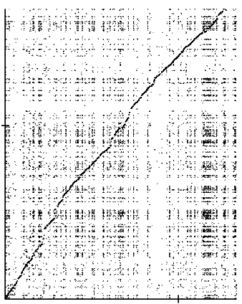
Synteny: local and global in context
Example: human vs. dog
All alignments

Slide 8
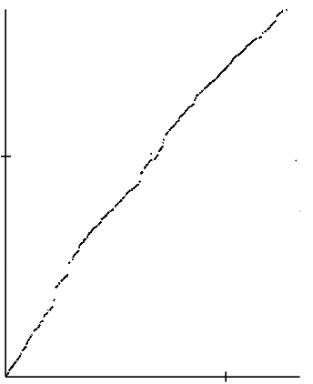
Synteny: local and global in context
Example: human vs. dog
All alignments Syntenic only

Slide 9
Problem 1: how to get synteny only?
Repeat masking?
Matches unique in either genome only?
Anything else?

Slide 10
Problem 1: how to get synteny only?
Repeat masking?
Will not work for gene families
Will miss repeats inserted before split
Will not filter low-copy number repeats
Computationally expensive!!
Matches unique in either genome only?
Anything else?

Slide 11
Problem 1: how to get synteny only?
Repeat masking?
Will not work for gene families
Will miss repeats inserted before split
Will not filter low-copy number repeats
Computationally expensive!!
Matches unique in either genome only?
Will miss anything that is duplicated
How do you define “unique”
Anything else?

Slide 12
Problem 1: how to get synteny only?
Repeat masking?
Will not work for gene families
Will miss repeats inserted before split
Will not filter low-copy number repeats
Computationally expensive!!
Matches unique in either genome only?
Will miss anything that is duplicated
How do you define “unique”
Anything else?
=> Yes! Dynamic programming!

Slide 13
What is dynamic programming?
Essential algorithm for any kind of sequence alignment
Brute-force is computationally not feasible!
The trick: avoid unnecessary computations

Slide 14
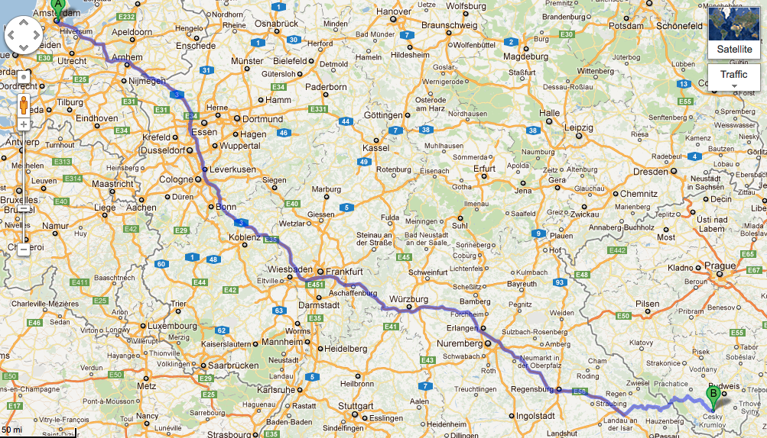

Example: best way from Amsterdam to Český Krumlov

Slide 15
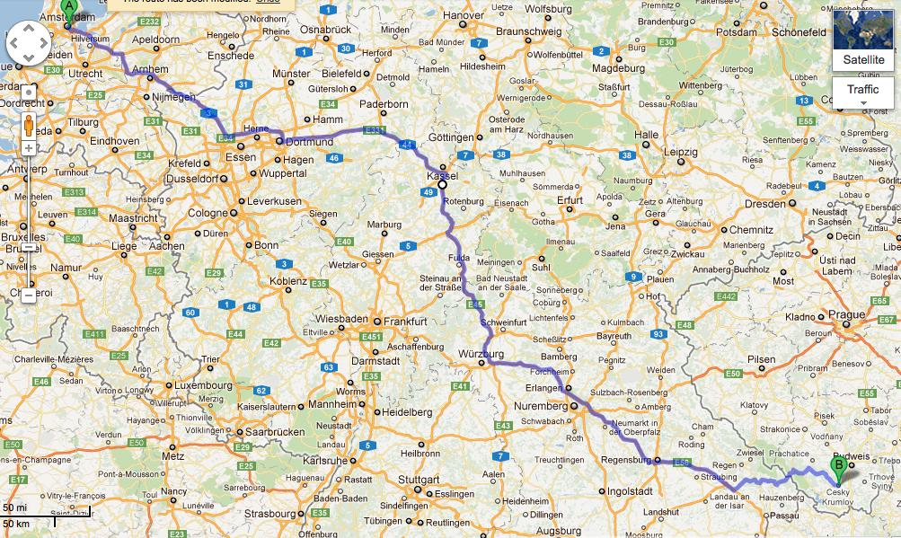
Example: best way from Amsterdam to Český Krumlov

Slide 16
Example: best way from Amsterdam to Český Krumlov
Graph:
Cities -> Nodes
Streets -> Edges
=> Avoid full combinatorial

Slide 17
Example: best way from Amsterdam to Český Krumlov

Slide 18
Example: best way from Amsterdam to Český Krumlov

Slide 19
Example: best way from Amsterdam to Český Krumlov
Minimize “cost”!
Only keep best local score
Würzburg-Krumlov independent of Essen- Würzburg

Slide 20
Example: best way from Amsterdam to Český Krumlov
What to optimize:
Define cost function
Distance
Travel time
Scenic routes, etc.
Minimize “cost”!
Only keep best local score
Würzburg-Krumlov independent of Essen- Würzburg

Slide 21
A more recent example…
Driving from Vienna to Český Krumlov
Český Krumlov
Gmünd
Bad Leonfelden
Friedberg
Tulln
Amstetten
Stockerau
Linz
Vienna
St Pölten
Neulengbach

Slide 22
A more recent example…
Driving from Vienna to Český Krumlov
Český Krumlov
1.0
1.1
Gmünd
Bad Leonfelden
1.7
2.0
Friedberg
Tulln
0.8
1.9
0.2
1.4
1.2
Amstetten
Stockerau
Linz
0.8
1.7
0.7
1.0
1.3
Vienna
St Pölten
Neulengbach
0.9
1.1

Slide 23
A more recent example…
Driving from Vienna to Český Krumlov
Český Krumlov
1.0
1.1
Gmünd
Bad Leonfelden
1.7
2.0
Friedberg
Tulln
0.8
1.9
0.2
1.4
1.2
Amstetten
Stockerau
Linz
0.8
1.7
0.7
1.0
1.3
Vienna
St Pölten
Neulengbach
0.9
1.1

Slide 24
A more recent example…
Driving from Vienna to Český Krumlov
Český Krumlov
1.0
1.1
Gmünd
Bad Leonfelden
1.7
2.0
Friedberg
Tulln
0.8
1.9
0.2
1.4
1.2
Amstetten
Stockerau
Linz
0.8
1.7
0.7
1.0
1.3
Vienna
St Pölten
Neulengbach
0.9
1.1
The route I took…

Slide 25
Apply to synteny
Generate list of local match candidates
Use combination of match score (sequence identity) and syntenic order
Find best path across
But: allow for breaks (at a cost!)

Slide 26
Apply to synteny
Generate list of local match candidates
Use combination of match score (sequence identity) and syntenic order
Find best path across
But: allow for breaks (at a cost!)

Slide 27
Exercise II: draft genomes & synteny alignments
Software: Satsuma
Read the documentation
Set up a sample project
Start up alignment
Download from: https://www.broadinstitute.org/science/programs/genome-biology/spines

Slide 28

Synteny alignments with Satsuma: How it works

Slide 29
Satsuma: how it works
What you will need:
Assembled genome sequences
A lot of CPUs

Slide 30
Conventional synteny alignments
Mask repeats in sequences (hard & soft)
Use seeds to find potential alignments
Follow up with local alignments
Apply Synteny filter
Done!

Slide 31
Seed and match
Genome A
Genome B

Slide 32
Seed and match
Genome A
Genome A: dictionary of short (11-16bp), overlapping sequences
Genome B

Slide 33
Seed and match
Genome A
Genome A: dictionary of short (11-16bp), overlapping sequences
Genome B
Genome B: lookup matches for short sequences
=> Use as “seeds” for local alignments

Slide 34
Seed and match
Genome A
Genome A: dictionary of short (11-16bp), overlapping sequences
Genome B
Genome B: lookup matches for short sequences
=> Use as “seeds” for local alignments

Slide 35
Problem: repeats have many matches
Genome A
Genome A: dictionary of short (11-16bp), overlapping sequences
Genome B
Genome B: lookup matches for short sequences
=> Use as “seeds” for local alignments

Slide 36
Problem: repeats have many matches
Genome A
Genome A: dictionary of short (11-16bp), overlapping sequences
Seeds can occur millions of times
Genome B
Genome B: lookup matches for short sequences
=> Use as “seeds” for local alignments

Slide 37
Problem: repeats have many matches
Genome A
Workaround:
Avoid repetitive sequences
Avoid common sequences
Trade-off between sensitivity and search space
Genome A: dictionary of short (11-16bp), overlapping sequences
Seeds can occur millions of times
Genome B
Genome B: lookup matches for short sequences
=> Use as “seeds” for local alignments

Slide 38
How Satsuma does it
Prioritize search space
Exhaustively search top candidates
Collect results
Apply Synteny filter
When space exhausted, done!
No seeding required!
- Built-in asynchronous parallelization!
Feedback

Slide 39

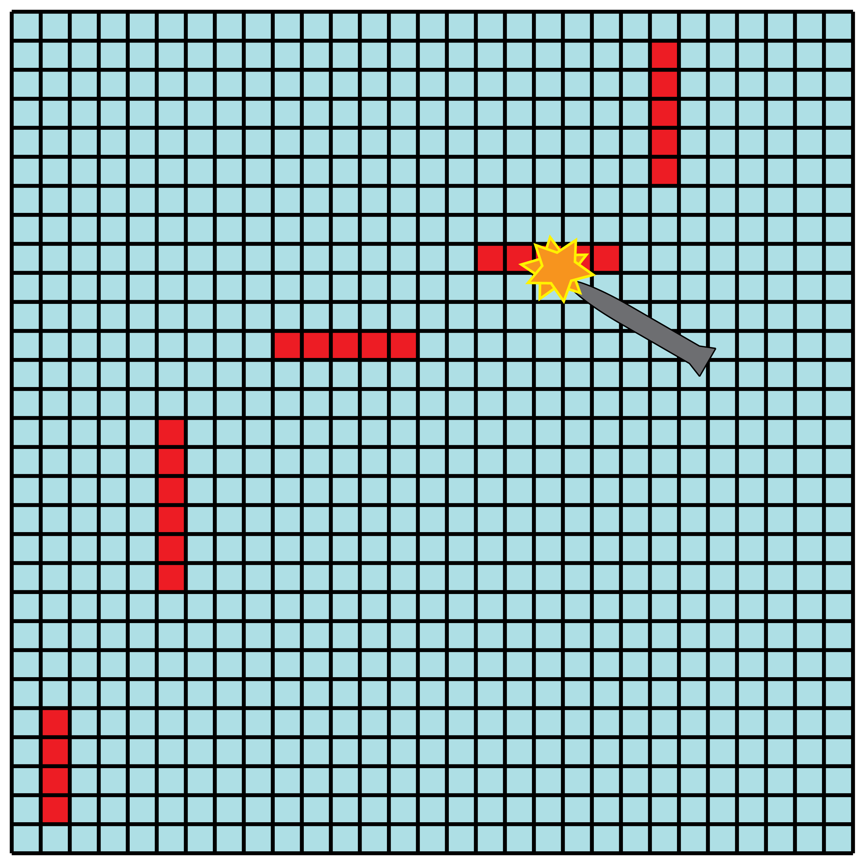
“Battleship” search
Play the paper-and-pencil game battleship
Distribute over multiple CPUs (server-client model)

Slide 40

Battleship search for alignments
Avoid searching all pairs of query and target sequences:
Exploit the fact that order and orientation of homologous sequences are highly conserved
Map genomes onto a 2-dimensional grid
Each pixel represents 4096x4096 bp
Several full line searches to find initial set of “hits” - pixels that survive synteny filter
Prioritize pixels bordering hits for subsequent search

Slide 41
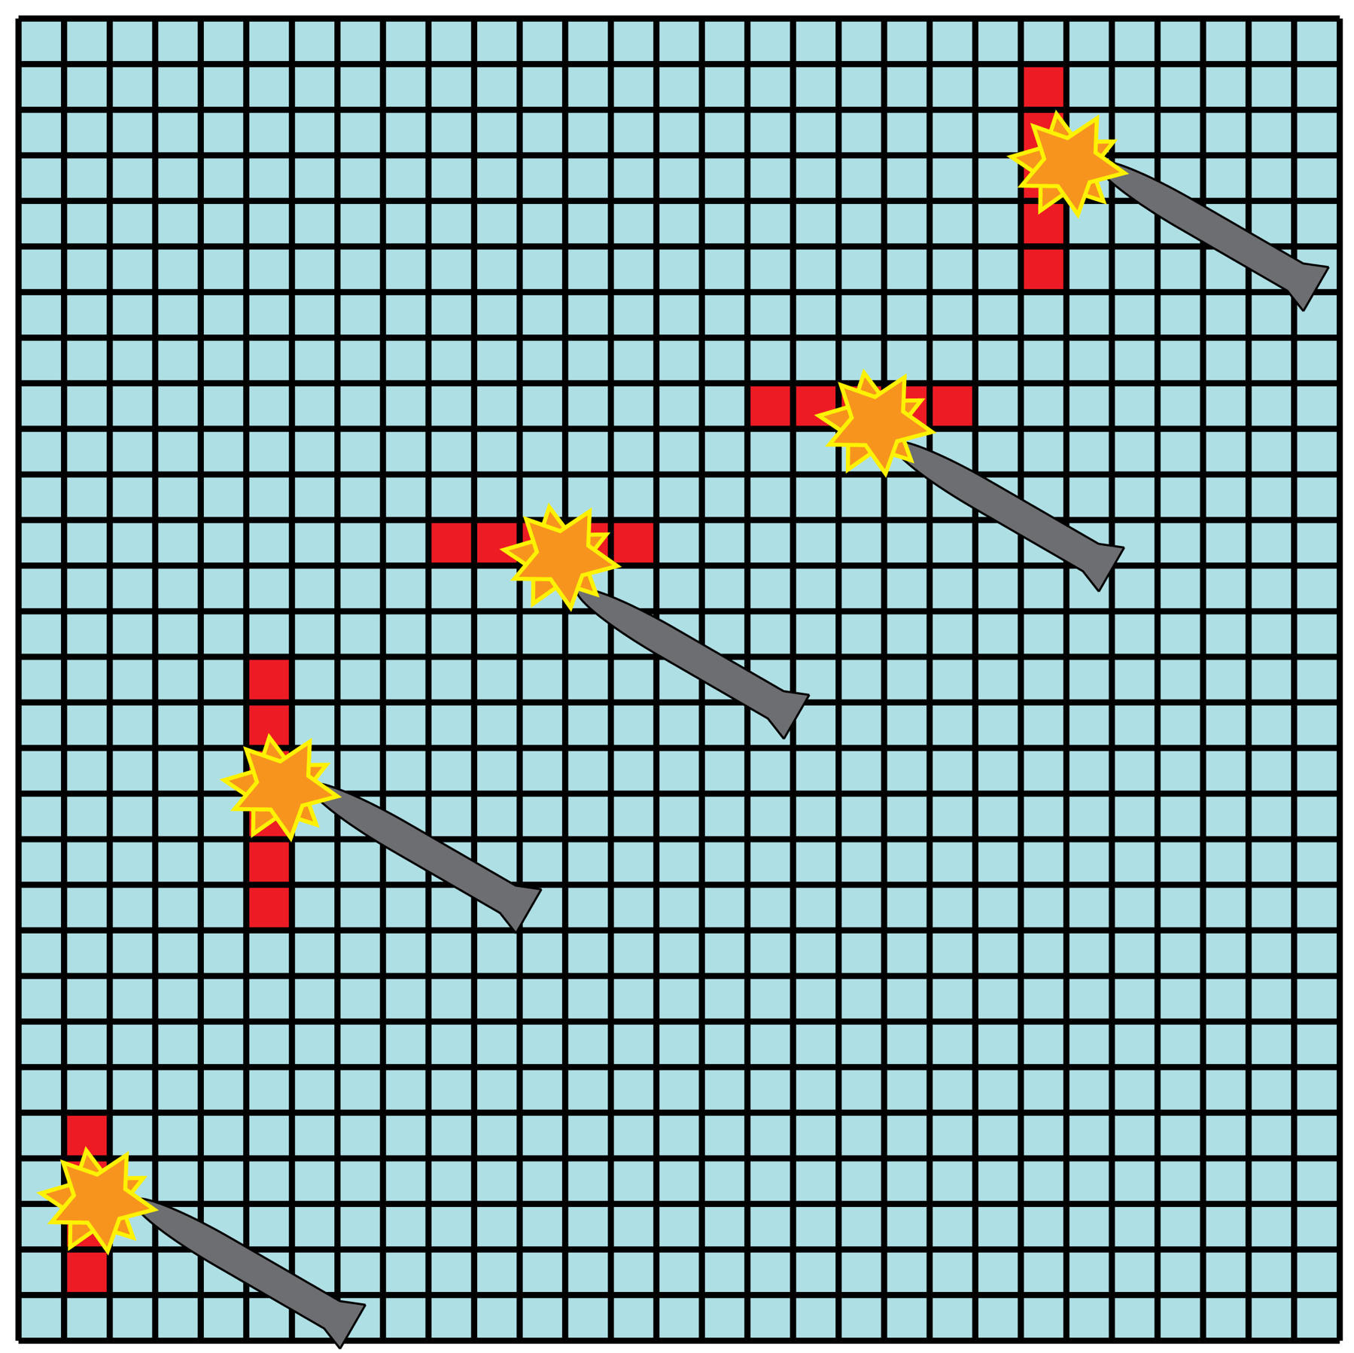
Battleship parallelization
Pixels are distributed to parallel search processes
Central process maintains priority queue and constantly updates map of grid
Pixels bordering hits are prioritized for search
As processes return, new processes are farmed out to search high-priority pixels
When there are not enough high-ranking pixels in the queue, more initiation points are searched

Slide 42



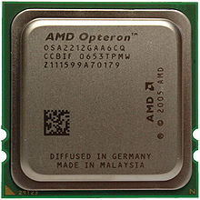
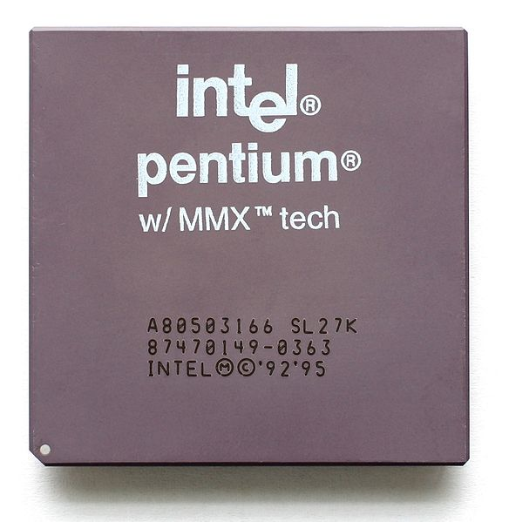
Dynamic parallelization: master-and-slave model
Master
Dynamic communication
channel (TCP/IP) across
the network
Distribute jobs to CPUs
(multi-CPU machine,
Server farm)
Slaves
Slaves initialize once (expensive!), request directives, send back results

Slide 43
Master: constantly update priority queue
Collect and merge slave output
Build global priority queue
Push onto communication stack
Wait for slaves to pick up coordinates
Mark coordinates being processed
Check for backup strategy (blind search)
Check for exit

Slide 44
Master: constantly update priority queue
Collect and merge slave output
Build global priority queue
Push onto communication stack
Wait for slaves to pick up coordinates
Mark coordinates being processed
Check for backup strategy (blind search)
Check for exit
Queue

Slide 45
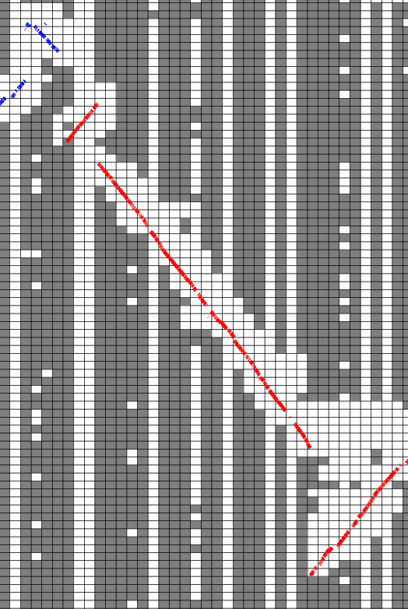
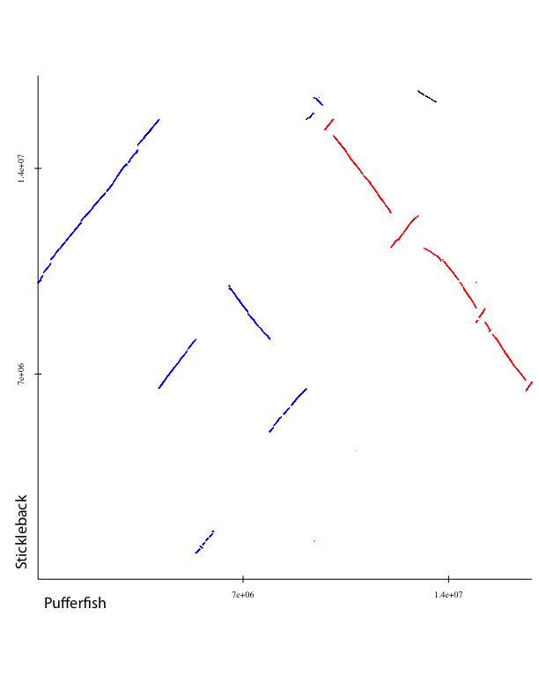
Battleship search: Stickleback vs. Pufferfish
460Mb vs. 220 Mb genomes in 120 CPU hours
Pixels searched
Not searched
Align two mammalian genomes in 32 hours
(non-repeat-masked blastz: 160,000+ CPU hours!)

Slide 46

A few implementation details (that we learned the hard way)…
Make sure each allocated CPU is busy: load balancing is non-trivial
Slave process file output: latency (several seconds) due to file system caching
Master cannot get carried away in managing priority queue (incremental!)
Use “keep-alive” mechanism (make sure master did not die)
Fault-tolerance mechanism for failing slaves (on a farm, accidents happen!)

Slide 47
But it works…
Processes are assigned to CPUs as they become available
Allows for heterogeneous architectures and being “nice” in variable-load environments (use CPUs if nobody else does)
Order of search is nondeterministic
Set of pixels that are ultimately searched is nondeterministic
Nevertheless, performance is stable across trials

Slide 48
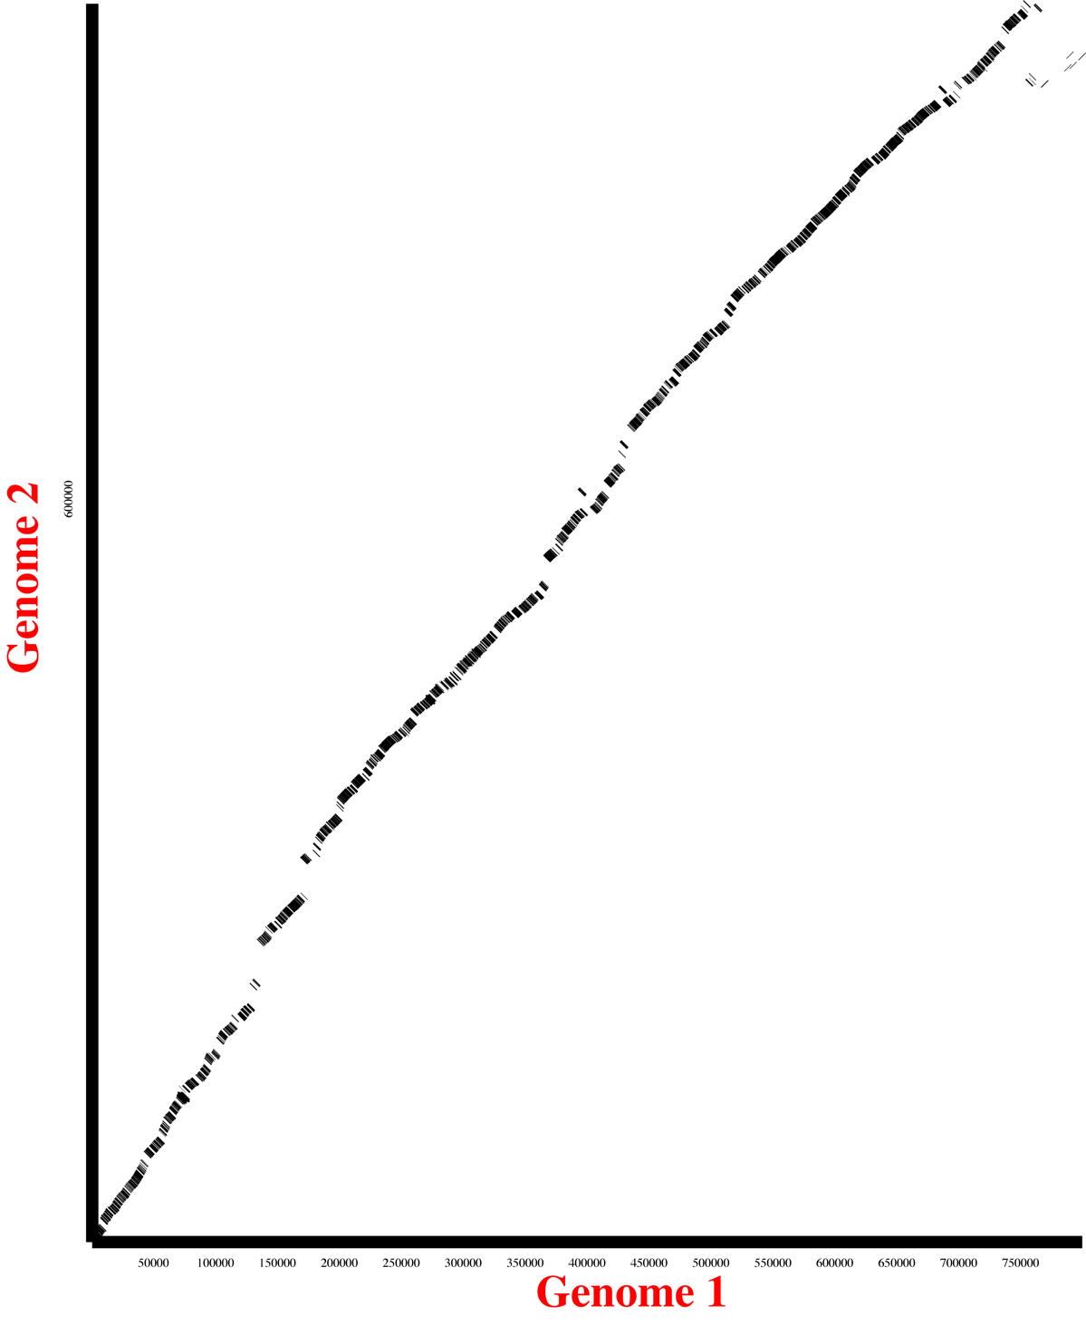
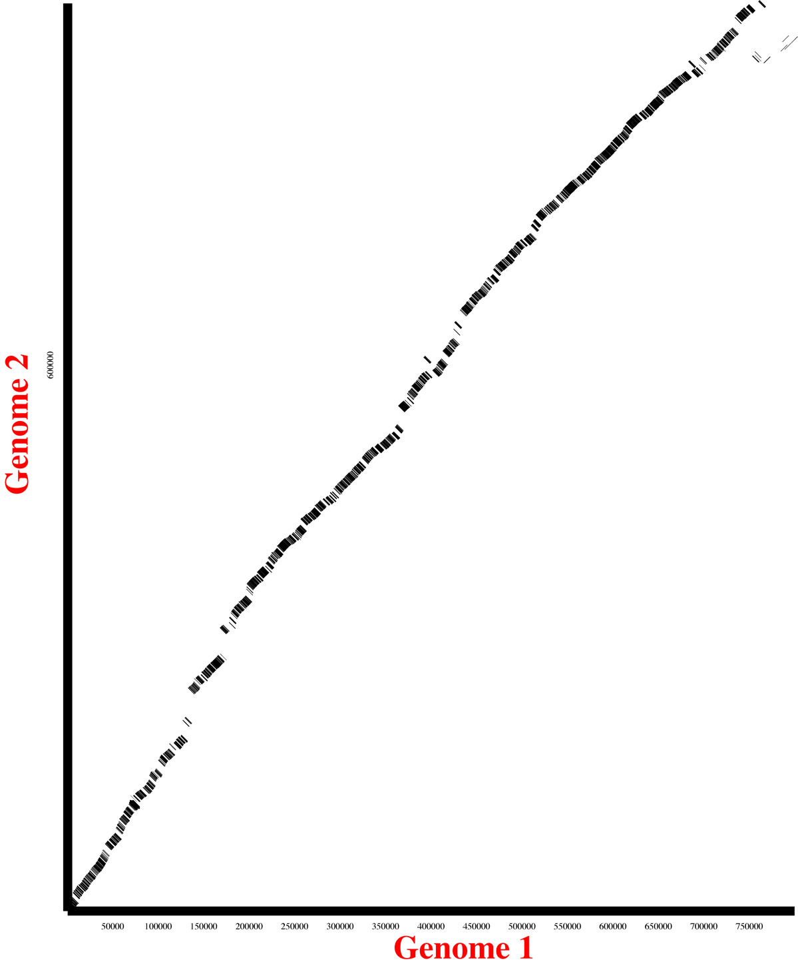


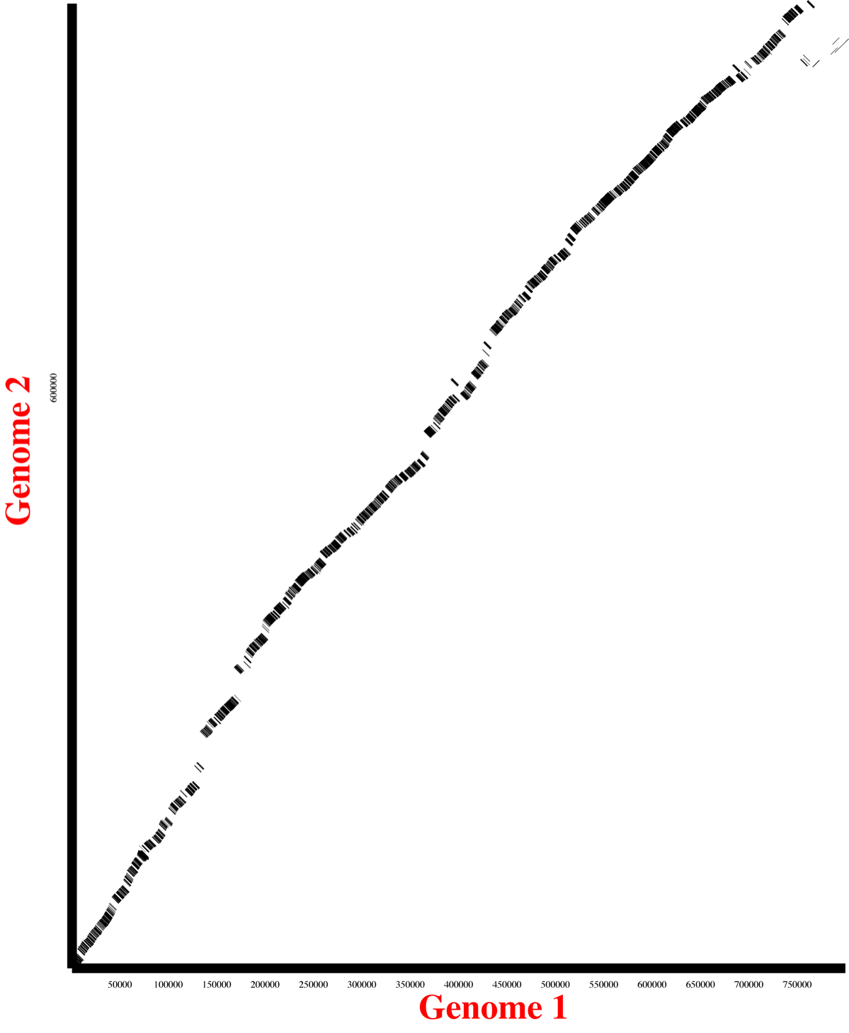

Stability of nondeterministic search: Human vs. Dog
1 CPU
751 seconds
2 CPUs
404 seconds
3 CPUs
288 seconds
4 CPUs
238 seconds
6 CPUs
176 seconds
8 CPUs
151 seconds

Slide 49
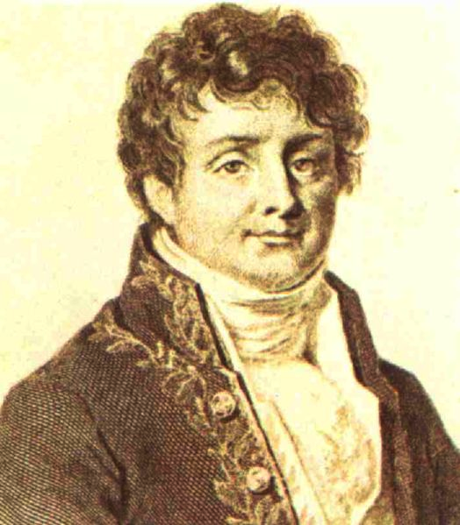
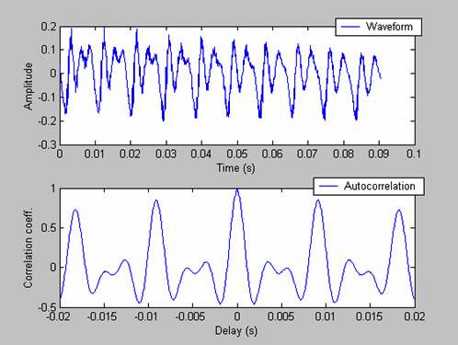
Satsuma: semi-local search
ACGTTAC
0 GATA
1 GATA
3 GATA
0 GATA
Score
Basic idea: slide query along target and count matches
Technique widely used in audio signal processing
Cross-correlation can be done via Fourier Transform
Efficient implementation: FFT (J.W. Cooley and J.W. Tukey 1965, rediscovered from C.F. Gauss 1805)
=> Analog signal processing technique, but applicable
to genomic sequence (nucleotide, protein)
=> There are no SEEDS to find sequence matches
Jean Baptiste Joseph Fourier (1768-1830)

Slide 50
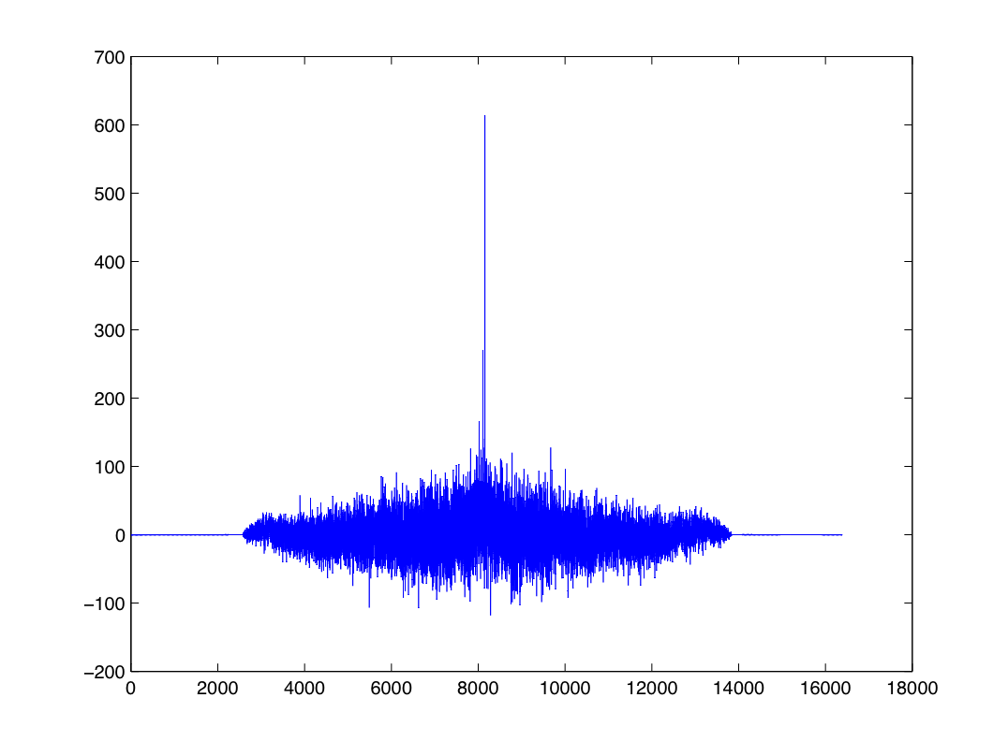
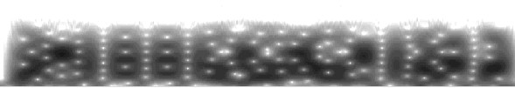
How Satsuma finds alignments: cross-correlation
Chunk query and target sequences (8192 bp by default)
Sequences to signal
(-0.3, -0.3, -0.3, +0.7, -0.3, -0.3, -0.3, +0.7, -0.3, -0.3, -0.3…)
A
TCGAGCTACGT…
(-0.3, +0.7, -0.3, -0.3, -0.3, +0.7, -0.3, -0.3, +0.7, -0.3, -0.3…)
C
(-0.3, -0.3, +0.7, -0.3, +0.7, -0.3, -0.3, -0.3, -0.3, +0.7, -0.3…)
G
(+0.7, -0.3, -0.3, -0.3, -0.3, -0.3, +0.7, -0.3, -0.3, -0.3, +0.7…)
T
Fast Fourier Transform (FFT)
Cross-Correlation:
Multiply complex conjugates, inverse FFT
Find all partial alignments
TTACACAAGAGCAGACATAGCATTTGCTGT
| ||||||| | || || | ||||||||
TAACACAAGGCCTGATATTTCTTTTGCTGT
Filter by probability
Merge overlapping alignments through Dynamic Programming and chain alignments
TTACACAAGAGCAGACATAGCATTTGCTGT
| ||||||| | || || | ||||||||
TAACACAAGGCCTGATATTTCTTTTGCTGT
TTACACAAGAGCAGACATAGCATTTGCTGT---GTCCGATCC
| ||||||| | || || | |||||||| ||| ||||
TAACACAAGGCCTGATATTTCTTTTGCTGTTCGGTCAGATCT

Slide 51
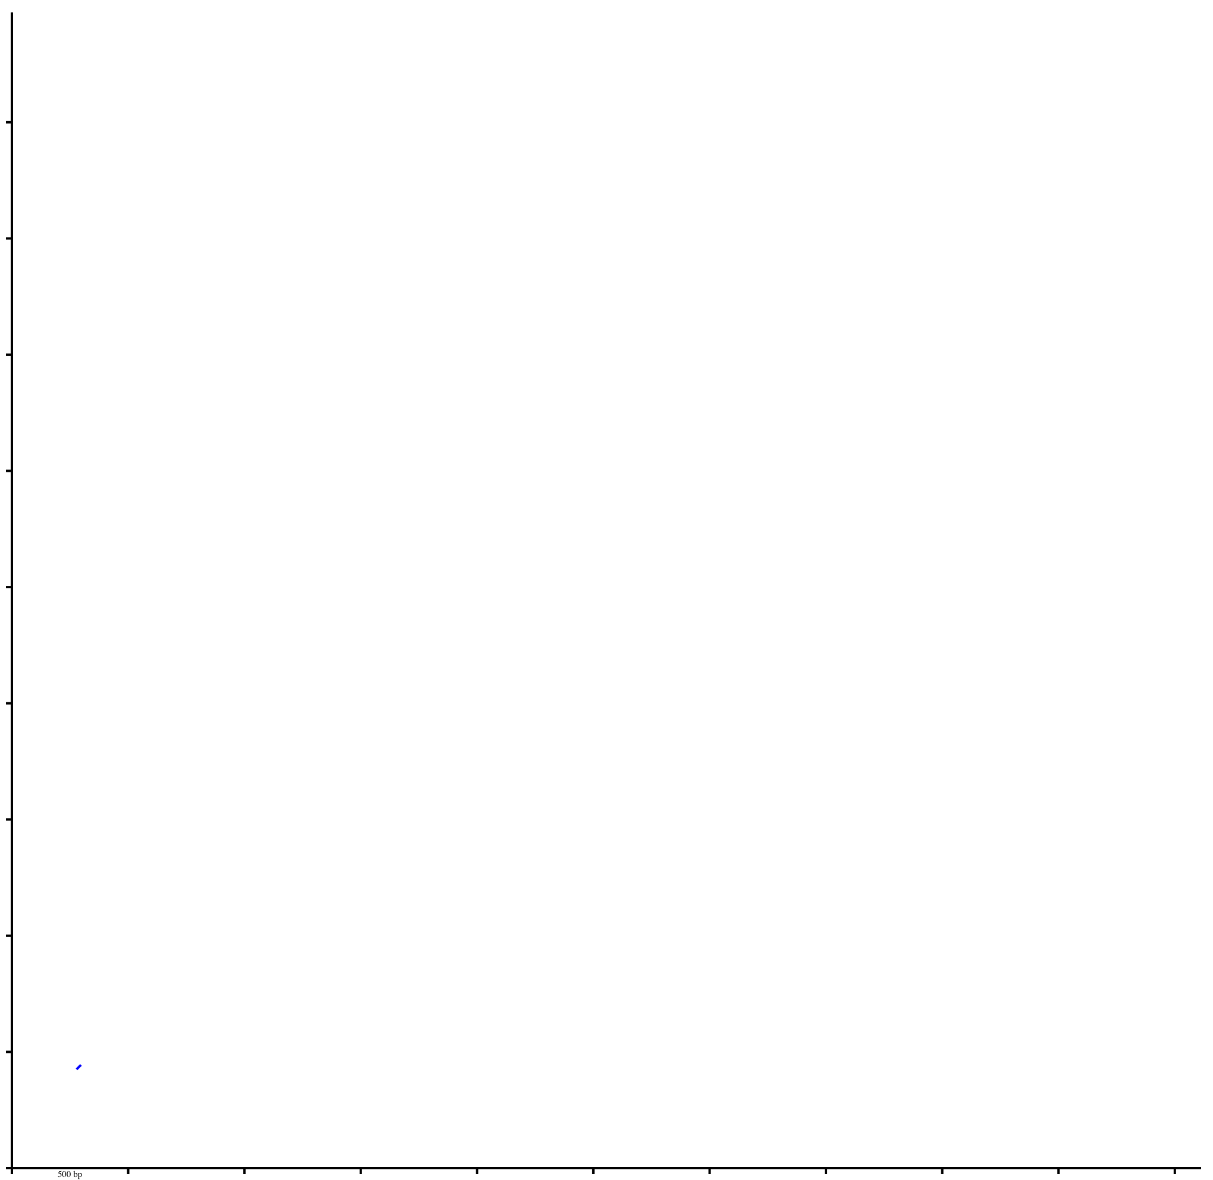
Example: 16 bp seed - no signal
10 kbp
LTR/copia 2
5
LTR/copia 1
5
10 kbp

Slide 52
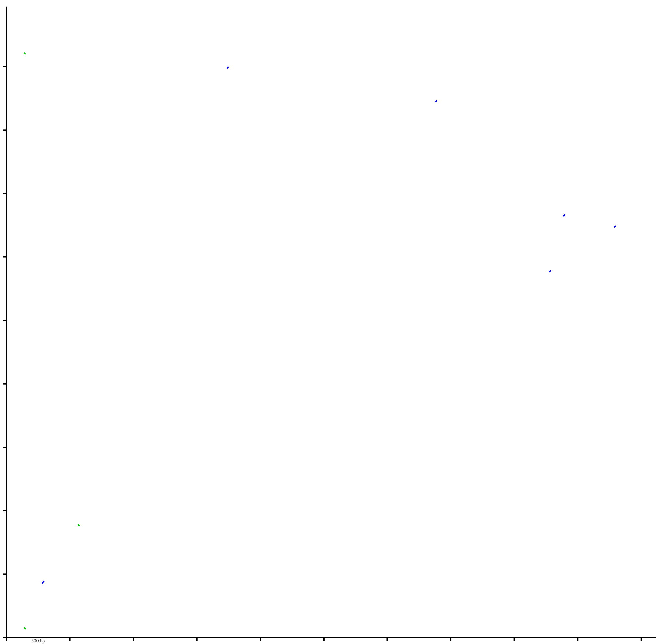
Example: 12 bp seed - very weak signal
10 kbp
LTR/copia 2
5
LTR/copia 1
5
10 kbp

Slide 53

Example: 8 bp seed - weak signal, lots of noise
10 kbp
LTR/copia 2
5
LTR/copia 1
5
10 kbp

Slide 54
Example: Satsuma - good signal, no noise
10 kbp
LTR/copia 2
5
LTR/copia 1
5
10 kbp

Slide 55
Example: Satsuma - good signal, no noise
10 kbp
LTR/copia 2
5
LTR/copia 1
5
10 kbp

Slide 56
Example: Satsuma - good signal, no noise
10 kbp
LTR/copia 2
Identity (w/o indel count): 50.4348 %
-------------------------------------------------------------------------------
ATGCAAGATTTCAGTGAAGGCATTAATTTGAAAGATTGCAAGAAGTTTCTGGATTGCAATGTATGTAAGAAAACAAAAGC
| || | | ||| | | ||| || ||||| ||||| ||||| | | ||| | |||
CAGACAGCTGAGTTGTGTGAGATTCCTATTCAAGGATGTAAGAATTTTCTAGATTGTGAAATTTGTGCATCAGAAAATCT
-------------------------------------------------------------------------------
ACAGTCAGCTCCAATTAGTAAGAAAAGCTTAAGAAACTCAGAAGAAGCTTTTCAATTAGTGCATGCTGATTTAATTGGTC
|| |||||| ||| || | || ||| ||| || || | | || ||| ||| || |||||
TAAGAAAGCTCCTATTGCAAAATACAGTACTAGAGTTTCAAAAAGGATCTTAGAGCTTGTTCATATTGACATATCTGGTC
-------------------------------------------------------------------------------
CTTTTCAGCCAAGTAAAGGTGGAGCAATTTATGTTTTGTGTATTTTAGATGATTATTCAAATTTTGCATGGAGTTTTCTG
|| | | | ||| || ||| ||| ||||| | | ||||||||| ||||| | || | || |
CTCACCCTACTTCTGTAGGAGGGTCAAAATATTTTTTGATTTTGGTAGATGATTTTTCAAGGCTGAAATTCACCTTCTTT
-------------------------------------------------------------------------------
TTAAAACAAAAGAGTGAGGTTTTTGAAATTTTTAAAAATTTGGGTGGCATATGTTAA--GAGGCAGTTTGGAGCTGGAGT
|||| || |||| |||||| ||| || || | || | | | ||
CTAAAGACTAAAGGTGAAGTTTTTCAAAAACTTTCTGTTTGGCTGAAGTTAATGCAGACACAGTTTCCTAAGTACCCGGT
-------------------------------------------------------------------------------
AAAAGCTCTACAAACAGATAGAGGAGGAGAATTTACCTCACACAATTTGGAACATTTTCTAAAGCAGGAGGGGATAAAGC
||||||| | || | ||| | || | || |||| || | | || | |||| | || || || ||| |
AAAAGCTTTTCAGAGTGATCGTGGTGCTGAGTTTATGTCCAAACAAATGCAGAATTTGTTTAAAAAGTTTGGTATAGTCC
-------------------------------------------------------------------------------
5
LTR/copia 1
5
10 kbp

Slide 57
Synteny alignments with Satsuma: How to make it work

Slide 58
A few considerations
Practical features:
Input: 2 fasta sequences (genomes)
No repeat masking required
Ambiguity codes (incl. “N”) are OK
Runs on local clusters and server farms
To watch out for:
Each slave loads the full genomes (memory!)
=> Partial target vs. full query is OK
Search is NOT symmetric wrt to target and query!
=> Target should be the LESS complete sequence
Genomes need to have synteny (human-coelacanth OK!)

Slide 59
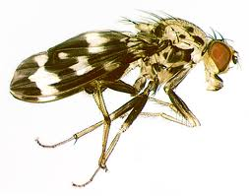
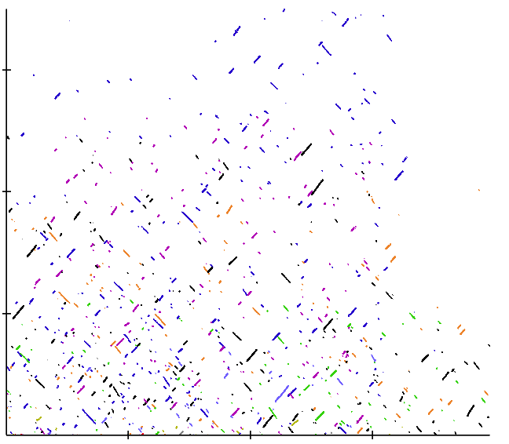
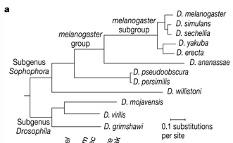
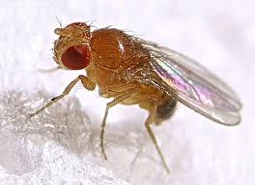
Local synteny between genomes required
D. grimshawi
D. melanogaster

Slide 60
Fragmented genomes are problematic
NST Genomes can be highly fragmented (N50 = a few 100 bp)
As a result: millions of (short) scaffolds
Each search pixel is 4096x4096 bp!
Space is wasted, expect delays!
No synteny to follow -> fall back to exhaustive search

Slide 61
Output files
MergeXCorrMatches.out: detailed alignments
Satsuma_summary.out: genomic coordinates
Visualization: ./MicroSyntenyPlot (postscript)

Slide 62

Originally developed at the Vertebrate Biology Group
Broad Institute
Jessica Alföldi
Evan Mauceli
Jeremy Johnson
Pamela Russell
Federica DiPalma
Kerstin Lindblad-Toh
Check out the new version from SciLifeLab/Uppsala University

