Slide 1


Cesky Krumlov
Short read alignment:
An introduction
Dr Konrad Paszkiewicz
University of Exeter, UK
k.h.paszkiewicz@exeter.ac.uk

Slide 2
Contents
Alignment algorithms for short-reads
  Background – Blast (why can’t we use it?)
  Adapting hashed seed-extend algorithms to work with shorter reads
  Suffix/Prefix Tries
  Indels
  Other alignment considerations
  Typical alignment pipeline
  New methods of SNP calling

Slide 3
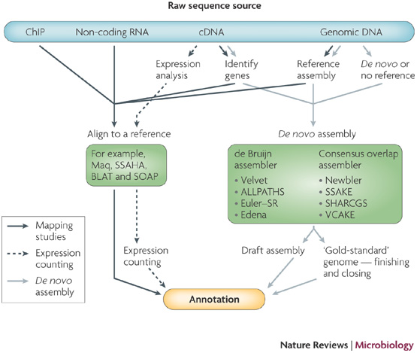
Notes:
Maclean & Studholme

Slide 4
Alignment of reads to a reference
Reference
..ACTGGGTCATCGTACGATCGATCGATCGATCGATCGGCTAGCTAGCTA..
Sample
..ACTGGGTCATCGTACGATCGATAGATCGATCGATCGCTAGCTAGCTA..

Slide 5
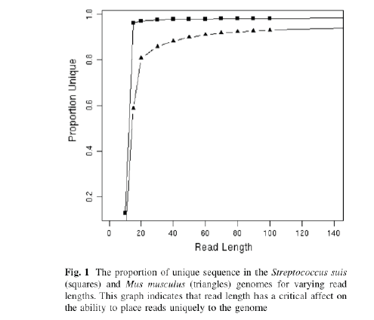
Why is short read alignment hard?
The shorter a read, the less likely it is to have a unique match to a reference sequence

Slide 6
Why do we generate short reads?
Sanger reads lengths ~ 800-2000bp
Generally we define short reads as anything below 200bp
  Illumina (100bp – 250bp)
  SoLID (80bp max)
  Ion Torrent (200-400bp max...)
  Roche 454 – 400-800bp
Even with these platforms it is cheaper to produce short reads (e.g. 50bp) rather than 100 or 200bp reads
Diminishing returns:
  For some applications 50bp is more than sufficient
    Resequencing of smaller organisms
    Bacterial de-novo assembly
    ChIP-Seq
    Digital Gene Expression profiling
    Bacterial RNA-seq

Slide 7
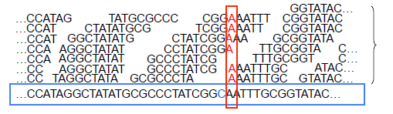
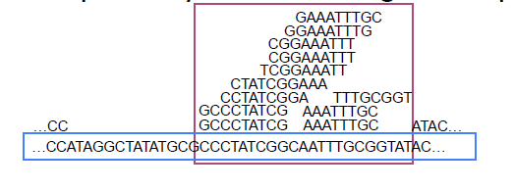
Short read alignment applications
Genotyping:
Methylation
SNPs
Indels
Classify and measure peaks:
ChIP-Seq
RNA-Seq

Slide 8
Contents
Alignment algorithms for short-reads
  Background – Blast (why can’t we use it?)
  Adapting hashed seed-extend algorithms to work with shorter reads
  Indel detection
  Suffix/Prefix Tries
  Other alignment considerations
  Typical alignment pipeline
  New methods of SNP calling

Slide 9
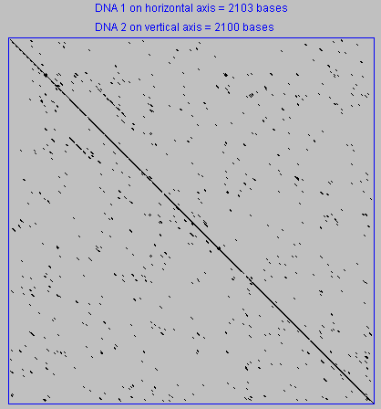
Dot Matrix Method
- Aligning by eye
http://arbl.cvmbs.colostate.edu/molkit/dnadot/index.html

Slide 10
Sequence Alignment
ATCGATACG
ATGGATTACG
ATCGAT-ACG
ATGGATTACG
3 possibilities
Match
…A…
…A…
Mismatch
…C…
…G…
Indel
…-…
…T…
|

Slide 11
Alignment cost
Points for a matching letter: 1
Points for a non-matching letter: -1
Points for inserting a gap: -2

Slide 12
Global Pair-wise Alignment
ATCGATACG, ATGGATTACG
ATCGAT-ACG
ATGGATTACG
|| ||| |||
Matches:
+1
+1
+1
+1
+1
+1
+1
+1
= +8
Mismatches:
-1
= -1
Gaps:
-2
= -2
Total score = +5

Slide 13
Dynamic Programming
Global alignment (Needleman-Wunsch) algorithm
Example – align GATC to GAC

Slide 14
Dynamic Programming
Global alignment (Needleman-Wunsch) algorithm
Points for match = +1
Points for mismatch = -1
Points for a gap insertion = -2

Slide 15
Dynamic Programming
Global alignment (Needleman-Wunsch) algorithm
Points for match = +1
Points for mismatch = -1
Points for a gap insertion = -2

Slide 16
Dynamic Programming
Global alignment (Needleman-Wunsch) algorithm
+1
Max= 1
Points for match = +1
Points for mismatch = -1
Points for a gap insertion = -2

Slide 17
Dynamic Programming
Global alignment (Needleman-Wunsch) algorithm
1
-1
Points for match = +1
Points for mismatch = -1
Points for a gap insertion = -2

Slide 18
Dynamic Programming
Global alignment (Needleman-Wunsch) algorithm
Points for match = +1
Points for mismatch = -1
Points for a gap insertion = -2

Slide 19
Backtracking and final alignment
GATC
GA-C
|| |

Slide 20
Dynamic programming
Guaranteed to give you the best possible alignment
In biology, this algorithm is very inefficient because most sequences will not align to each other
Takes a long time to run

Slide 21
BLAST –
Basic Local Alignment Search Tool

Slide 22
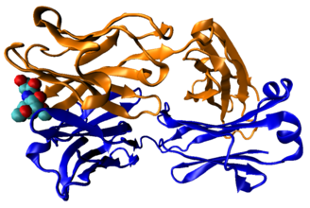
Background – BLAST
Primarily designed to identify homologous sequences
  Blast is a hashed seed-extend algorithm
  Functional conservation
  Only some parts of a sequence are usually constrained

Slide 23
BLAST - Original version
A C G A A G T A A G G T C C A G T
Example:
Seed size = 4,
No mismatches in seed
The matching word GGTC initiates an alignment
Extension to the left and right with no gaps until alignment score falls below 50%
Output:
GTAAGGTCC
GTTAGGTCC
C C C T T C C T G G A T T G C G A

Slide 24
BLAST - Original algorithm
Finding seeds significantly increases the speed of BLAST compared to doing a full local alignment over a whole sequence
BLAST first finds highly conserved or identical sequences which are then extended with a local alignment.

Slide 25
BLAST – Speed (or lack thereof)
Typically BLAST will take approximately 0.1 – 1 second to search 1 sequence against a database
Depends on size of database, e-value cutoff and number of hits to report selected
60 million reads equates to 70 CPU days!
Even on multi-core systems this is too long!
Especially if you have multiple samples!
This is still true of FPGA and SIMD (vectorised) implementations of BLAST

Slide 26
When NOT to use BLAST
A typical situation: you have lots DNA sequences and want to extend it or find where on a genome it maps.
In other words, you want an exact or near-exact match to a sequence that is part of an assembled genome.
Short reads require very fast algorithms for finding near-exact matches in genomic sequences:
  BLAT
    Highly recommended: the BLAT paper (Kent WJ (2003) Genome Res 12:656-64) - it is famous for its unorthodox writing style
  SOAP
  Bowtie/Bowtie 2
  MAQ
  BWA
  Shrimp2

Slide 27
Contents
Alignment algorithms for short-reads
  Background – Blast (why can’t we use it?)
  Adapting hashed seed-extend algorithms to work with shorter reads
  Indel detection
  Suffix/Prefix Tries
  Other alignment considerations
  Typical alignment pipeline
  New methods of SNP calling

Slide 28
Adapting hashed seed-extend algorithms to work with shorter reads
Improve seed matching sensitivity
  Allow mismatches within seed
      BLAST
  Allow mismatches + Adopt spaced-seed approach
      ELAND, SOAP, MAQ, RMAP, ZOOM
  Allow mismatches + Spaced-seeds + Multi-seeds
      SSAHA2, BLAT, ELAND2
Above and/or Improve speed of local alignment for seed extension
  Single Instruction Multiple Data
      Shrimp2, CLCBio
  Reduce search space to region around seed

Slide 29
Hashed seed-extend algorithms
  These are most similar to BLAST
  Are not designed to work with large databases
2 step process
  Identify a match to the seed sequence in the reference
  Extend match using sensitive (but slow) Smith-Waterman algorithm (dynamic programming)

Slide 30
Seed-extend algorithm
Reference sequence:
...ACTGGGTCATCGTACGATCGATCGATCGATCGATCGGCTAGCTAGCTA...
Short read:
GTCATCGTACGATCGATAGATCGATCGATCGGCTA
Note that the short read has 1 difference wrt to reference
Notes:
N.B This is only a toy example, the real BLAST selects kmers rather than breaking a read up like this

Slide 31
Seed-extend algorithm
Reference sequence:
...ACTGGGTCATCGTACGATCGATCGATCGATCGATCGGCTAGCTAGCTA...
Short read:
GTCATCGTACG ATCGATAGATCG ATCGATCGGCTA
11bp word
11bp word
11bp word
The algorithm will try to match each word to the reference. If there is a match at with any single word it will perform a local alignment to extend the match

Slide 32
Seed-extend algorithm
Reference sequence:
...ACTGGGTCATCGTACGATCGATCGATCGATCGATCGGCTAGCTAGCTA...
Seed
Extend with Smith Waterman
GTCATCGTACG
ATCGAACGATCGATCGATCGGCTA
Short read:
GTCATCGTACG ATCGATAGATCG ATCGATCGGCTA
Here the algorithm is able to match the short read with a word length of 11bp

Slide 33
Seed-extend algorithm
Reference sequence:
...ACTGGGTCATCGTACGATCGATCGATCGATCGATCGGCTAGCTAGCTA...
Short read:
GTCATCGTACGATCGATCGATCGATCGATCGGCAA
Note that the short read has 3 differences
Possibly sequencing errors, possibly SNPs

Slide 34
Seed-extend algorithm
Reference sequence:
...ACTGGGTCATCGTACGATCGATCGATCGATCGATCGGCTAGCTAGCTA...
Short read:
GTCATCGTACG ATCGATCGATCG ATCGATCGGCAA
11bp word
11bp word
11bp word
Note that the short read has 3 differences

Slide 35
Seed-extend algorithm
Reference sequence:
...ACTGGGTCATCGTACGATCGATCGATCGATCGATCGGCTAGCTAGCTA...
Short read:
GTCATCGTACG ATCGATCGATCG ATCGATCGGCAA
No seeds match
Therefore the algorithm would find no hits at all!

Slide 36
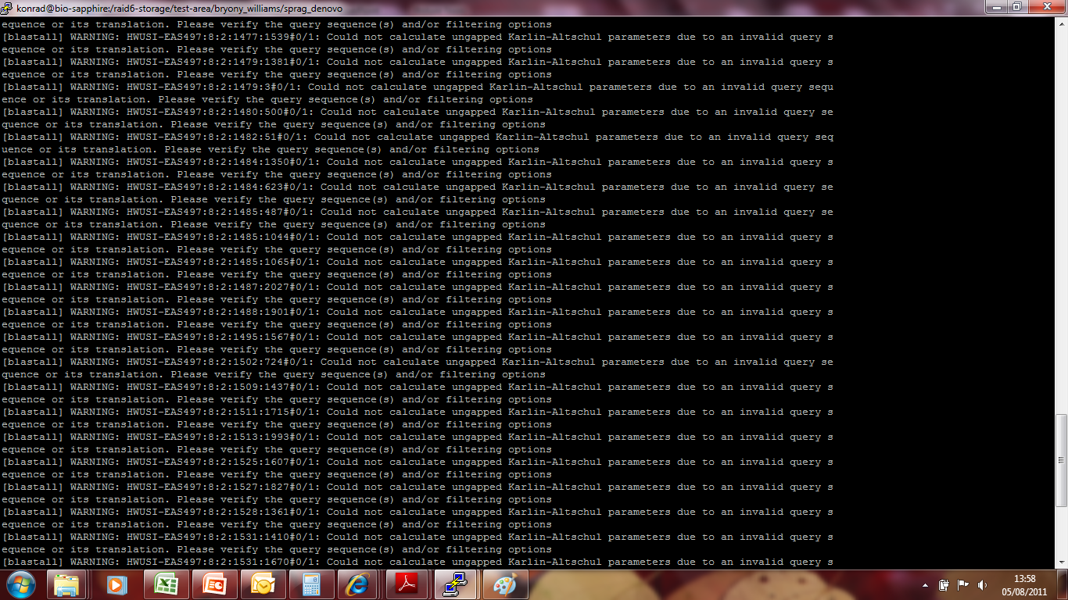

Slide 37
Adapting hashed seed-extend algorithms to work with shorter reads
Improve seed matching sensitivity
  Allow mismatches within seed
      BLAST
  Allow mismatches + Adopt spaced-seed approach
      ELAND, SOAP, MAQ, RMAP, ZOOM
  Allow mismatches + Spaced-seeds + Multi-seeds
      SSAHA2, BLAT, ELAND2
Above and/or Improve speed of local alignment for seed extension
  Single Instruction Multiple Data
      Shrimp2, CLCBio
  Reduce search space to region around seed

Slide 38
Adapting hashed seed-extend algorithms to work with shorter reads
Improve seed matching sensitivity
  Allow mismatches within seed
      BLAST
  Allow mismatches + Adopt spaced-seed approach
      ELAND, MAQ, RMAP, ZOOM
  Allow mismatches + Spaced-seeds + Multi-seeds
      SSAHA2, BLAT, ELAND2
Above and/or Improve speed of local alignment for seed extension
  Single Instruction Multiple Data
      Shrimp2, CLCBio
  Reduce search space to region around seed

Slide 39
Consecutive seed
Consecutive seed 9bp with no mismatches:
Reference sequence
ACTCCCATCGTCATCGTACTAGGGATCGTAACA
CCACTGTCCTCCTACATAGGAACGA
SNP ‘heavy’ read
TCATCGTAC
TCCTCCTAC
Cannot find seed match due to A->C SNP and G->C SNP
Even allowing for 2 mismatches in the seed - no seeds match.
No hits!

Slide 40
Spaced seeds
To increase sensitivity we can used spaced-seeds:
11111111111
Consecutive seed template with length 9bp
ACTATCATCGTACACAT
Reference
TCATCGTAC
Query
11001100110011001
Spaced-seed template with weight 9bp
ACTATCATCGTACACAT
Reference
ACTCTCACCGTACACAT
Query
Notes:
All positions with a 1 indicate a perfect match. Those with a 0 indicate a mismatch. Weight in a spaced seed is simply the number of positions which require a match

Slide 41
Spaced seeds
Spaced seed with weight 9bp and no mismatches:
Reference sequence
ACTCCCATTGTCATCGTACTTGGGATCGTAACA
CCACTGTAATCGTACATGGGAACGA
SNP ‘heavy’ read
CCATTGTCATCGTACAT
CCXXTGXXATXXTAXXT
Despite SNPs – seed matched with 0 mismatches
Can now extend with Smith-Waterman or other local alignment

Slide 42
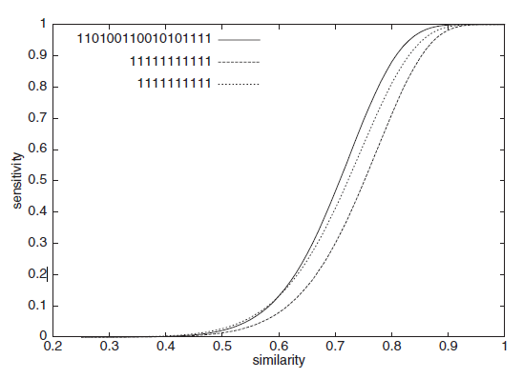
Spaced seeds
Spaced seeds:
A seed template ‘111010010100110111’ is 55% more sensitive than BLAST’s default template ‘11111111111’ for two sequences of 70% similarity
Typically seeds of length ~30bp and allow up to 2 mismatches in short read datasets
Ma, B. et al. PatternHunter. Bioinformatics Vol 18, No 3, 2002

Slide 43
Contents
Alignment algorithms for short-reads
  Background – Blast (why can’t we use it?)
  Adapting hashed seed-extend algorithms to work with shorter reads
  Suffix/Prefix Tries
  Indel detection
  Other alignment considerations
  Typical alignment pipeline
  New methods of SNP calling

Slide 44
Suffix-Prefix Trie
A family of methods which uses a Trie structure to search a reference sequence
  Bowtie
  BWA
  SOAP version 2
  Trie – data structure which stores the suffixes (i.e. ends of a sequence)
Key advantage over hashed algorithms:
  Alignment of multiple copies of an identical sequence in the reference only needs to be done once
  Use of an FM-Index to store Trie can drastically reduce memory requirements (e.g. Human genome can be stored in 2Gb of RAM)
  Burrows Wheeler Transform to perform fast lookups

Slide 45
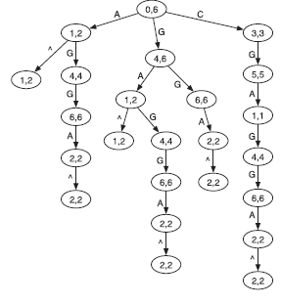
Suffix Trie
AGGAGC
Heng Li & Nils Homer. Sequence alignment algorithms for next-generation sequencing. Briefings in Bioinformatics. Vol 11. No 5. 473 483, 2010
Notes:
Data structures based on a prefix trie. (A) Prefix trie of string AGGAGC where symbol ^ marks the
start of the string. The two numbers in each node give the suffix array interval of the substring represented by
the node, which is the string concatenation of edge symbols from the node to the root.

Slide 46
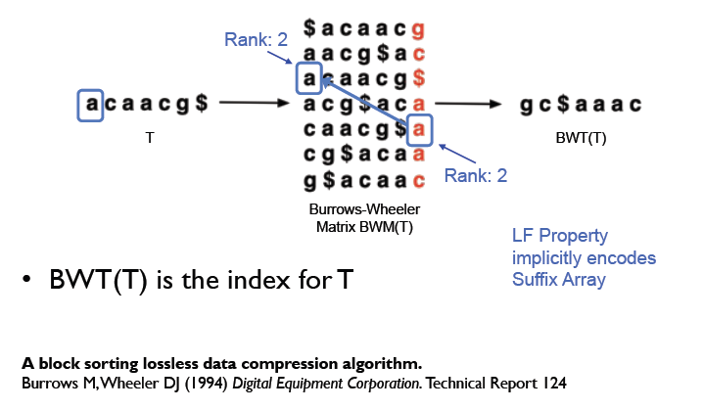
Suffix Trie

Slide 47
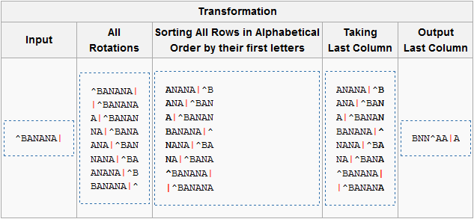
Burrows-Wheeler Algorithm
Encodes data so that it is easier to compress
Burrows-Wheeler transform of the word BANANA
Can later be reversed to recover the original word

Slide 48
More Burrows-Wheeler
Input | SIX.MIXED.PIXIES.SIFT.SIXTY.PIXIE.DUST.BOXES
Burrows-Wheeler Output | TEXYDST.E.IXIXIXXSSMPPS.B..E.S.EUSFXDIIOIIIT
Repeated characters mean that it is easier to compress

Slide 49
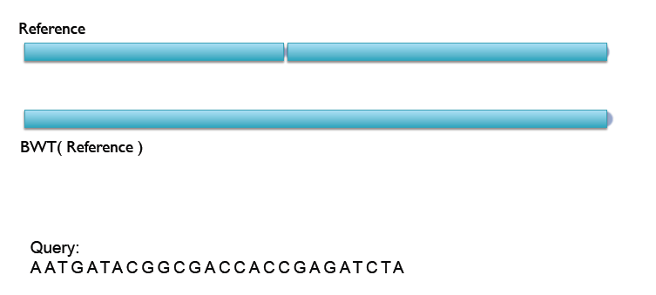
Bowtie/Soap2 example

Slide 50
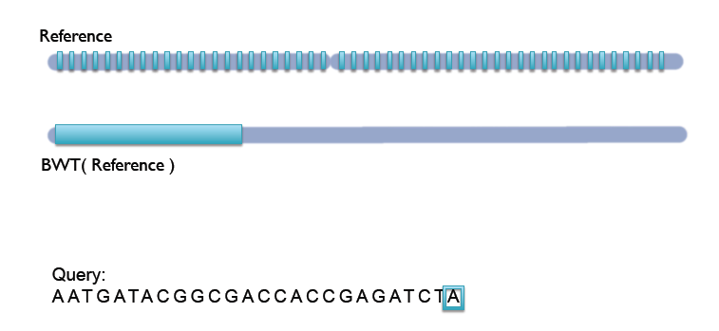
Bowtie/Soap2 example

Slide 51
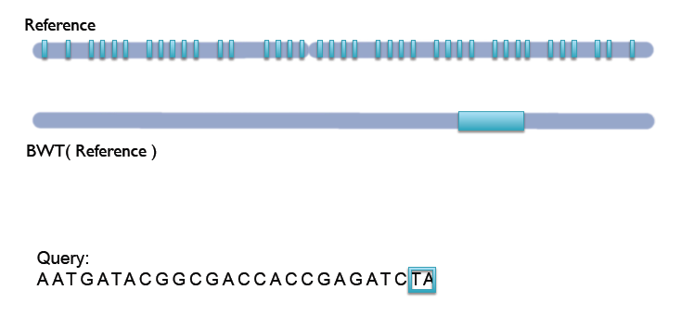
Bowtie/Soap2 example

Slide 52
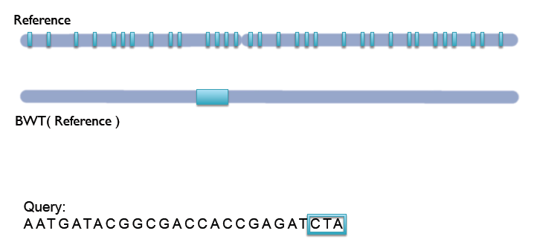
Bowtie/Soap2 example

Slide 53
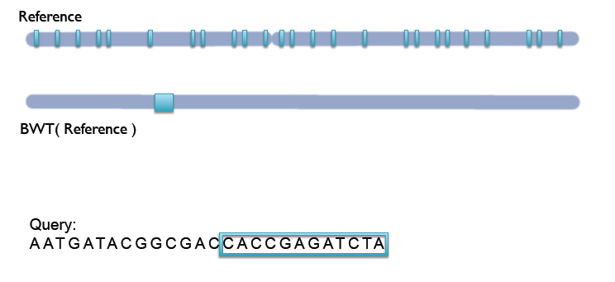
Bowtie/Soap2 example

Slide 54
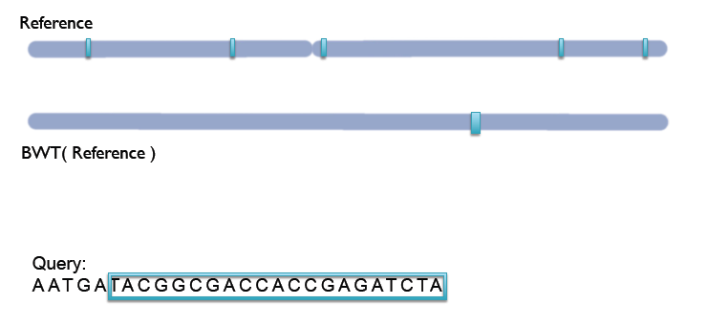
Bowtie/Soap2 example

Slide 55
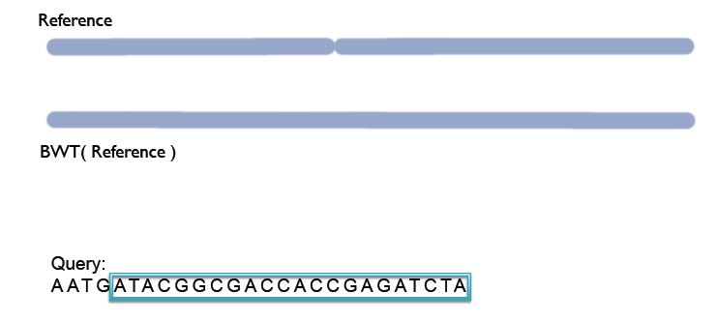
Bowtie/Soap2 example

Slide 56
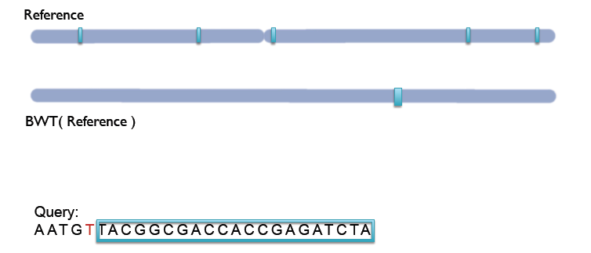
Bowtie/Soap2 example

Slide 57
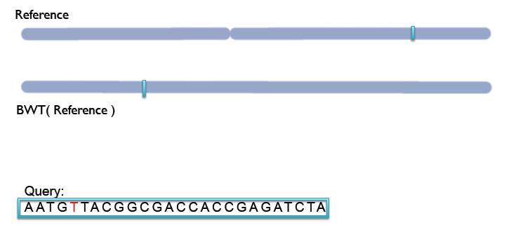
Bowtie/Soap2 example

Slide 58
Bowtie/Soap2 vs. BWA
Bowtie and Soap2 cannot handle gapped alignments
  No indel detection => Many false SNP calls
Bowtie/Soap2:
ACTCCCATTGTCATCGTACTTGGGATCGTAACA Reference
CCATTGTCATCGTACTTGGGATCTA
TCATCGTACTTGGGATCTA
TTGGGATCTA
False SNPs
N.B. Bowtie2 can handle gapped alignments

Slide 59
Bowtie/Soap2 vs. BWA
Bowtie and Soap2 cannot handle gapped alignments
  No indel detection => Many false SNP calls
BWA:
ACTCCCATTGTCATCGTACTTGGGATCGTAACA Reference
CCATTGTCATCGTACTTGGGATC-TA
TCATCGTACTTGGGATC-TA
TTGGGATC-TA
N.B. Bowtie2 can handle gapped alignments

Slide 60
Comparison
Hash referenced spaced seeds
Requires ~50Gb of memory
Runs 30-fold slower
Is much simpler to program
Most sensitive
Suffix/Prefix Trie
Requires <2Gb of memory
Runs 30-fold faster
Is much more complicated to program
Least sensitive

Slide 61
There are limits however
With 100bp reads, indels or variable regions longer than 3-4bp are likely to be missed entirely because reads will not map to the reference
ACTCCCATTGTCATCGTACTTGGGATCGTAACA Reference
CCATTGTCAACCATCTAGTAGCT-TA
TCAACCATCTAGTAGCT-TA
ACCATCTA-TA

Slide 62
You only find what you are looking for
What happens if there are SNPs and Indels in the same region?
Let’s assume that the SNP caller made this call of a single SNP:
ATGTATGTA
ATGTGTGTA
and the indel caller produced this call of a 3 base deletion:
ATGTATGTA
ATGT- - - TA
Should we assume this is a heterozygous SNP opposite a heterozygous Indel or a more complex locus?

Slide 63
Comparison
Bowtie's reported 30-fold speed increase over hash-based MAQ with
small loss in sensitivity
Limitations to Trie-based approaches:
  Only able to find alignments within a certain 'edit distance’
  Bowtie does not do gapped alignments – no indels!
  Important to quality clip reads (-q in BWA)
  Non-A/C/G/T bases on reads are often treated as mismatches
  Make sure Ns are removed!
Hash based approaches are more suitable for divergent alignments
Rule of thumb:
  <2% divergence -> Trie-based
    E.g. human alignments
  >2% divergence -> seed-extend based approach
    E.g. wild mouse strain alignments

Slide 64
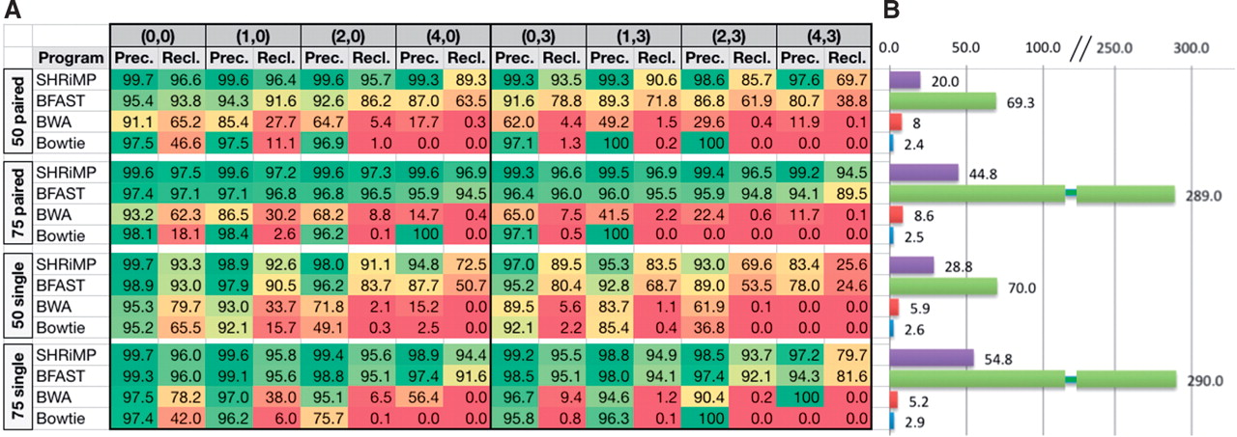
Precision and recall by amount of variation for 4 datasets, by polymorphism:
(number of SNPs, Indel size)
David M et al. Bioinformatics 2011;27:1011-1012
Notes:
(A) Precision and recall by amount of variation for 4 datasets, by polymorphism: (number of SNPs, Indel size). (X, Y): reads/read pairs containing X SNPs, where the larges indel is of size Y, as well as errors. (B) Running times (in min) of each tool on 6 × 106 reads from each dataset while utilizing an 8 core 3.0 GHz Intel Xeon machine with 16 GB RAM.

Slide 65
Summary of open-source short read alignment programs
Program | Algorithm | SoLID | Long reads | Gapped alignment | Paired-end | Quality scores used?
Bfast | Hashing ref | Yes | No | Yes | Yes | No
Bowtie* | FM-Index | Yes | No | No* | Yes | Yes
Blat | Hashing ref | No | Yes | Yes | No | No
BWA | FM-Index | Yes | Yes | Yes | Yes | No
MAQ | Hashing reads | Yes | No | Yes | Yes | Yes
Mosaik | Hashing ref | Yes | Yes | Yes | Yes | No
Novoalign | Hashing ref | No | No | Yes | Yes | Yes
Shrimp2 | Hashing ref | Yes | Yes | Yes | Yes | Yes
SOAP2 | FM-Index | No | No | No | Yes | Yes
SSAHA2 | Hashing ref. | No | No | No | Yes | Yes
Heng Li & Nils Homer. Sequence alignment algorithms for next-generation sequencing. Briefings in Bioinformatics. Vol 11. No 5. 473 483, 2010
* Bowtie2 (just released) does support gapped alignments
Notes:
aWork well for Sanger and 454 reads, allowing gaps and clipping.
bPaired end mapping. cMake use of base quality in alignment. dBWA
trims the primer base and the first color for a color read. eLong-read
alignment implemented in the BWA-SW module. fMAQ only does
gapped alignment for Illumina paired-end reads. gFree executable for
non-profit projects only.

Slide 66
Contents
Alignment algorithms for short-reads
  Background – Blast (why can’t we use it?)
  Adapting hashed seed-extend algorithms to work with shorter reads
  Indel detection
  Suffix/Prefix Tries
  Other alignment considerations
  Typical alignment pipeline
  New methods of SNP calling

Slide 67
Other alignment considerations
Indel detection
Effect of paired-end alignments
Using base quality to inform alignments
PCR duplicates
Methylation experiments – bisulfite treated reads
Multi-mapping reads
Aligning spliced-reads from RNA-seq experiments
Local realignment to improve SNP/Indel detection
Platform specific errors
Unmapped reads

Slide 68
Indel detection
Spaced seed with weight 9bp and no mismatches:
Reference sequence
ACTCCCATTGTCATCGTACTTGGGATCGTAACA
CCATTGTCATGTACTTGGGATCGT
Read containing a
deletion
CCATTGTCATCGTACAT
CCXXTGXXATXXACXXG
Seed not matched due to frame shift caused by gap
No seed match. No alignment!

Slide 69
Indel detection
Reference sequence:
...ACTGGGTCATCGTACGATCGATCGATCGATCGATCGGCTAGCTAGCTA...
Seed
Extend with Smith Waterman
GTCATCGTACG
ATCGA-CGATCGATCGATCGGCTA
Most alignment programs can only detect gaps in Smith-Waterman phase
once a seed has been identified. Some algorithms (e.g. Bowtie) do not even allow gaps at this stage
This reduces sensitivity especially with multiple insertions in a small region

Slide 70
Indel detection
Some algorithms do allow gaps within seed
  Indel seeds for homology search Bioinformatics (2006) 22(14): e341-e349 doi:10.1093/bioinformatics/btl263
  Weese D, Emde AK, Rausch T, et al. RazerS–fast read mapping with sensitivity control. Genome Res 2009;19:1646–54
  Rumble SM, Lacroute P, Dalca AV, et al. SHRiMP: accurate mapping of short color-space reads. PLoS Comput Biol 2009;5:e1000386
Use of multiple seeds
  Especially useful for longer reads (>36bp)
  Li R, Li Y, Kristiansen K, et al. SOAP: short oligonucleotide alignment program. Bioinformatics 2008;24:713–4
  Jiang H, Wong WH. SeqMap: mapping massive amount of oligonucleotides to the genome. Bioinformatics 2008;24: 2395–6

Slide 71
Paired-end reads are important
Known Distance
Read 1
Read 2
Repetitive DNA
Unique DNA
Paired read maps uniquely
Single read maps to
multiple positions

Slide 72
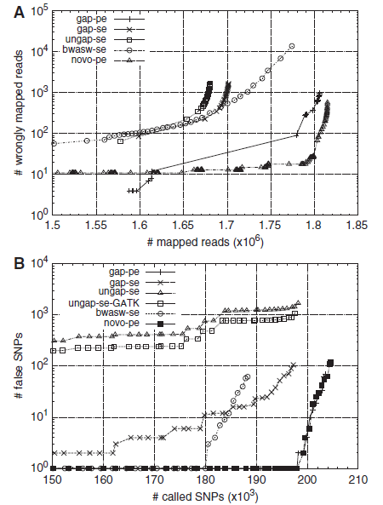
Effect of paired-end alignments
Heng Li & Nils Homer. Sequence alignment algorithms for next-generation sequencing. Briefings in Bioinformatics. Vol 11. No 5. 473 483, 2010
Notes:
Alignment and SNP call accuracy under
different configurations of BWA and Novoalign. (A)
Number of misplaced reads as a function of the number
ofmapped reads under differentmapping quality cut-off.
Reads (108 bp) were simulated from human genome
build36 assuming 0.085% substitution and 0.015% indel
mutation rate, and 2% uniform sequencing error rate.
(B) Number of wrong SNP calls as a function of the
numberof calledSNPunderdifferent SNPqualitycut-offs.
Reads (108 bp) were simulated from chr6 of the human
genome and mapped back to the whole genome. SNPs
are called and filtered by SAMtools. In both figures,
‘novo-pe’ denotes novoalign alignment; the rest correspond
to alignments under different configurations of
BWA, where ‘gap-pe’ stands for the gapped paired-end
(PE) alignment, ‘gap-se’ for gapped single-end (SE) alignment,
‘ungap-se’ for ungapped SE alignment, ‘bwasw-se’
for BWA-SW SE alignment, and ‘ungap-se-GATK’ for
alignmentcleanedby theGATKrealigner.

Slide 73
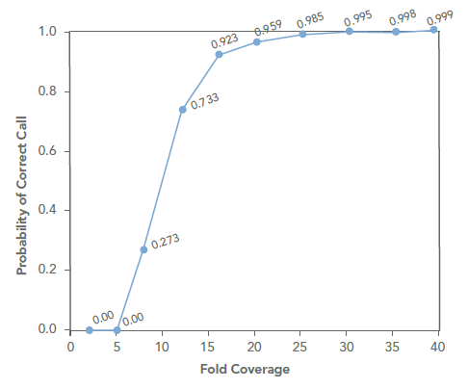
Effect of coverage on SNP call accuracy
Depends crucially on ploidy
Bacterial genomes can get away with 10-20x
For human genomes and other diploids 20-30x is regarded as
standard
Poly-ploids (e.g wheat) may need much higher coverage
Source – Illumina Tech Note
Human diploid sample

Slide 74
PCR duplicates
2nd generation sequencers are not single-molecule sequencers
  All have at least one PCR amplification step
  Can result in duplicate DNA fragments
  This can bias SNP calls or introduce false SNPs
Generally duplicates only make up a small fraction of the results
  Good libraries have < 2-3% of duplicates
  SAMtools and Picard can identify and remove these when aligned against a reference genome
  Do NOT do this for RNA and ChIP-seq data!

Slide 75
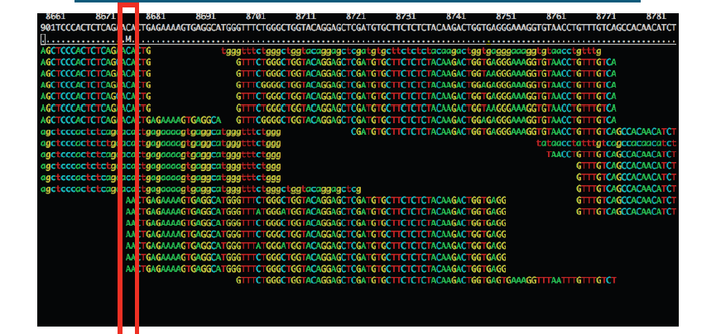
PCR duplicates

Slide 76
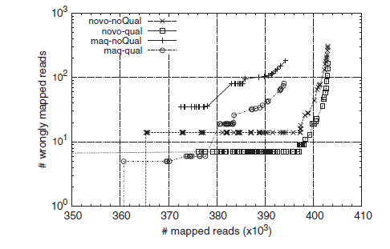
Base quality impacts on read mapping
Heng Li & Nils Homer. Sequence alignment algorithms for next-generation sequencing. Briefings in Bioinformatics. Vol 11. No 5. 473 483, 2010
Notes:
Alignment accuracy of simulated reads
with and without base quality. Paired-end reads (51bp)
are simulated by MAQ from the human genome, assuming
0.085% substitution and 0.015% indel mutation rate.
Base quality model is trained from run ERR000589
from the European short read archive. Base quality is
not used in alignment for curves with labels ended
with ‘-noQual’.

Slide 77
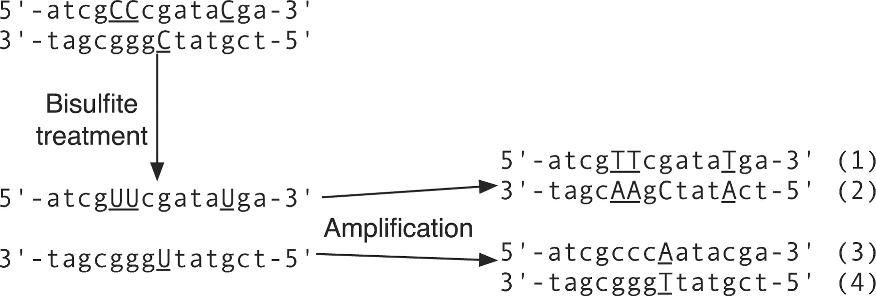
Methylation experiments
Unmethylated cytosine
Notes:
Bisulfite sequencing. Cytosines with underlines
are not methylated. Denaturation and bisulfite
treatment will convert these cytosines to uracils.
After amplification, four different sequences from the
original double-strand DNA result.

Slide 78
Methylation experiments
Directly aligning reads against a reference will fail due to excessive mismatches in non-methylated regions
Most aligners deal with this by creating 2 reference sequences
  One has all Cs converted to Ts
  One has all Gs converted to As
Convert Cs to Ts in all reads aligned against C-T reference
Convert Gs to As in all reads aligned against G-A reference
If there are no mutations or sequencing errors the reads will always map to one of the two references
Notes:
Bisulfite sequencing. Cytosines with underlines
are not methylated. Denaturation and bisulfite
treatment will convert these cytosines to uracils.
After amplification, four different sequences from the
original double-strand DNA result.

Slide 79
Multiple mapping reads
A single read may occur more than once in the reference genome.
This may be due to gene or whole chromosome duplication or repetitive sequences
Aligners generally allow you to chose how these are dealt with
Some aligners automatically assign a multi-mapping read to one of the locations at random (e.g. MAQ)

Slide 80
Spliced-read mapping
Need packages which can account for splice variants
Examples: TopHat, ERANGE

Slide 81
Local realignment to improve SNP/Indel detection
Read aligners map each read (or read pair) independently of all other reads
Around indels and other variants it can be helpful to make use of other metrics
  e.g. Global median coverage for multi-mapping reads
Tools such as GATK, SAMtools, Pindel and Breakdancer realign reads in the vicinity of variants to improve calls
http://www.broadinstitute.org/gsa/wiki/index.php/The_Genome_Analysis_Toolkit
Chen, K. BreakDancer: an algorithm for high-resolution mapping of genomic structural variation Nature Methods 6, 677 - 681 (2009)
Li H.*, Handsaker B.*, Wysoker A., Fennell T., Ruan J., Homer N., Marth G., Abecasis G., Durbin R. and 1000 Genome Project Data Processing Subgroup (2009) The Sequence alignment/map (SAM) format and SAMtools. Bioinformatics, 25, 2078-9

Slide 82
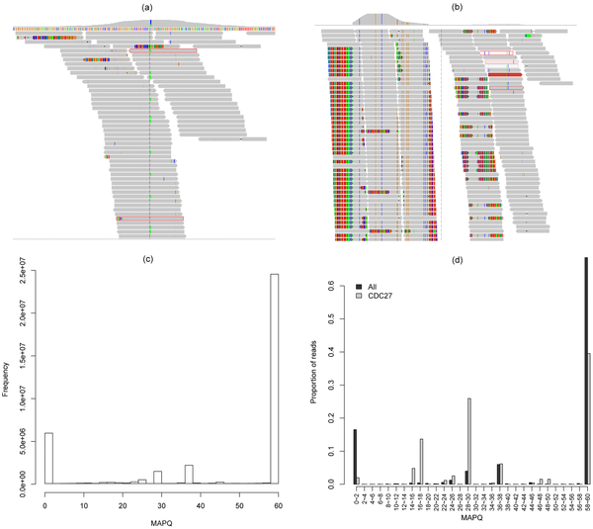

Figure 6. A visual examination of a spurious gene (CDC27).
Jia P, Li F, Xia J, Chen H, et al. (2012) Consensus Rules in Variant Detection from Next-Generation Sequencing Data. PLoS ONE 7(6): e38470. doi:10.1371/journal.pone.0038470
http://www.plosone.org/article/info:doi/10.1371/journal.pone.0038470

Slide 83
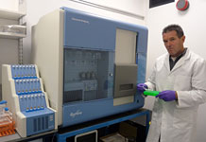
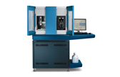
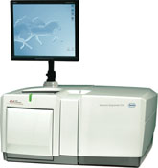
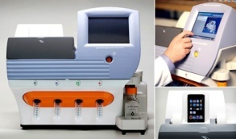
All platforms have errors and artefacts
Illumina
SoLID/ABI-Life
Roche 454
Ion Torrent
Removal of low quality bases
Removal of adaptor sequences
Platform specific artefacts (e.g homopolymers)

Slide 84
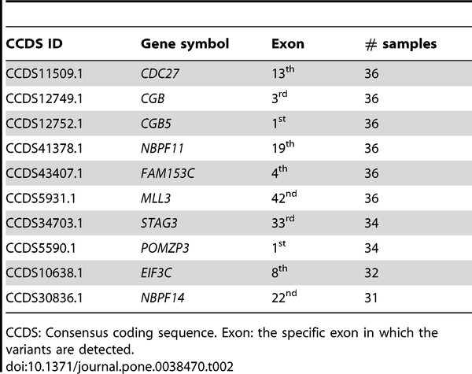
Table 2. Spurious genes having mutations detected in 30 samples.
Jia P, Li F, Xia J, Chen H, et al. (2012) Consensus Rules in Variant Detection from Next-Generation Sequencing Data. PLoS ONE 7(6): e38470. doi:10.1371/journal.pone.0038470
http://www.plosone.org/article/info:doi/10.1371/journal.pone.0038470

Slide 85
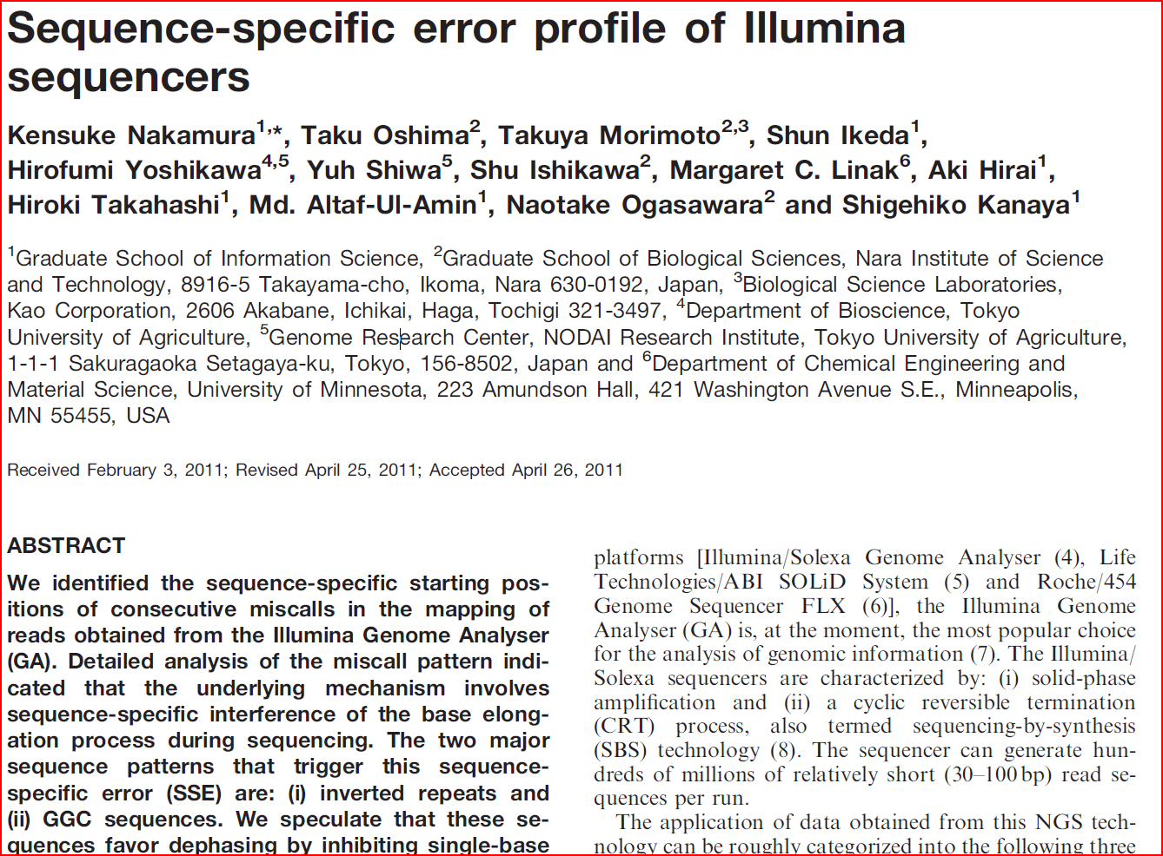
Illumina artefacts
Nakamura, K. et al. Sequence-specific error profile of Illumina sequencers
Nucl. Acids Res. (2011) May 16, 2011

Slide 86
Illumina artefacts
GC rich regions are under represented
    PCR
    Sequencing
Substitutions more common than insertions
3. GGC/GCC motif is associated with low quality and mismatches
4. Filtering low quality reads exacerbates low coverage of GC regions
Software should ideally account for this technology specific bias but doesn’t (yet)

Slide 87
Unmapped reads

Slide 88
Unmapped reads
Can be the result of:
  Sequencing errors (should be small fraction if quality filtering applied before mapping)
  Contamination
  Excessive matches to repeats
  Highly divergent regions between samples
  Novel genetic material not present in reference
  Plasmids
Should be assembled de-novo with paired-end information if possible
Resulting contigs run through MegaBlast against NCBI NT to check species
Check against RepBase to remove repetitive contigs
Call ORFs
Blast ORFs using BlastP against NCBI NR or Swissprot and Blast2GO
Run through PFAM

Slide 89
Typical alignment pipeline
QC
Remove low quality bases
Remove reads containing adaptor sequences
Alignment
Generate reference or read index
Post alignment
Sort SAM file and convert to BAM with SAMtools
Supply BAM file to variant caller (e.g. Samtools mpileup)
Align reads to index
SAM output file
Analyse variants (are they within genes, synonymous vs nonsynonymous changes etc)*
Assemble unmapped reads
Locate missing genes/regulatory regions
Assemble unmapped reads (e.g. using Velvet)
Call Open Reading Frames (ORFs)
Search for homologous genes (BLASTP), protein families (PFAM)
Identify novel genes
Remove suspected PCR duplicates with SAMtools
Trim or remove reads containing Ns
Perform local realignment around indels using GATK
* http://bioinformatics.net.au/software.nesoni.shtml

Slide 90
Contents
Alignment algorithms for short-reads
  Background – Blast (why can’t we use it?)
  Adapting hashed seed-extend algorithms to work with shorter reads
  Indel detection
  Suffix/Prefix Tries
  Other alignment considerations
  Typical alignment pipeline
  New methods of SNP calling

Slide 91
New methods of SNP calling
FreeBayes (http://arxiv.org/pdf/1207.3907v2.pdf)
Warning - unpublished
  Haplotype calling
  ACA Reference Genome
  Assume a SNP at both 5’ A->T and 3’ A->G
  Do we have a homozygous?
  TCG
  Or a heterozygous?
  ACG
  TCA
  Or
  and
ACTCCGTTTGTCATCGTACTTGGGATCGTAACA Strand 1
ACTCCCATTGTCATCGTACTTGGGATCGTAACA Strand 2 (rev-comp)

Slide 92
New methods of SNP calling
FreeBayes (http://arxiv.org/pdf/1207.3907v2.pdf)
  Haplotype calling
ACTCCGTTTGTCATCGTACTTGGGATCGTAACA Strand 1
ACTCCCATTGTCATCGTACTTGGGATCGTAACA Strand 2 (rev-comp)

Slide 93
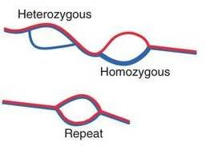
New methods of SNP calling
Why align at all?
  We only do this because of computational constraints
  Ideally we want to assemble denovo and then align to reference genome
Cortex is a step in this direction:
  Denovo genome assembler, but keeps track of differences which could be due to SNPs/Indels

Slide 94
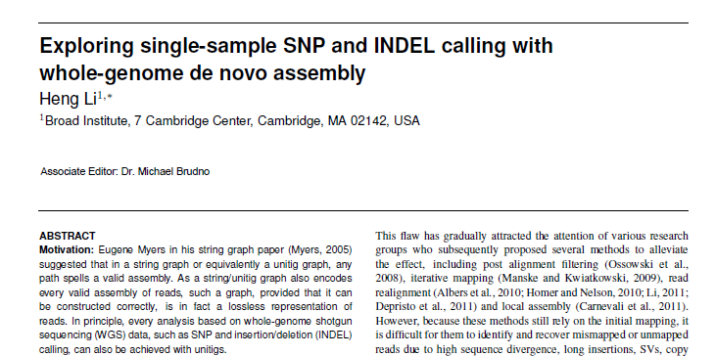
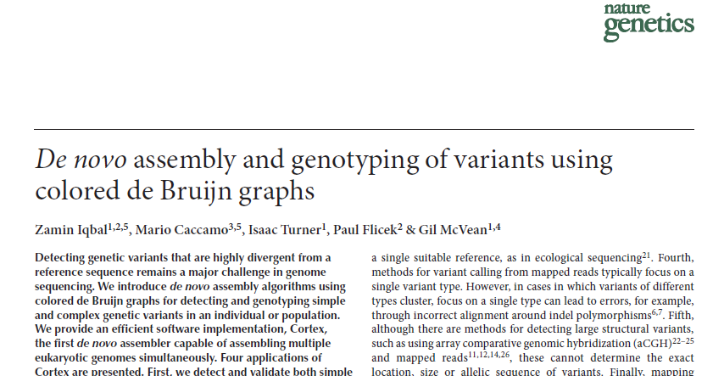
Variant calling with de-novo assembly

Slide 95
Questions!
biosciences.exeter.ac.uk/facilities/sequencing/usefulresources/

Slide 96
Assembly algorithms for short reads

Slide 97
De-novo sequence assembly
Sequence DNA fragments from each end
Insert length

Slide 98
De-novo sequence assembly
Sequence DNA fragments from each end
Reads aligned to generate contigs

Slide 99
De-novo sequence assembly
Sequence DNA fragments from each end
Reads aligned to generate contigs

Slide 100
De-novo sequence assembly
Sequence DNA fragments from each end
Reads aligned to generate contigs
Supercontigs derived from paired reads on different contigs
Notes:
Often called scaffolding

Slide 101
De-novo sequence assembly
Sequence DNA fragments from each end
Reads aligned to generate contigs
Supercontigs derived from paired reads on different contigs
Ordering of contigs is determined
Different insert lengths and read lengths can resolve ambiguities
Insert size can be increased to 2-20kb by using mate-pair libraries (helps to span repetitive regions)

Slide 102
Mate-pair vs paired-end
Often causes confusion
Paired-end usually refers to libraries prepared for the Illumina platform with insert sizes 50-500bp.
Mate-pair is a different library preparation protocol and usually produces insert sizes 2kb-20kb.

Slide 103
Contents
Alignment algorithms for short-reads
  Background – Blast (why can’t we use it?)
  Adapting hashed seed-extend algorithms to work with shorter reads
  Suffix/Prefix Tries
  Other alignment considerations
  Typical alignment pipeline
Assembly algorithms for short reads
  Effect of repeats
  Overlap-Consensus
  de Bruijn graphs
  Assembly evaluation metrics
  Typical assembly pipeline

Slide 104
Repetitive sequence
Main reason for fragmented genome assemblies
Additional sequencing depth will not help overcome repeat limited assemblies
Whiteford N, Haslam N, Weber G, et al. An analysis of the feasibility of short read sequencing. Nucleic Acids Res 2005;33:e171

Slide 105
Repetitive sequence
Known Distance
Read 1
Read 2
Paired read maps uniquely
Repetitive DNA
Paired read does not map
Unique DNA
Single read maps to
multiple positions

Slide 106
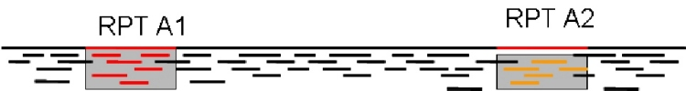
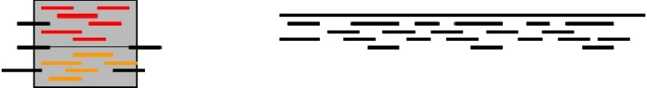
Repetitive sequence
Can try to identify collapsed repeats by increased relative coverage
http://www.cbcb.umd.edu/research/assembly_primer.shtml
Notes:
Two copies of a repeat along a genome. The reads colored in red and those colored in yellow appear identical to the assembly program.
Genome mis-assembled due to a repeat. The assembly program incorrectly combined the reads from the two copies of the repeat leading to the creation of two separate contigs

Slide 107
Repetitive sequence
Main reason for fragmented genome assemblies
Additional sequencing depth will not help overcome repeat limited assemblies
Can estimate the number of repetitive regions, based on relative coverage
Only longer reads or paired-end/mate-pair reads can overcome this
PacBio reads can extend up to 10-20kb but expensive and impractical for most labs
Large mate pair insert sizes ~20kb are possible, but library preparation is inefficient (2-3 days of trial and error). Also a significant fraction will be error-prone and/or chimeric
Whiteford N, Haslam N, Weber G, et al. An analysis of the feasibility of short read sequencing. Nucleic Acids Res 2005;33:e171

Slide 108

Assumptions made by de-novo assemblers
Based on Lander-Waterman model
Number of times a base is sequenced follows a Poisson distribution
Reads are randomly distributed throughout a genome
The ability to detect an overlap between two reads is not dependent on the base-composition of the read
L = Read length
N = Number of reads
G = Genome size
P = Probability base is sequenced
Lander, E.S. and Waterman, M.S. (1988). "Genomic Mapping by Fingerprinting Random Clones: A Mathematical Analysis". Genomics 2 (3): 231–239

Slide 109
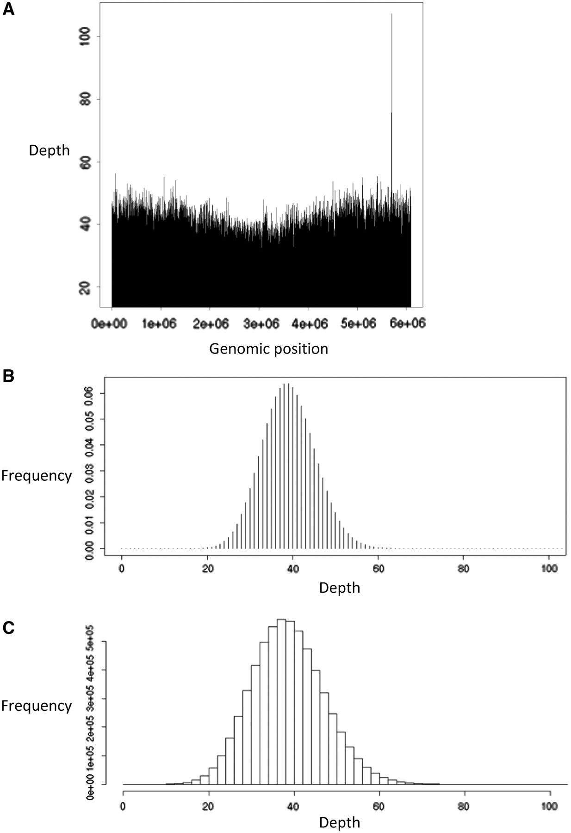

Assumptions are not true
Paszkiewicz K , Studholme D J Brief Bioinform 2010;11:457-472
© The Author 2010. Published by Oxford University Press. For Permissions, please email: journals.permissions@oxfordjournals.org
Notes:
Biases in real short-read sequence data. A set of Illumina 36-nucleotide genomic sequence reads [53] from P. syringae pathovar syringae B728a was aligned against the previously published [116] genome sequence of this strain. (A) Illustrates the depth of coverage by aligned reads over the 6 Mb circular chromosome. Coverage is shallower around the 3 Mb region than it is near the origin of replication (position 0), (B) illustrates the expected frequency distribution of alignment depth, assuming random sampling of the genome and (C) illustrates the observed frequency distribution of alignment depth, which is broader than the expected distribution, indicating greater variance due to biased sampling.

Slide 110
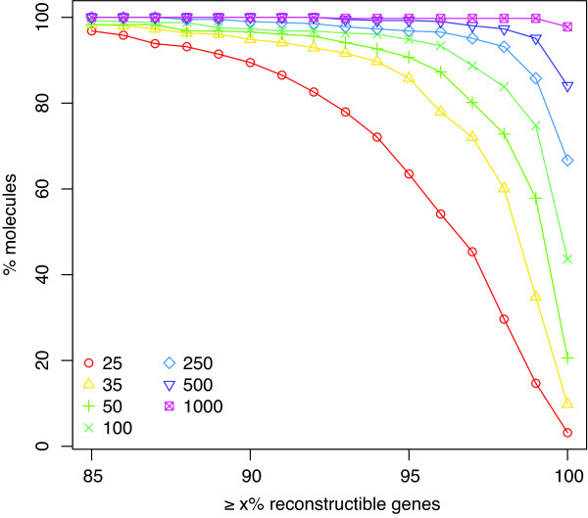
NGS de-novo assemblies are draft quality at best
500 contigs covering most of a bacterial genome can be obtained in 1 week from genomic DNA to Genbank submission
To get 1 contigs covering all genomic sequence could take many months
Is the extra effort worth it?
Short answer: Usually not.
Assembly complexity of prokaryotic genomes using short reads
Carl Kingsford , Michael C Schatz and Mihai Pop
BMC Bioinformatics 2010, 11:21
Notes:
Fraction of reconstructible genes. Cumulative histogram plotting a percentage of genes (x-axis) against the percentage of chromosomes for which at least that many genes can be reconstructed. When k = 1000, nearly all chromosomes have all their genes completely reconstructed. When k = 25, the number of reconstructible genes falls off quicker, but many genes can still be reconstructed: 90% or more of the genes can be reconstructed in 89% of the chromosomes when k = 25.

Slide 111
Contents
Alignment algorithms for short-reads
  Background – Blast (why can’t we use it?)
  Adapting hashed seed-extend algorithms to work with shorter reads
  Suffix/Prefix Tries
  Other alignment considerations
  Typical alignment pipeline
Assembly algorithms for short reads
  Effect of repeats
  Overlap-Consensus
  de Bruijn graphs
  Assembly evaluation metrics
  Typical assembly pipeline

Slide 112
Overlap consensus vs. de Bruijn
2 main categories of assembly algorithms
  Overlap Consensus (OLC) and de Bruijn graph assemblers
OLC
  Primarily used for Sanger and hybrid assemblies
  Memory constraints prevent its use beyond 1 million reads or so
de Bruijn
  Primarily used for NGS assemblies
  Still memory hungry but possible

Slide 113
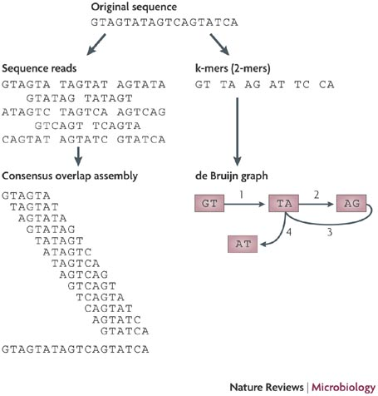

Slide 114

de Bruijn graph assembly

Slide 115
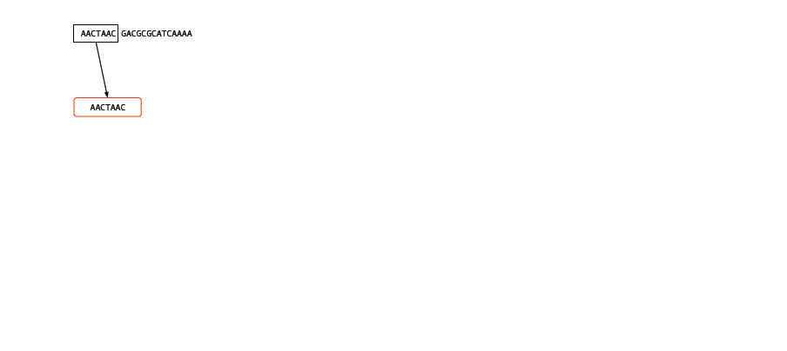
de Bruijn graph assembly

Slide 116
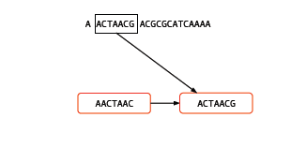
de Bruijn graph assembly

Slide 117
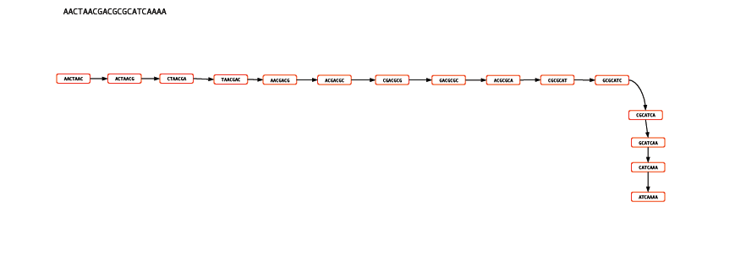
de Bruijn graph assembly

Slide 118
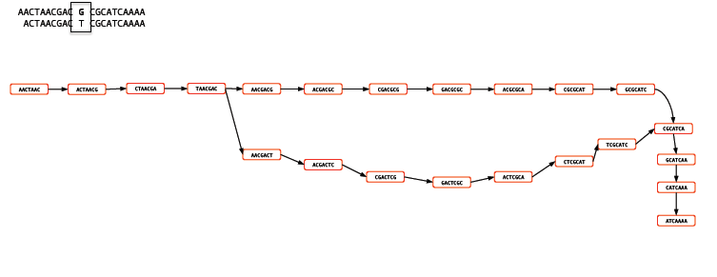
de Bruijn graph assembly

Slide 119
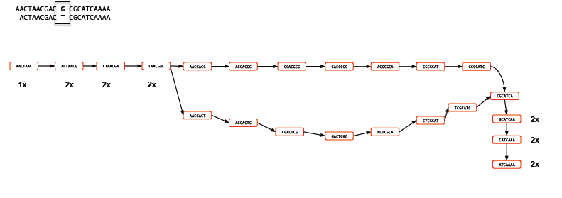
de Bruijn graph assembly

Slide 120
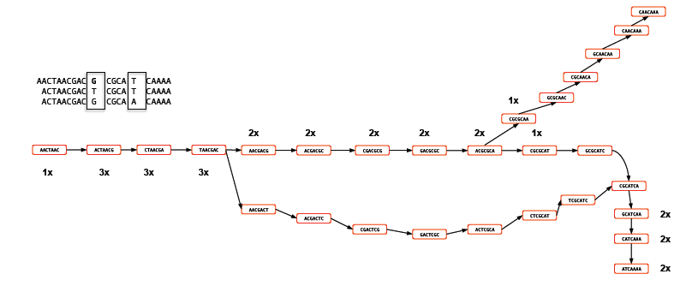
de Bruijn graph assembly

Slide 121
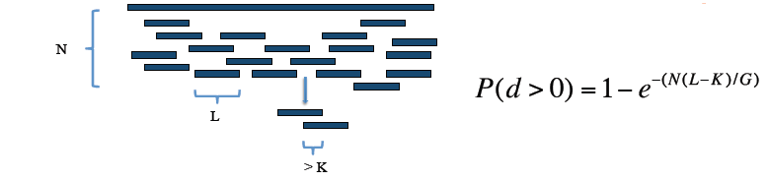
de Bruijn graph assembly
Diagrams courtesy M. Caccamo, TGAC

Slide 122
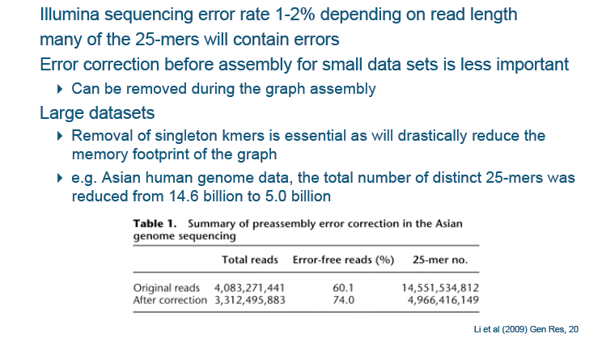
Dealing with errors
Thomas Keane and Jan Aerts, Wellcome Trust Sanger

Slide 123
de Bruijn graph assembly error correction
Diagrams courtesy M. Caccamo, TGAC

Slide 124
Errors or rare sequence?
Depends on the type of data:
  Assumptions are probably true for single haploid genome data
  Diploid and polyploid expect any branches to have equal coverage
  Less clear for RNA-seq due to splicing
  Completely false assumption for metagenomic and metatranscriptomic data!

Slide 125
Short read assemblers
First de Bruijn based assembler was Newbler
  Adapted to handle main 454 error – indels in homopolymers
Several other de Bruijn assemblers developed subsequently
  Velvet, Euler-SR, ABySS, ALLPATHS2
  Most can use paired-end and mate-pair information
Most cannot deal with mammalian sized genomes
  ABySS – distributed genome assembly via MPI
  SOAPde-novo (BGI) Cortex (TGAC)
    Early removal of spurious errors
Hybrid assemblers
  MIRA – capable of assembling 454, Sanger and short reads
  Memory hungry
Other approaches
  String graph assemblers
  Fermi, SGA
  Correcting PacBio reads with Illumina

Slide 126
Contents
Alignment algorithms for short-reads
  Background – Blast (why can’t we use it?)
  Adapting hashed seed-extend algorithms to work with shorter reads
  Suffix/Prefix Tries
  Other alignment considerations
  Typical alignment pipeline
Assembly algorithms for short reads
  Effect of repeats
  Overlap-Consensus
  de Bruijn graphs
  Assembly evaluation metrics
  Typical assembly pipeline

Slide 127
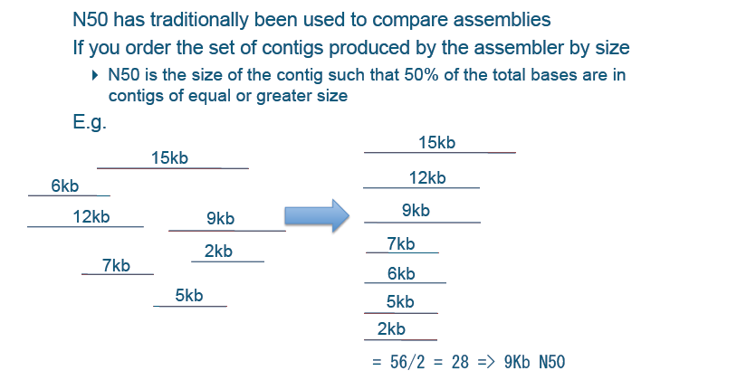
Assembly evaluation – N50
Thomas Keane and Jan Aerts, Wellcome Trust Sanger

Slide 128

Assembly length vs. N50
Thomas Keane and Jan Aerts, Wellcome Trust Sanger

Slide 129

Assembly evaluation metrics
Thomas Keane and Jan Aerts, Wellcome Trust Sanger

Slide 130

Which human assembly is better? Why?
Thomas Keane and Jan Aerts, Wellcome Trust Sanger

Slide 131



Assembly benchmarking software
Darling et al Mauve Assembly Metrics Bioinformatics (2011) btr451 first published online August 2, 2011
http://t.co/BbpbTPz

Slide 132

Types of assemblers
2 main categories, many variations
Each tends to have its own niche
Memory and hardware requirements can differ substantially
Typically a parameter scan is need to get the ‘best’ assembly
This means many assemblies need to be generated
Narzisi G, Mishra B, Comparing De Novo Genome Assembly:
The Long and Short of It. 2011 PLoS ONE 6(4):
De novo assembly of short sequence reads
Paszkiewicz, K. Studholme, D.
Briefings in Bioinformatics
August 2010 11(5): 457-472

Slide 133
Which assembler is best?
Depends on:
  Type of reads (Illumina, SoLID, 454, Ion Torrent, PacBio, Sanger etc)
  Paired/mate-pair data?
  Genome
  Repeat content
  Available hardware
Prokaryote genomes – Velvet
Larger genomes ABySS or Soapdenovo
Narzisi G, Mishra B, Comparing De Novo Genome Assembly:
The Long and Short of It. 2011 PLoS ONE 6(4):

Slide 134
Merging assemblies
Often assemblies are produced from 454 or Sanger data and need to be merged with Illumina data
In order of preference:
  Attempt to assemble 454/Sanger reads with Illumina reads using MIRA
  2. Merge assemblies separately using minimus2 or SSPACE
  3. Input 454/Sanger contigs as part of a reference guided assembly (e.g. Velvet/Columbus)

Slide 135
Transcriptome assembly
de-novo transcriptome assembly is also possible
RNA-seq reads can be assembled and isoform abundance estimated
Much harder as Lander-Waterman assumptions of randomly distributed reads are not true
Also complicated by splice-variants and the need to statistically model isoform abundance based on read distributions
Oases/Velvet
Trans-ABySS
SOAPde-novo
Trinity
Good experimental option for vertebrates and other non-model organisms where a reference genome is not available

Slide 136
Typical assembly pipeline
QC
Remove low quality bases
Remove reads containing adaptor sequences
Assembly
Generate multiple assemblies using different parameters
Alignment
Align filtered reads back to contigs for each assembly
Annotation
Call Open Reading Frames (ORFs)
Search for homologous genes (BLASTP), protein families (PFAM) and/or Interproscan
Trim or remove reads containing Ns
Calculate assembly metrics of N50, total assembly length, number of reads mapping to assembly etc
Call any relevant SNPs in case of intra-sample variation
de-novo gene prediction (e.g. FGENES, Genemark, Glimmer)
Alignment to related species
Obtain synteny alignments (e.g. Mummer0
Additional sequencing to improve de-novo assembly
Visualise in Mauve, IGV, GBrowseSyn
Mate-pair libraries to span repeats
Sanger sequencing to gap -fill
Blast unaligned reads to determine if contaminants are present

Slide 137
Optimal de-novo sequencing strategy and review papers
Assessing the benefits of using mate-pairs to resolve repeats in de novo short-read prokaryotic assemblies
Joshua Wetzel , Carl Kingsford and Mihai Pop
BMC Bioinformatics 2011, 12:95
Comparing De Novo Genome Assembly:
The Long and Short of It.
Narzisi, G. Mishra B.
2011 PLoS ONE 6(4)
De novo assembly of short sequence reads
Paszkiewicz, K. Studholme, D.
Briefings in Bioinformatics
August 2010 11(5): 457-472
A new strategy for genome assembly using short sequence reads and reduced representation libraries
Young A.L., Abaan H.O., Zerbino D, et al. Genome Research 2010;20:249–56.

Slide 138
Variant calling with de-novo assembly

Slide 139
Notes:
Maclean & Studholme

Slide 140
Questions!
biosciences.exeter.ac.uk/facilities/sequencing/usefulresources/

Slide 141

de-Bruijn graph assembly 1

Slide 142

de-Bruijn graph assembly 2

Slide 143

de-Bruijn graph assembly 3

