Slide 1
Transcriptome reconstruction and quantification

Slide 2
Outline
Lecture: algorithms & software solutions
Exercises II: de-novo assembly using Trinity
Exercises I: read-mapping and quantification using Cufflinks

Slide 3
The transcriptome…
“… is everything that is transcribed in a certain sample under certain conditions”
-> What sequences are transcribed?
-> What are the transcripts?
-> What are their expression patterns?
-> What is their biological function?
-> How are they transcribed and regulated?
High-throughput sequencing: cost-efficient way to get
reads from active transcripts.

Slide 4
RNA-Seq: a historic perspective
Traditional: sequence cDNA libraries by Sanger
Tens of thousands of pairs at most (20K genes in mammal)
Redundancy due to highly expressed genes
Not only coding genes are transcribed
Poor full-lengthness (read length about 800bp)
Indels are the dominant error mode in Sanger (frameshifts)

Slide 5
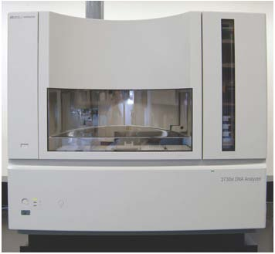
Next-Gen Sequencing technologies
1 Lane of HiSeq yields 30GB in sequence
Error patterns are mostly substitutions
Good depth, high dynamic range
Full-length transcripts
Allow for expression quantification
Strand-specific libraries

Slide 6
The problem:
Reconstruct full-length transcripts (1000’s bp) from reads (100bp)
Read coverage highly variable
Capture alternative isoforms
Annotation? Expression differences? Novel non-coding?
Solution(?):
Read-to-reference alignments, assemble transcripts
(Cufflinks, Scripture)
Assemble transcripts directly (Trans-ABySS, Oases, Trinity)

Slide 7
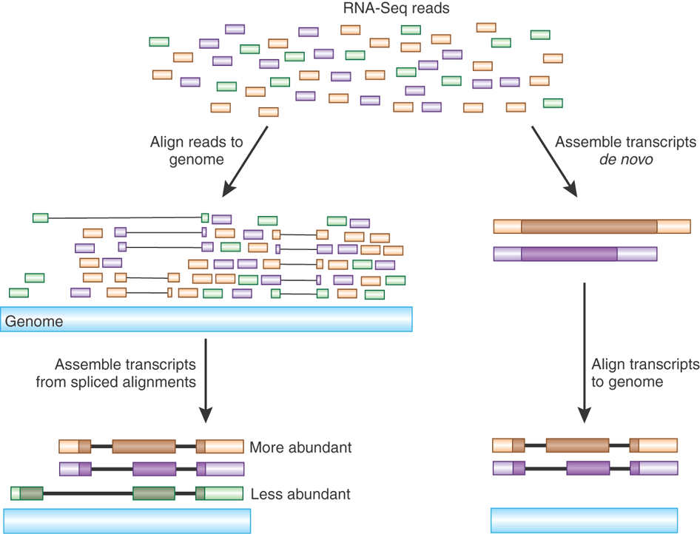
Read mapping vs. de novo assembly
Haas and Zody, Nature Biotechnology 28, 421–423 (2010)

Slide 8
Read mapping vs. de novo assembly
Good reference
No genome
Haas and Zody, Nature Biotechnology 28, 421–423 (2010)

Slide 9
Transcriptome reconstruction with Cufflinks: How it works
Cole Trapnell
Adam Roberts
Geo Pertea
Brian Williams
Ali Mortazavi
Gordon Kwan
Jeltje van Baren Steven Salzberg Barbara Wold
Lior Pachter

Slide 10
Workflow
Map reads to reference genome:
  Disambiguate alignments
  Allow for gaps (introns)
  Use pairs (if available)
Build sequence consensus:
  Identify exons & boundaries
  Identify alternative isoforms
  Quantify isoform expression
Differential expression:
  Between isoforms (Expectation Maximization)
  Between samples
  Annotation-based and novel transcripts

Slide 11
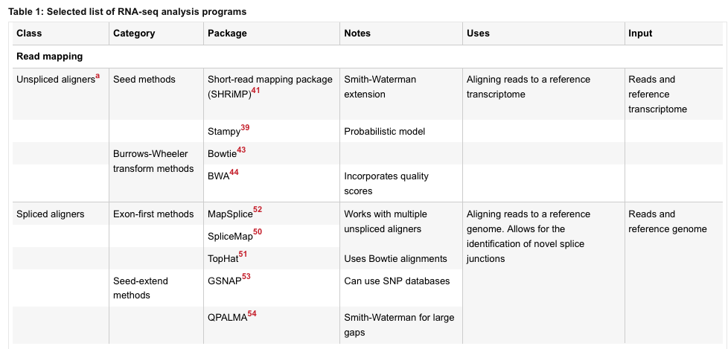
Read-to-reference alignment
Garber et al. Nature Methods 8, 469–477 (2011)

Slide 12
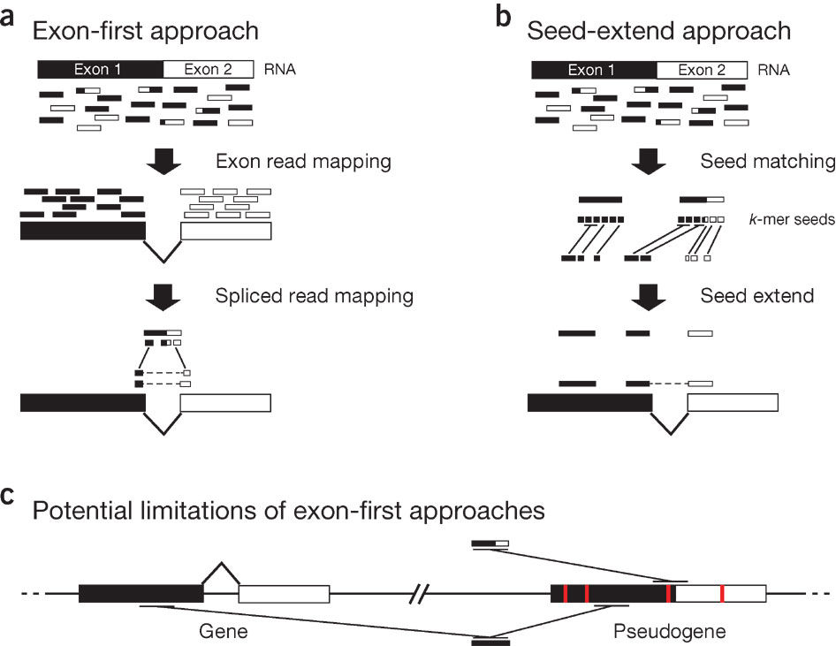
Read-to-reference alignment
Garber et al. Nature Methods 8, 469–477 (2011)

Slide 13
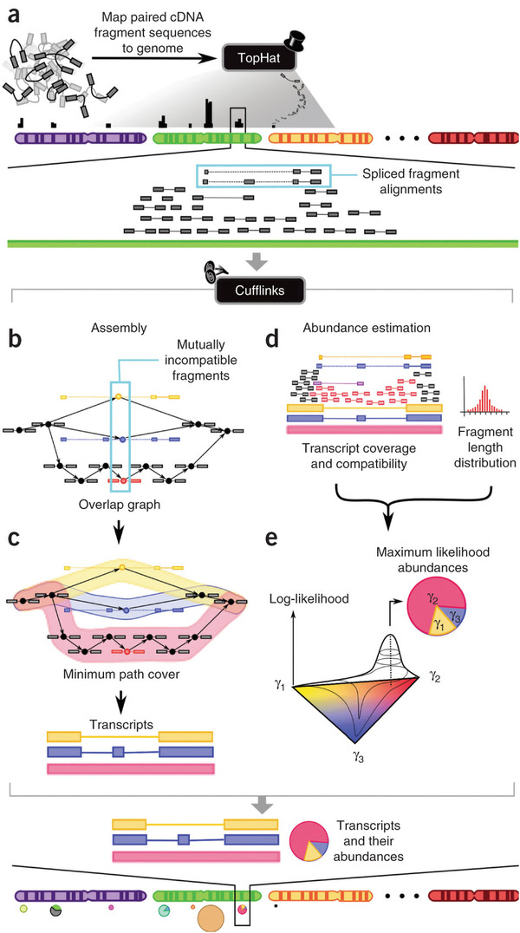
Tophat
Trapnell et al. Nature Biotechnology 28, 511–515 (2010)

Slide 14
Cufflinks
Trapnell et al. Nature Biotechnology 28, 511–515 (2010)

Slide 15
Cufflinks
Trapnell et al. Nature Biotechnology 28, 511–515 (2010)

Slide 16
Measure for expression: FPKM and RPKM
FPKM: Fragments Per Kilobase of exon per Million fragments mapped
RPKM: equivalent for unpaired reads
Longer transcripts, more fragments
FPKM/RPKM measure “average pair coverage” per transcript
Normalizes for total read counts
But it does NOT report absolute values (sum of transcripts constant)

Slide 17
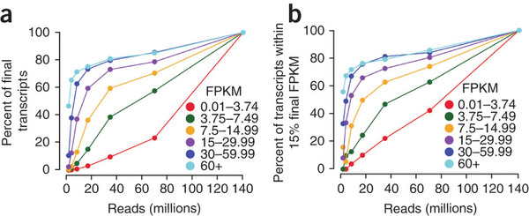
Sensitivity and specificity as function of depth
Trapnell et al. Nature Biotechnology 28, 511–515 (2010)

Slide 18
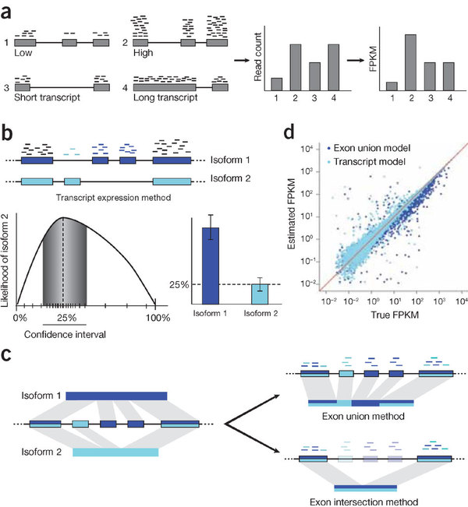
Garber et al. Nature Methods 8, 469–477 (2011)

Slide 19
Alternative isoform quantification
Only reads that map to exclusive exons distinguish
Hundred reads might group many thousands
Robustness: Maximation Estimation (EM) algorithm

Slide 20
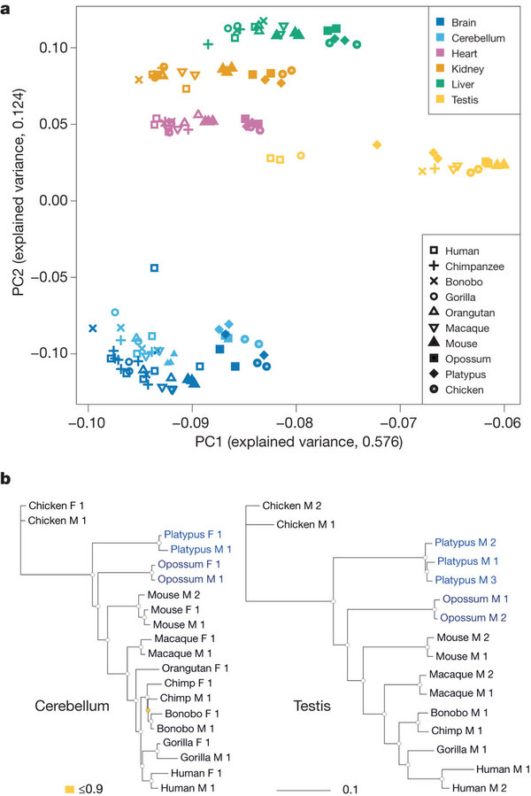
Comparative transcriptomics
Kessmann et al. Nature 478, 343–348 (20 October 2011)

Slide 21
Kessmann et al. Nature 478, 343–348 (20 October 2011)

Slide 22

Transcriptome assembly with Trinity: How it works
Brian Haas
Moran Yassour
Kerstin Lindblad-Toh
Aviv Regev
Nir Friedman
David Eccles
Alexie Papanicolaou
Michael Ott
…

Slide 23
Workflow
Compress data (inchworm):
  Cut reads into k-mers (k consecutive nucleotides)
  Overlap and extend (greedy)
  Report all sequences (“contigs”)
Build de Bruijn graph (chrysalis):
  Collect all contigs that share k-1-mers
  Build graph (disjoint “components”)
  Map reads to components
Enumerate all consistent possibilities (butterfly):
  Unwrap graph into linear sequences
  Use reads and pairs to eliminate false sequences
  Use dynamic programming to limit compute time (SNPs!!)

Slide 24
The de Bruijn Graph
Graph of overlapping sequences
Intended for cryptology
Minimum length element: k contiguous letters (“k-mers”)
CTTGGAA
TTGGAAC
TGGAACA
GGAACAA
GAACAAT

Slide 25
The de Bruijn Graph
Graph has “nodes” and “edges”
G GGCAATTGACTTTT…
CTTGGAACAAT TGAATT
A GAAGGGAGTTCCACT…

Slide 26
The de Bruijn Graph
Graph has “nodes” and “edges”
G GGCAATTGACTTTT…
CTTGGAACAAT TGAATT
A GAAGGGAGTTCCACT…

Slide 27
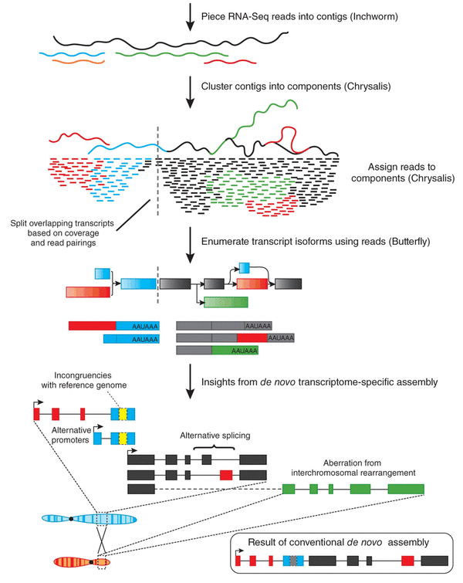
Iyer MK, Chinnaiyan AM (2011) Nature Biotechnology 29, 599–600

Slide 28
Iyer MK, Chinnaiyan AM (2011) Nature Biotechnology 29, 599–600

Slide 29
Iyer MK, Chinnaiyan AM (2011) Nature Biotechnology 29, 599–600

Slide 30
Iyer MK, Chinnaiyan AM (2011) Nature Biotechnology 29, 599–600

Slide 31

Inchworm Algorithm
Decompose all reads into overlapping Kmers (25-mers)
Identify seed kmer as most abundant Kmer, ignoring low-complexity kmers.
Extend kmer at 3’ end, guided by coverage.
G
A
GATTACA
9
T
C
Notes:
The inchworm algorithm works as follows:
It first decomposes reads into a catalog of overlapping Kmers. By default we use overlapping 25-mers.
The single most abundant kmer with reasonable sequence complexity is identified as a seed kmer.
This seed kmer is then extended at the 3’ end guided by the coverage of overlapping kmers.
For each extension, there are four possible kmers, each ending with one of the four possible nucleotides.

Slide 32
Inchworm Algorithm
G
4
A
GATTACA
9
T
C
Notes:
Each of the possible overlapping kmers is looked up in the kmer catalog to determine their frequency within the reads.
In this toy example, the kmer ending with ‘G’ is found 4 times.

Slide 33
Inchworm Algorithm
G
4
A
GATTACA
1
9
T
C
Notes:
‘A’ is found once.

Slide 34
Inchworm Algorithm
G
4
A
GATTACA
1
9
T
0
C
Notes:
The kmer ending with ‘T’ doesn’t exist in the reads, so it has a count of zero.

Slide 35
Inchworm Algorithm
G
4
A
GATTACA
1
9
T
0
C
4
Notes:
And the kmer ending with ‘C’ is found 4 times.

Slide 36
Inchworm Algorithm
G
4
A
GATTACA
1
9
T
0
C
4
Notes:
In this case we have a tie.

Slide 37
Inchworm Algorithm
G
A
0
5
T
1
G
4
C
A
0
GATTACA
1
9
T
0
G
C
1
4
A
1
C
T
1
1
Notes:
When we encounter a tie, we explore the tied paths recursively to find the extension providing the highest cumulative coverage.

Slide 38
Inchworm Algorithm
G
A
0
5
T
1
G
4
C
A
0
GATTACA
1
9
T
0
G
C
1
4
A
1
C
T
1
1
Notes:
In this case, the extension of two overlapping kmers ending with an ‘A’ provides the highest scoring path, and so the other paths are ignored.

Slide 39
Inchworm Algorithm
A
5
G
4
GATTACA
9
Notes:
Extensions continue to occur in this way until there are no more kmers that provide for an extension.

Slide 40
Inchworm Algorithm
A
5
C
G
0
4
T
0
GATTACA
A
9
6
G
1
Notes:
Then, we extend from right to left in the same manner, following the path of greatest coverage.

Slide 41
Inchworm Algorithm
A
5
G
4
GATTACA
A
9
6
A
7
Report contig: ….AAGATTACAGA….
Remove assembled kmers from catalog, then repeat the entire process.
Notes:
Once the extension completes, the assembled contig is reported.
--transition—
The kmers found in the contig are removed from the kmer catalog, and the entire process is repeated starting from a new seed.

Slide 42

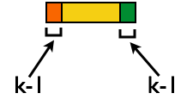
Inchworm Contigs from Alt-Spliced Transcripts
=> Minimal lossless representation of data
+
Notes:
Inchworm can only report contigs derived from unique kmers.
In the case of alternatively spliced transcripts, the more highly expressed transcript may be reported as a single contig, and only the parts that are different in the alternative isoform are reported separately, usually as smaller fragments.
The smaller contig can still be associated with the larger contig based on partial kmers of length k-1 at its termini.
The Chrysalis tool, in the next step, exploits these partial kmers to regroup related contigs.

Slide 43


Chrysalis
Integrate isoforms
via k-1 overlaps
Notes:
Chrysalis takes the linear contigs reported by inchworm, and clusters them based on the k-1mer overlaps.
Chyrsalis also leverages read pairing information to include minimally overlapping contigs.
After identifying the connected inchworm contigs, it constructs a separate de bruijn graph (or kmer graph) for each group, representing the overlaps between adjacent kmers in the sequences with branches at sequencing variations.
In many cases, we end up with one graph per gene, with each graph representing the transcriptional complexity at that locus.
These graphs can then be processed in a parallel fashion by the next step involving Butterfly.

Slide 44
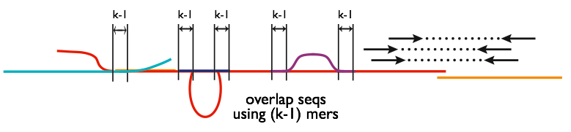
Chrysalis
Integrate isoforms
via k-1 overlaps
Notes:
Chrysalis takes the linear contigs reported by inchworm, and clusters them based on the k-1mer overlaps.
Chyrsalis also leverages read pairing information to include minimally overlapping contigs.
After identifying the connected inchworm contigs, it constructs a separate de bruijn graph (or kmer graph) for each group, representing the overlaps between adjacent kmers in the sequences with branches at sequencing variations.
In many cases, we end up with one graph per gene, with each graph representing the transcriptional complexity at that locus.
These graphs can then be processed in a parallel fashion by the next step involving Butterfly.

Slide 45
Chrysalis
Integrate isoforms
via k-1 overlaps
Verify via “welds”
Notes:
Chrysalis takes the linear contigs reported by inchworm, and clusters them based on the k-1mer overlaps.
Chyrsalis also leverages read pairing information to include minimally overlapping contigs.
After identifying the connected inchworm contigs, it constructs a separate de bruijn graph (or kmer graph) for each group, representing the overlaps between adjacent kmers in the sequences with branches at sequencing variations.
In many cases, we end up with one graph per gene, with each graph representing the transcriptional complexity at that locus.
These graphs can then be processed in a parallel fashion by the next step involving Butterfly.

Slide 46
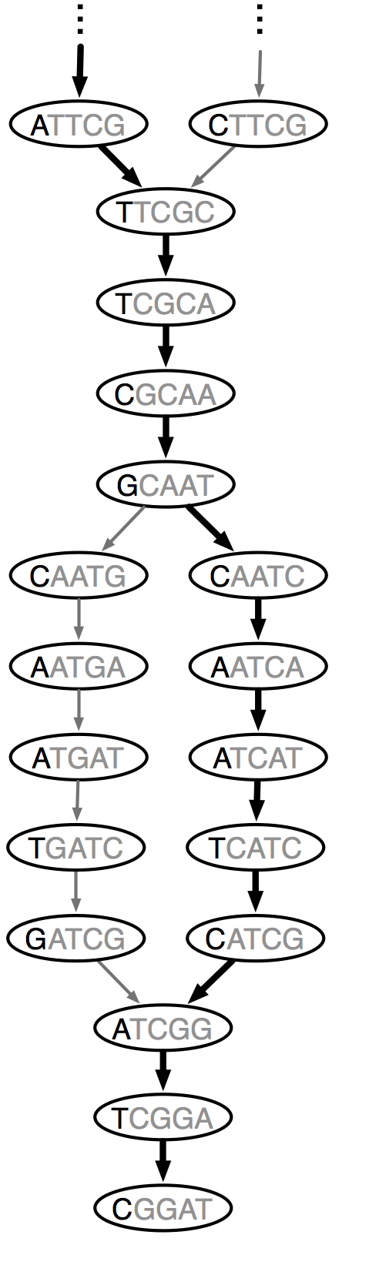
Chrysalis
Integrate isoforms
via k-1 overlaps
Verify via “welds”
Build de Bruijn Graphs
(ideally, one per gene)
Build de Bruijn Graphs
(ideally, one per gene)
Notes:
Chrysalis takes the linear contigs reported by inchworm, and clusters them based on the k-1mer overlaps.
Chyrsalis also leverages read pairing information to include minimally overlapping contigs.
After identifying the connected inchworm contigs, it constructs a separate de bruijn graph (or kmer graph) for each group, representing the overlaps between adjacent kmers in the sequences with branches at sequencing variations.
In many cases, we end up with one graph per gene, with each graph representing the transcriptional complexity at that locus.
These graphs can then be processed in a parallel fashion by the next step involving Butterfly.

Slide 47

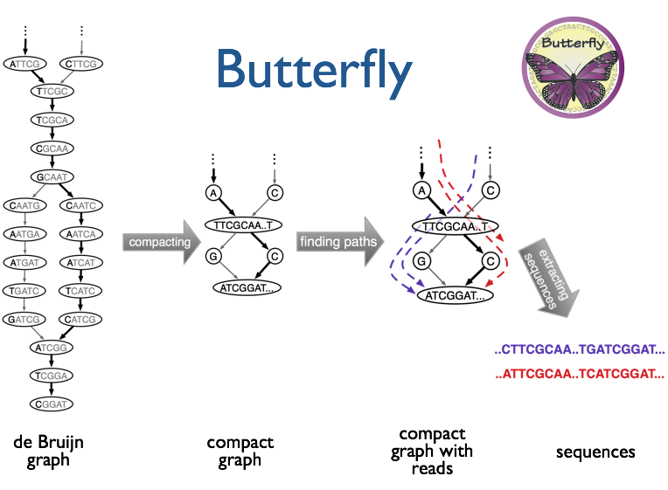
Notes:
Butterfly operates on each of these graphs independently.
It first simplifies the de Bruijn graph by collapsing streteches of the graph where there are no branches.
The original sequencing reads are threaded into the graph.
The most probable paths through the graph supported by the reads and read pairings are reported, emitting full-length transcripts for isoforms and paralogs.
(** add a bullet **)

Slide 48
Notes:
Butterfly operates on each of these graphs independently.
It first simplifies the de Bruijn graph by collapsing streteches of the graph where there are no branches.
The original sequencing reads are threaded into the graph.
The most probable paths through the graph supported by the reads and read pairings are reported, emitting full-length transcripts for isoforms and paralogs.
(** add a bullet **)

Slide 49
Notes:
Butterfly operates on each of these graphs independently.
It first simplifies the de Bruijn graph by collapsing streteches of the graph where there are no branches.
The original sequencing reads are threaded into the graph.
The most probable paths through the graph supported by the reads and read pairings are reported, emitting full-length transcripts for isoforms and paralogs.
(** add a bullet **)

Slide 50
Result: linear sequences grouped in components, contigs and sequences
>comp1017_c1_seq1_FPKM_all:30.089_FPKM_rel:30.089_len:403_path:[5739,5784,5857,5863,353]
TTGGGAGCCTGCCCAGGTTTTTGCTGGTACCAGGCTAAGTAGCTGCTAACACTCTGACTGGCCCGGCAGGTGATGGTGAC
TTTTTCCTCCTGAGACAAGGAGAGGGAGGCTGGAGACTGTGTCATCACGATTTCTCCGGTGATATCTGGGAGCCAGAGTA
ACAGAAGGCAGAGAAGGCGAGCTGGGGCTTCCATGGCTCACTCTGTGTCCTAACTGAGGCAGATCTCCCCCAGAGCACTG
ACCCAGCACTGATATGGGCTCTGGAGAGAAGAGTTTGCTAGGAGGAACATGCAAAGCAGCTGGGGAGGGGCATCTGGGCT
TTCAGTTGCAGAGACCATTCACCTCCTCTTCTCTGCACTTGAGCAACCCATCCCCAGGTGGTCATGTCAGAAGACGCCTG
GAG
>comp1017_c1_seq2_FPKM_all:4.913_FPKM_rel:2.616_len:525_path:[2317,2791]
CTGGAGATGGTTGGAACAAATAGCCGGCTGGCTGGGCATCATTCCCTGCAGAAGGAAGCACACAGAATGGTCGTTAAGTA
ACAGGGAAGTTCTCCACTTGGGTGTACTGTTTGTGGGCAACCCCAGGGCCCGGAAAGGACAGACAGAGCAGCTTATTCTG
TGTGGCAATGAGGGAGGCCAAGAAACAGATTTATAATCTCCACAATCTTGAGTTTCTCTCGAGTTCCCACGTCTTAACAA
AGTTTTTGTTTCAATCTTTGCAGCCATTTAAAGGACTTTTTGCTCTTCTGACCTCACCTTACTGCCTCCTGCAGTAAACA
CAAGTGTTTCAGGCAAAGAAACAAAGGCCATTTCATCTGACCGCCCTCAGGATTTAGAATTAAGACTAGGTCTTGGACCC
CTTTACACAGATCATTTCCCCCATGCCTCTCCCAGAACTGTGCAGTGGTGGCAGGCCGCCTCTTCTTTCCTGGGGTTTCT
TTGAATGTATCAGGGCCCGCCCCACCCCATAATGTGGTTCTAAAC
>comp1017_c1_seq3_FPKM_all:3.322_FPKM_rel:2.91_len:2924_path:[2317,2842,2863,1856,1835]
CTGGAGATGGTTGGAACAAATAGCCGGCTGGCTGGGCATCATTCCCTGCAGAAGGAAGCACACAGAATGGTCGTTAAGTA
ACAGGGAAGTTCTCCACTTGGGTGTACTGTTTGTGGGCAACCCCAGGGCCCGGAAAGGACAGACAGAGCAGCTTATTCTG
TGTGGCAATGAGGGAGGCCAAGAAACAGATTTATAATCTCCACAATCTTGAGTTTCTCTCGAGTTCCCACGTCTTAACAA
AGTTTTTGTTTCAATCTTTGCAGCCATTTAAAGGACTTTTTGCTCTTCTGACCTCACCTTACTGCCTCCTGCAGTAAACA
Notes:
We evaluated methods here by their ability to fully reconstruct the full-length coding region of a given transcript.
We found Trinity to outperform the other de novo assemblers, and, in contrast to the other denovo assemblers, to reconstruct many alternatively spliced isoforms, which is why the transcript bar exceeds the number of genes.

Slide 51
Result: linear sequences grouped in components, contigs and sequences
GTTCGAGGACCTGAATAAGCGCAAGGACACCAAGGAGATCTACACGCACTTCACGTGCGCCACCGACACCAAGAACGTGC
GTTCGAGGACCTGAATAAGCGCAAGGACACCAAGGAGATCTACACGCACTTCACGTGCGCCACCGACACCAAGAACGTGC
AGTTTGTGTTTGATGCCGTCACCGACGTCATCATCAAGAACAACCTGAAGGACTGCGGCCTCTTCTGAGGGGCAGCGGGG
AGTTTGTGTTTGATGCCGTCACCGACGTCATCATCAAGAACAACCTGAAGGACTGCGGCCTCTTCTGAGGGGCAGCGGGG
CCTGGCAGGATGG-------------------------------------------------------------------
CCTGGCAGGATGGTGAGCCCGGGGTGGAGCGGAGCAGAGCTGTGGAGCCCAGAGAAGGGAGCGGTGGGGGCTGGGGTGGG
--------------------------------------------------------------------------------
CCGTGGTGGGGGTATGGTGGTAGAGTGGTAGGTCGGTAGGACGACCTGAGGGGCATGGGCACACGGATAGGCCGGGCCGG
--------------------------------------------------------------------------------
GGCCCAGATGGCAGAAGCATCCGGCCGTGCGCCGGGAGACAACGGAATGGCTGTCCTGACCACCCTTGGAGAAAGCTTAC
--------------------------------------------------------------------------------
CGGCTCTGTGCTCAGCCCTGCAGTCTTTCCCTCAGACCTATCTGAGGGTTCTGGGCTGACACTGGCCTCACTGGCCGTGG
--------------------------------------------------------------------------------
GGGAGATGGGCACGGTTCTGCCAGTACTGTAGATCCCCCTCCCTCACGTAACCCAGCAACACACACACTGGCTCTGGGGC
--------------------------------------------------------------------------------
AGCCACTGGGTCCCTCATAACAGGTGGAGGAGAAAAAGGAGAGAGTCCTTGTCTAGGGAGGGGGGAGGAGAGACACACCC
--------------------------------------------GCCACCGCCGACTCTGCTTCCCCCAGTTCCTGAGGA
TGGCCACCTCCCGACCCATGCCCTGACTGTCCCCCACCTCCAGGGCCACCGCCGACTCTGCTTCCCCCAGTTCCTGAGGA
AGATGGGGGCAAGAGGACCACGCTCTCTGCCTGTCCGTACCCCCGCCCTGGCTGCTTTTCCCCTTTTCTTTGTTCTTGGC
AGATGGGGGCAAGAGGACCACGCTCTCTGCCTGTCCGTACCCCCGCCCTGGCTGCTTTTCCCCTTTTCTTTGTTCTTGGC
TCCCCTGTTCCCTCCCTCAGTTCCAGAGACTCGTGGGAGGAGCTGCCACAGGCCTCCCTGTTTGAAGCCGGCCCTTGTCC
TCCCCTGTTCCCTCCCTCAGTTCCAGAGACTCGTGGGAGGAGCTGCCACAGGCCTCCCTGTTTGAAGCCGGCCCTTGTCC
Notes:
We evaluated methods here by their ability to fully reconstruct the full-length coding region of a given transcript.
We found Trinity to outperform the other de novo assemblers, and, in contrast to the other denovo assemblers, to reconstruct many alternatively spliced isoforms, which is why the transcript bar exceeds the number of genes.

Slide 52
Result: linear sequences grouped in components, contigs and sequences
GTTCGAGGACCTGAATAAGCGCAAGGACACCAAGGAGATCTACACGCACTTCACGTGCGCCACCGACACCAAGAACGTGC
GTTCGAGGACCTGAATAAGCGCAAGGACACCAAGGAGATCTACACGCACTTCACGTGCGCCACCGACACCAAGAACGTGC
AGTTTGTGTTTGATGCCGTCACCGACGTCATCATCAAGAACAACCTGAAGGACTGCGGCCTCTTCTGAGGGGCAGCGGGG
AGTTTGTGTTTGATGCCGTCACCGACGTCATCATCAAGAACAACCTGAAGGACTGCGGCCTCTTCTGAGGGGCAGCGGGG
CCTGGCAGGATGG-------------------------------------------------------------------
CCTGGCAGGATGGTGAGCCCGGGGTGGAGCGGAGCAGAGCTGTGGAGCCCAGAGAAGGGAGCGGTGGGGGCTGGGGTGGG
--------------------------------------------------------------------------------
CCGTGGTGGGGGTATGGTGGTAGAGTGGTAGGTCGGTAGGACGACCTGAGGGGCATGGGCACACGGATAGGCCGGGCCGG
--------------------------------------------------------------------------------
GGCCCAGATGGCAGAAGCATCCGGCCGTGCGCCGGGAGACAACGGAATGGCTGTCCTGACCACCCTTGGAGAAAGCTTAC
--------------------------------------------------------------------------------
CGGCTCTGTGCTCAGCCCTGCAGTCTTTCCCTCAGACCTATCTGAGGGTTCTGGGCTGACACTGGCCTCACTGGCCGTGG
--------------------------------------------------------------------------------
GGGAGATGGGCACGGTTCTGCCAGTACTGTAGATCCCCCTCCCTCACGTAACCCAGCAACACACACACTGGCTCTGGGGC
--------------------------------------------------------------------------------
AGCCACTGGGTCCCTCATAACAGGTGGAGGAGAAAAAGGAGAGAGTCCTTGTCTAGGGAGGGGGGAGGAGAGACACACCC
--------------------------------------------GCCACCGCCGACTCTGCTTCCCCCAGTTCCTGAGGA
TGGCCACCTCCCGACCCATGCCCTGACTGTCCCCCACCTCCAGGGCCACCGCCGACTCTGCTTCCCCCAGTTCCTGAGGA
AGATGGGGGCAAGAGGACCACGCTCTCTGCCTGTCCGTACCCCCGCCCTGGCTGCTTTTCCCCTTTTCTTTGTTCTTGGC
AGATGGGGGCAAGAGGACCACGCTCTCTGCCTGTCCGTACCCCCGCCCTGGCTGCTTTTCCCCTTTTCTTTGTTCTTGGC
TCCCCTGTTCCCTCCCTCAGTTCCAGAGACTCGTGGGAGGAGCTGCCACAGGCCTCCCTGTTTGAAGCCGGCCCTTGTCC
TCCCCTGTTCCCTCCCTCAGTTCCAGAGACTCGTGGGAGGAGCTGCCACAGGCCTCCCTGTTTGAAGCCGGCCCTTGTCC
Notes:
We evaluated methods here by their ability to fully reconstruct the full-length coding region of a given transcript.
We found Trinity to outperform the other de novo assemblers, and, in contrast to the other denovo assemblers, to reconstruct many alternatively spliced isoforms, which is why the transcript bar exceeds the number of genes.

Slide 53
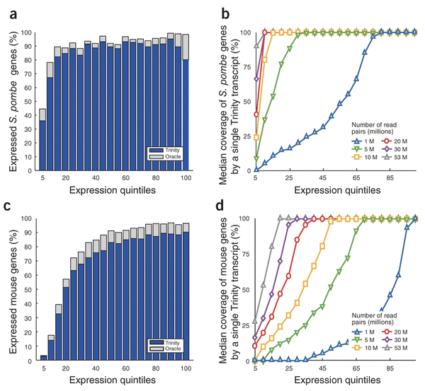
Completeness and coverage as function of read counts
Grabherr et al. Nature Biotechnology 29, 644–652 (2011)

Slide 54
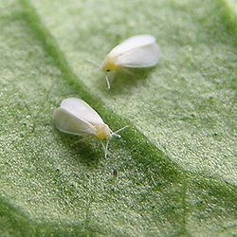
Accuracy allows for comparative transcriptomics
Alternative splicing and allelic variation in whitefly (no genome)
Grabherr et al. Nature Biotechnology 29, 644–652 (2011)

Slide 55
Leveraging RNA-Seq for
Genome-free Transcriptome Studies
Brian Haas

Slide 56
A Paradigm for Genomic Research
WGS Sequencing
Assemble
Draft Genome Scaffolds
Methylation
Tx-factor
binding sites
SNPs
Proteins
Notes:
Draft genome scaffolds assembled from whole genome shotgun sequences are typically the substrate for
downstream studies of gene content and genetic diversity among other analyses.

Slide 57
A Paradigm for Genomic Research
WGS Sequencing
RNA-Seq
Assemble
Align
Draft Genome Scaffolds
Transcripts
Methylation
Tx-factor
binding sites
SNPs
Proteins
Expression
Notes:
In this context, RNA-Seq data are typically aligned to the genome, used to help identify genes, reconstruct transcripts, and measure gene expression.

Slide 58
A Maturing Paradigm for Transcriptome Research
WGS Sequencing
RNA-Seq
Assemble
Align
Assemble
Draft Genome Scaffolds
Transcripts
Methylation
Tx-factor
binding sites
SNPs
Proteins
Expression
Notes:
Because of improvements in sequencing technologies and software tools, it is now becoming possible to study certain features of the genome exclusively through the lens of the transcriptome.
This alternative approach is made possible by our being able to directly assemble the RNA-Seq data into transcripts, from which we can glean insights into expression, protein coding content, and polymorphisms.

Slide 59
A Maturing Paradigm for Transcriptome Research
$$$$$
$$$$$
$$$$$
$$$$$
WGS Sequencing
RNA-Seq
+
$
Assemble
Align
Assemble
Draft Genome Scaffolds
$
Transcripts
Methylation
Tx-factor
binding sites
SNPs
Proteins
Expression
Notes:
One of the reasons this alternative approach is so attractive is because of cost.
In the case of large genomes, such as in plants and mammals, the cost of genome sequencing can be easily 20X the cost of RNA-Sequencing,
and for genome-based studies, you’re going to want to pursue the RNA-sequencing anyway to help with the genome annotation.
This cost difference can have influence over the types of experiments that you might want to do.

Slide 60









A Maturing Paradigm for Transcriptome Research
$$$$$
$$$$$
$$$$$
$$$$$
WGS Sequencing
RNA-Seq
+
$
Assemble
Align
Assemble
Draft Genome Scaffolds
$
Transcripts
Methylation
Tx-factor
binding sites
SNPs
Proteins
Expression
Notes:
For example, for the price of doing one primate genome, you might instead decide to pursue the transcriptomes of it and a dozen of its friends,
and results obtained at the transcriptome level might then circle back to inform the choice of organisms that you would want to pursue for whole genome sequencing.

Slide 61
A Maturing Paradigm for Transcriptome Research
$$$$$
$$$$$
$$$$$
$$$$$
WGS Sequencing
RNA-Seq
+
$
Assemble
Align
Assemble
Draft Genome Scaffolds
$
Transcripts
Methylation
Tx-factor
binding sites
SNPs
Proteins
Expression
Notes:
The success of this transcriptome-directed approach largely hinges upon the ability to accurately assemble the RNA-Seq reads into transcripts.

Slide 62
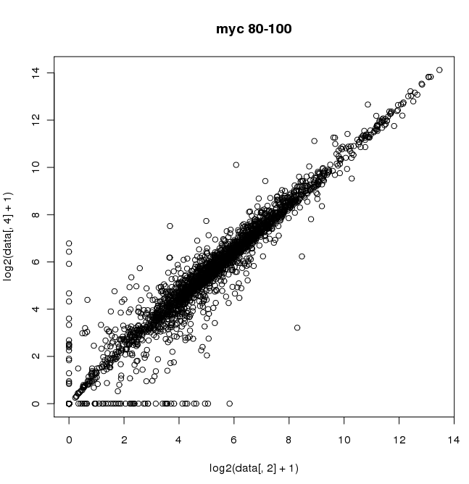
Near-Full-Length Assembled Transcripts Are Suitable Substrates for Expression Measurements
Expression Level Comparison
(80-100% Length Agreement)
14
R²=0.95
Trinity Assembly
0
0
2
4
6
8
10
12
14
Reference transcript
log₂(FPKM)
*Abundance Estimation via RSEM.
Notes:
If we measure expression levels based on counts of reads mapped to the reference transcripts and for the Trinity assemblies that are nearly fully reconstructed, we find that there is an excellent correlation.

Slide 63
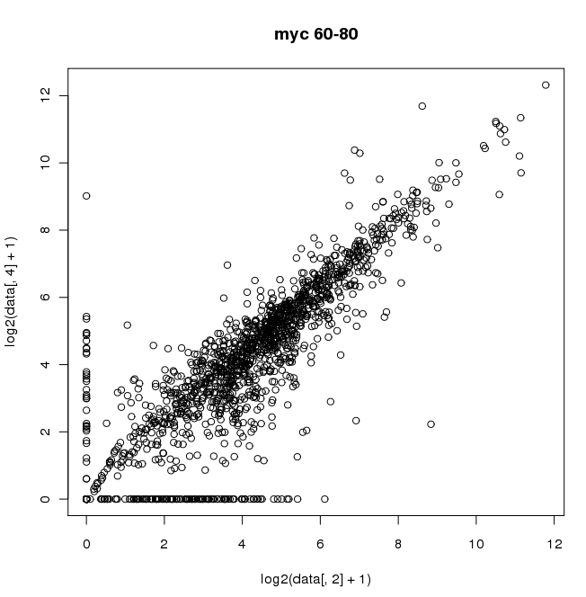
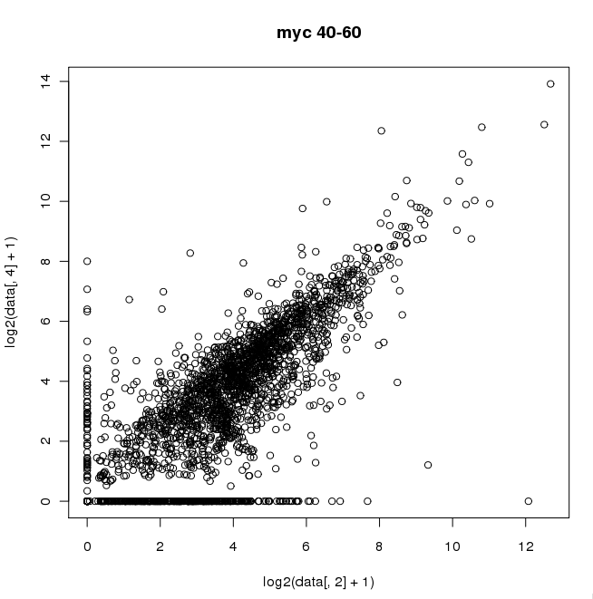

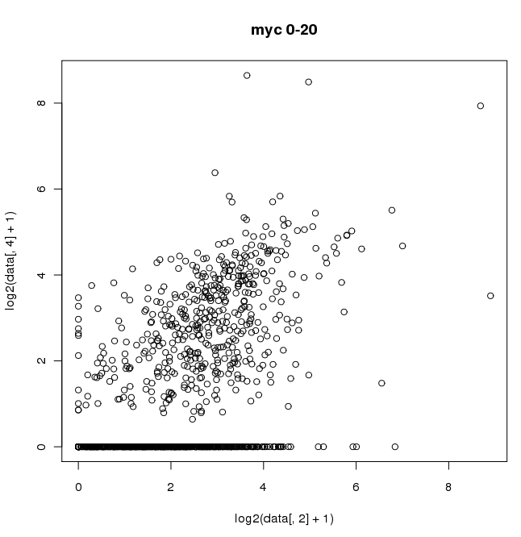
Trinity Partially-reconstructed Transcripts Can Serve as a Proxy for Expression Measurements
Expression Level Comparison
(80-100% Length Agreement)
60-80% Length
40--60% Length
14
R²=0.95
R²=0.83
R²=0.72
Trinity Assembly
20-40% Length
0-20% Length
0
0
4
6
8
10
12
14
R²=0.58
R²=0.40
2
Reference transcript
log₂(FPKM)
Only 13% of Trinity Assemblies
*Abundance Estimation via RSEM.
Notes:
The correlation begins to degrade as the trinity transcripts are found to exist as smaller fragments of the reference transcripts, but the correlations remain mostly high.
The smallest fragments, representing less than 20% of the reference transcript’s length and least correlated for expression levels represent only 13% of the reciprocally mapped assemblies, and so the vast majority of trinity transcripts are more informative.

Slide 64
Summary: what to do when you have your transcripts.
Quality control & metrics:
  Amount of sequence
  #of components
  Transcripts per component
  Length
Classify sequences:
  Align to protein database (if applicable)
  Examine promoters upstream of TSS (if applicable)
  Call ORFs
  Find polyadenylation signal in 3’ UTR
  Align to rfam database (non-coding)
  Secondary structure (snoRNA, miRNA)
What else:
  Annotation: align to reference (blat)
  Visualize (UCSC)
  Paralogs of gene family
  Population transcriptomics (SNPs + expression levels)
  Etc., etc., etc.

