Slide 1
Meta’omic taxonomic profiling with MetaPhlAn2 and biomarker discovery with LEfSe
Curtis Huttenhower
01-19-15
Harvard School of Public Health
Department of Biostatistics
U. Oregon

Slide 2
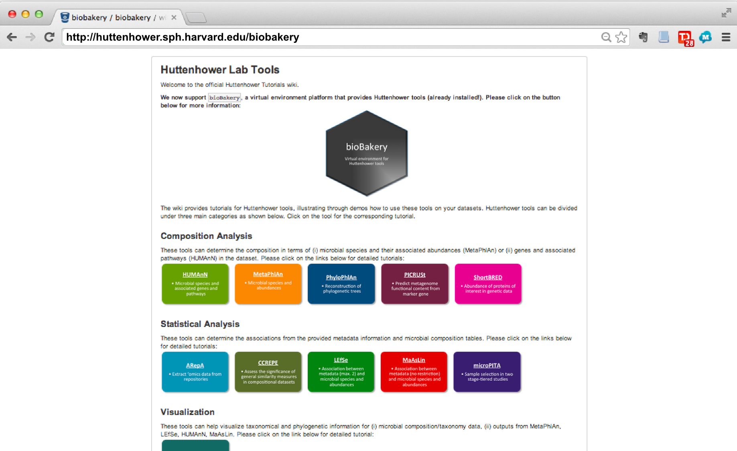

Slide 3
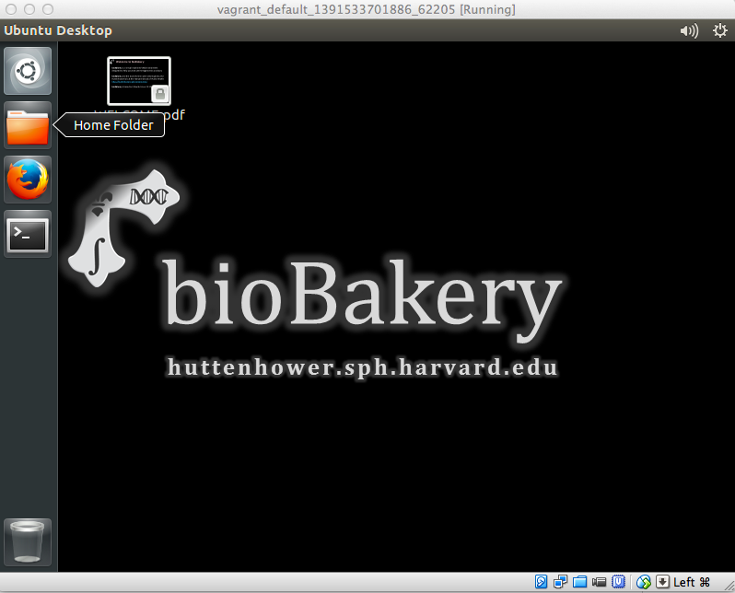
The bioBakery: a next-generation environment for microbiome analyses
Environment for meta’ome analysis
Shotgun metagenomes/transcriptomes
Taxonomic and functional profiling
Experimental design, statistical analysis
Pre-built one-click environments to run:
On your laptop graphically
On a server remotely
On the cloud (Amazon)
http://huttenhower.sph.harvard.edu/biobakery

Slide 4
The two big questions…
Who is there?
(taxonomic profiling)
What are they doing?
(functional profiling)

Slide 5
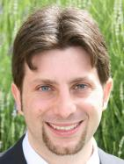
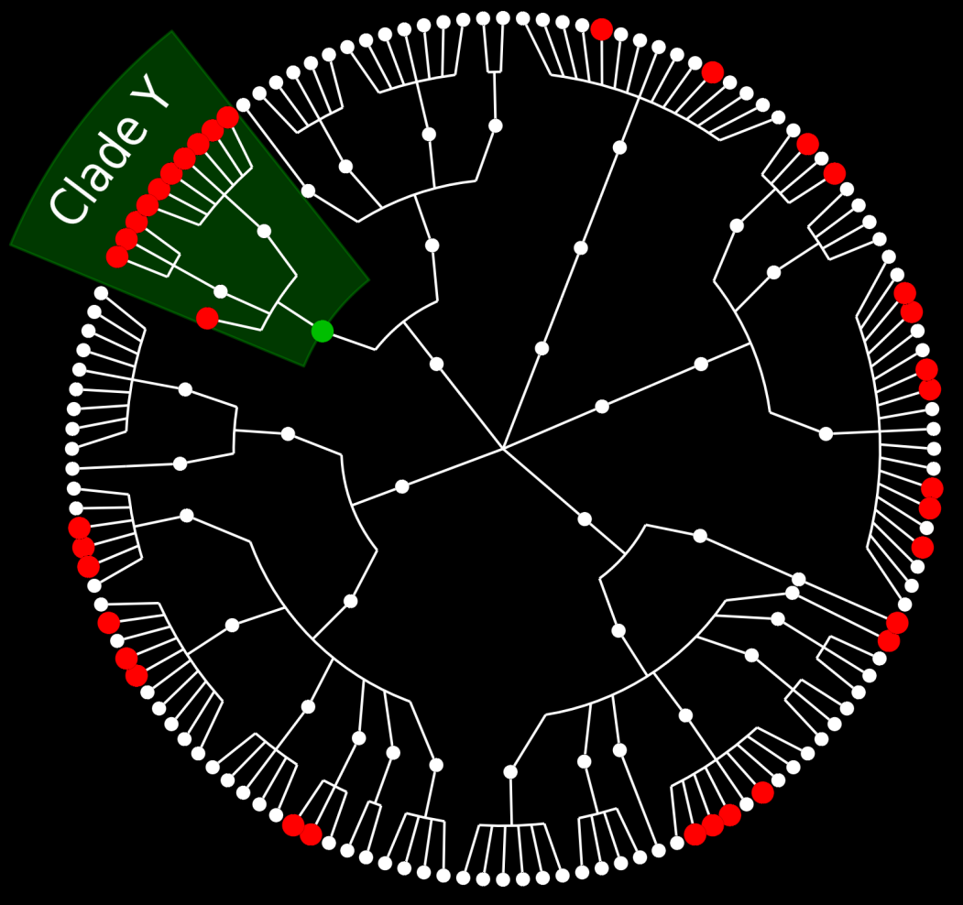
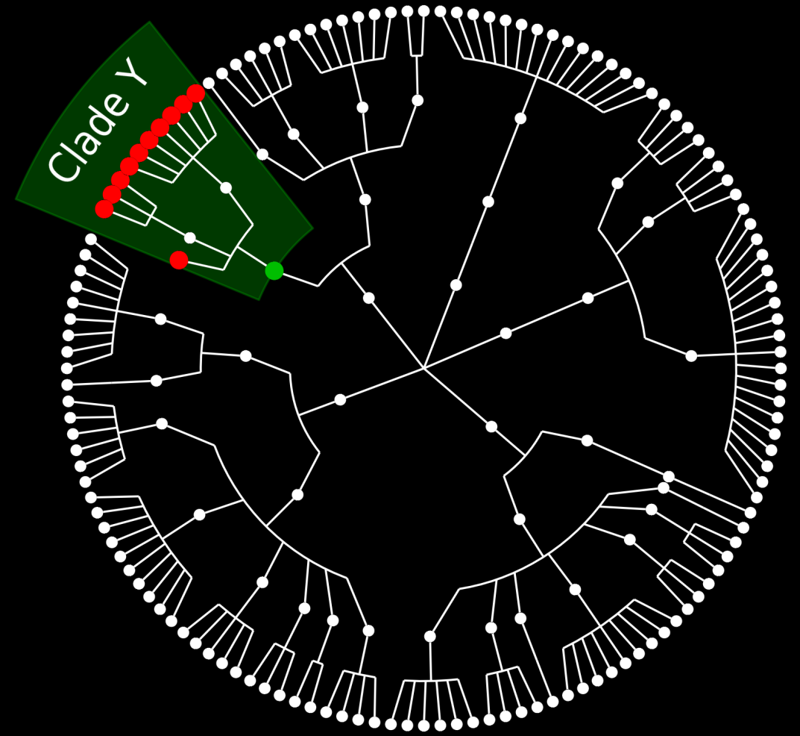
MetaPhlAn overview
Nicola
Segata
A is a core gene for clade Y
A is a unique marker gene for clade Y
Gene A

Slide 6
MetaPhlAn
Metagenomic Phylogenic Analysis
Reference Genomes
A
Y
X
B
Y
Y
C
A
X
X
B
X
Y
C
Short Reads

Slide 7
MetaPhlAn
Metagenomic Phylogenic Analysis
Reference Genomes
A
Y
X
B
Y
Y
C
A
X
X
B
X
Y
C
Short Reads

Slide 8
Evaluation of MetaPhlAn accuracy
Species
Classes
(Validation on high-complexity uniformly distributed synthetic metagenomes.)

Slide 9
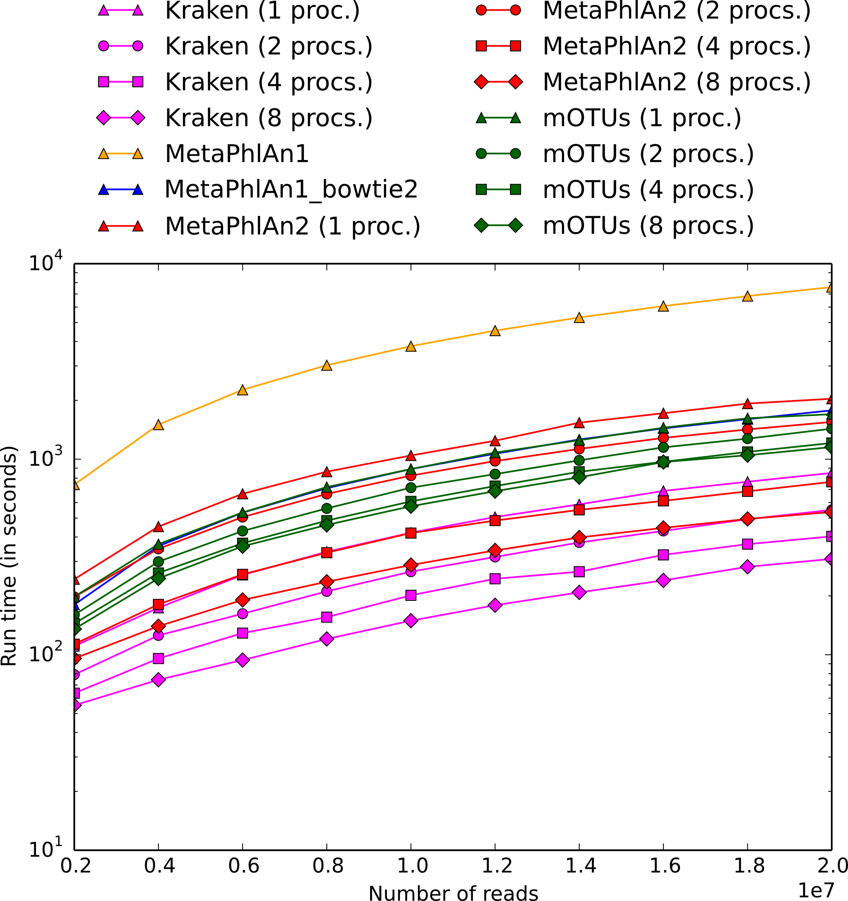
MetaPhlAn2: Taxonomic profiling using unique marker gene sequences
4Gnt synthetic metagenome, 125 organisms
http://huttenhower.sph.harvard.edu/metaphlan2

Slide 10
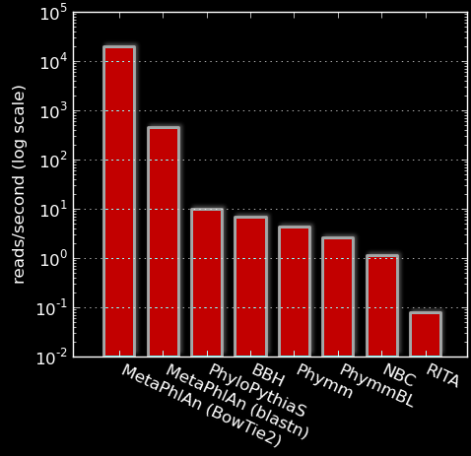
Evaluation of MetaPhlAn performance
>50 times faster than earlier methods
450 reads/sec (BLAST)
Up to 25,000 reads/sec (bowtie2)
Multi-threaded
Easily parallelizable

Slide 11
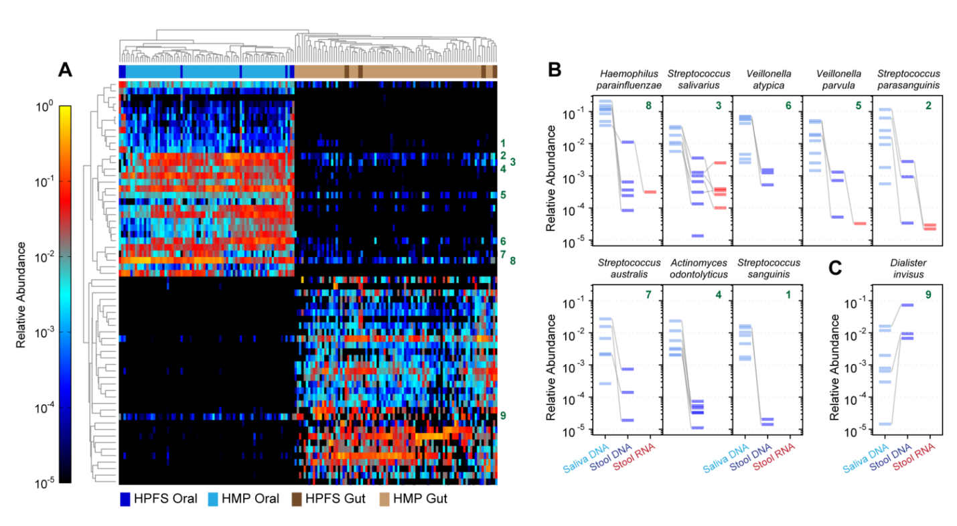
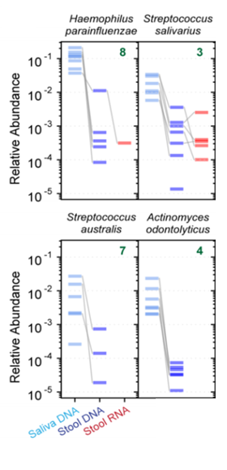
MetaPhlAn in action
Eric Franzosa
species
Franzosa et al. PNAS 11:E2329-38 (2014)

Slide 12
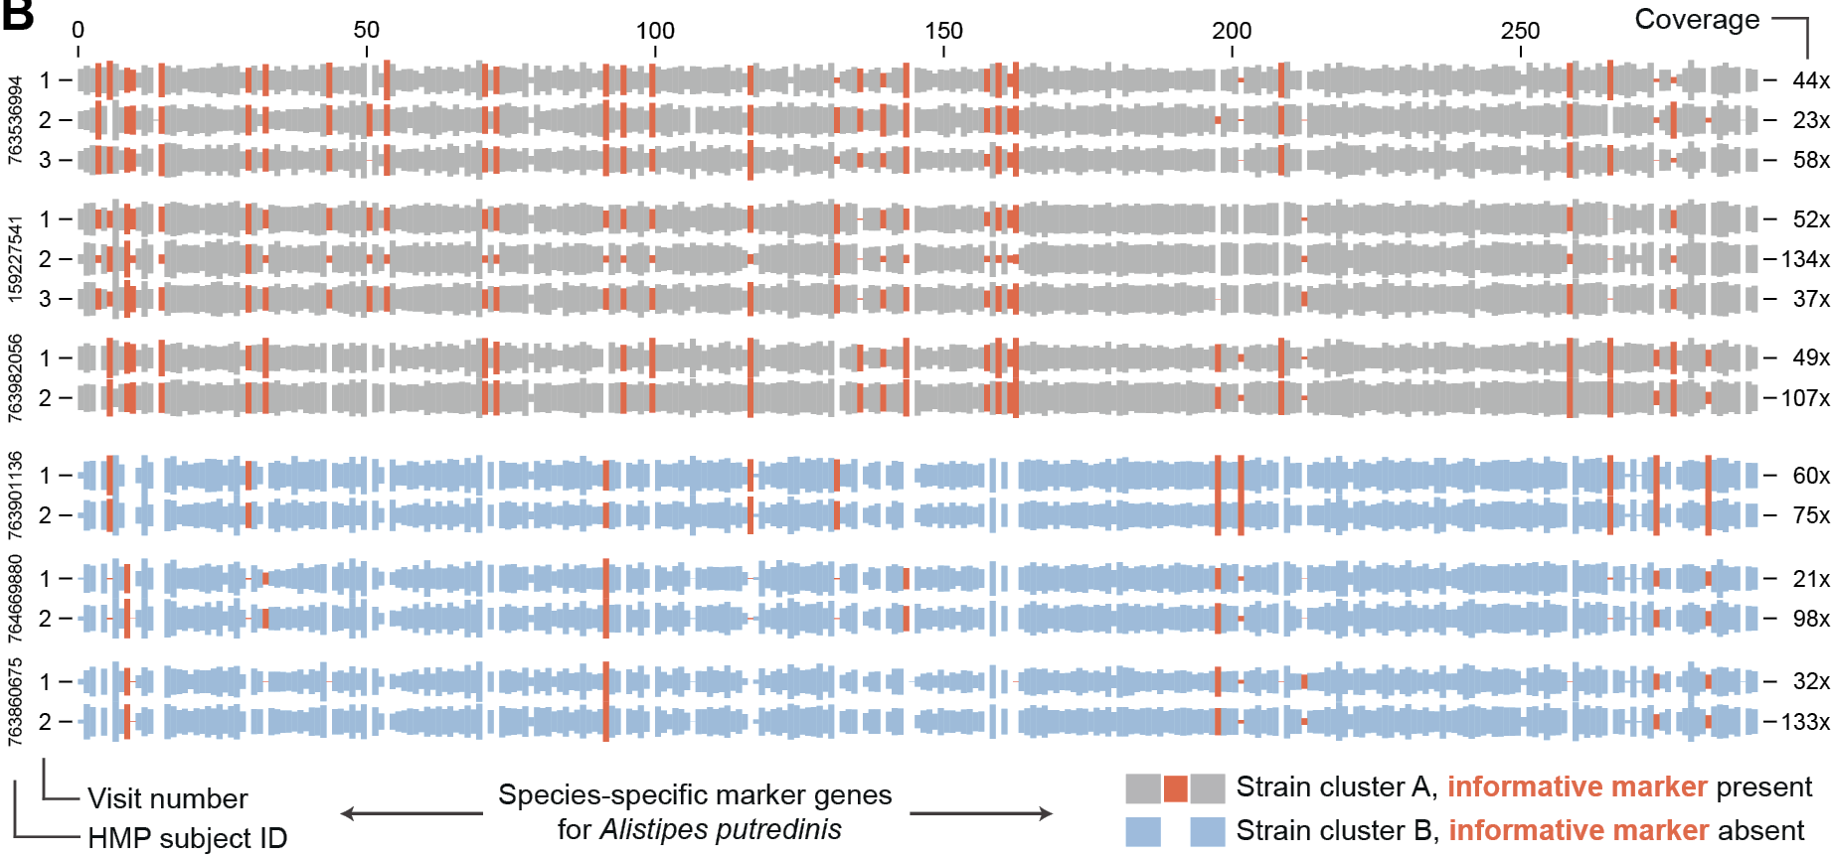
MetaPhlAn in action: strain profiling
In practice, not all markers are present
Individual-specific marker “barcodes”
Often very stable over time

Slide 13
Some setup notes
Slides with green titles or text include instructions not needed today, but useful for your own analyses
Keep an eye out for red warnings of particular importance
Command lines and program/file names appear in a monospaced font.
Commands you should specifically copy/paste are in monospaced bold blue.

Slide 14
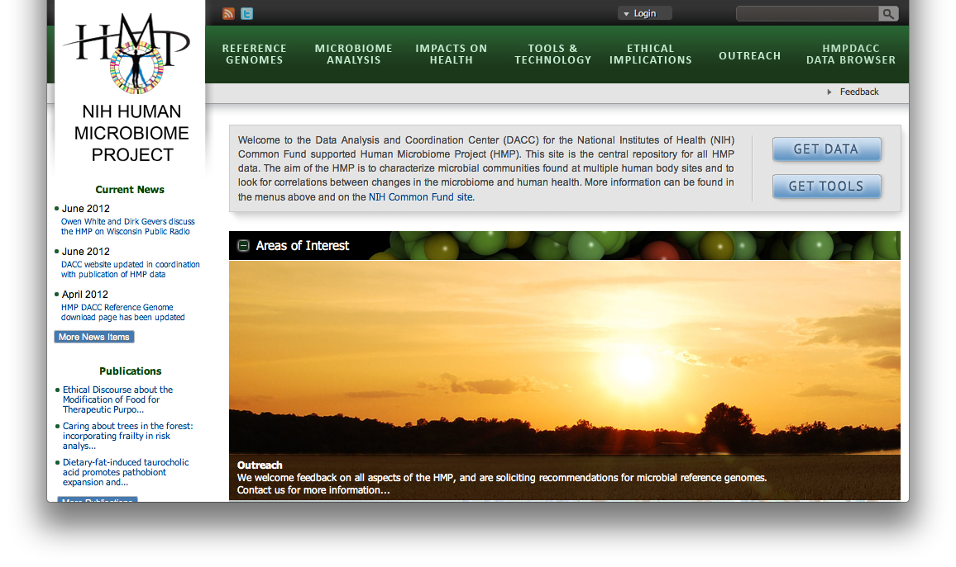
Getting some HMP data
Click “Get Data”
Go to http://hmpdacc.org

Slide 15
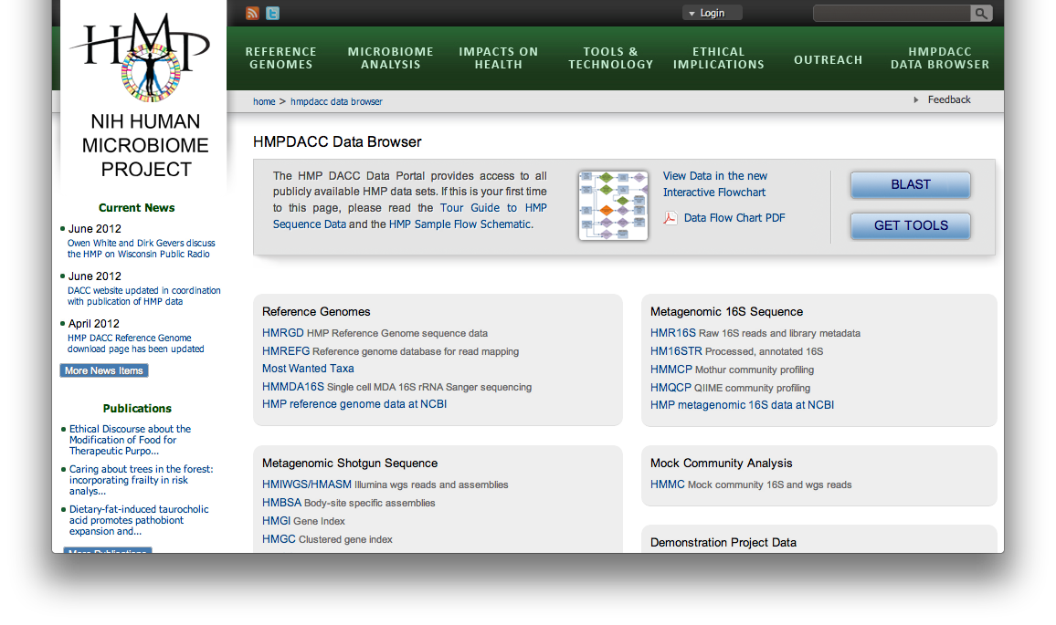
Getting some HMP data
Check out what’s available
Click “HMIWGS”

Slide 16
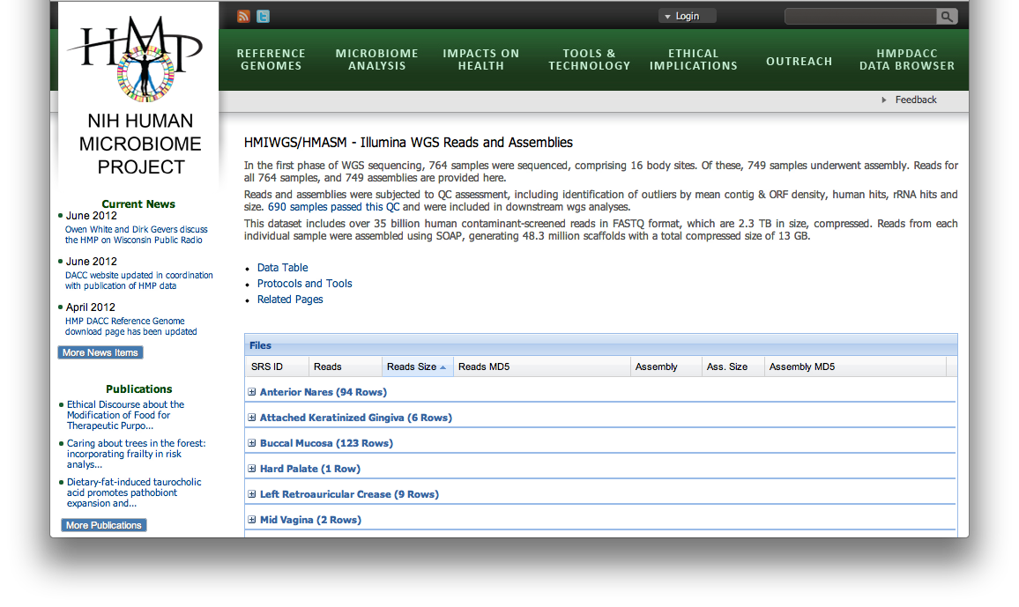
Getting some HMP data
Check out what’s available
Click on your favorite body site

Slide 17
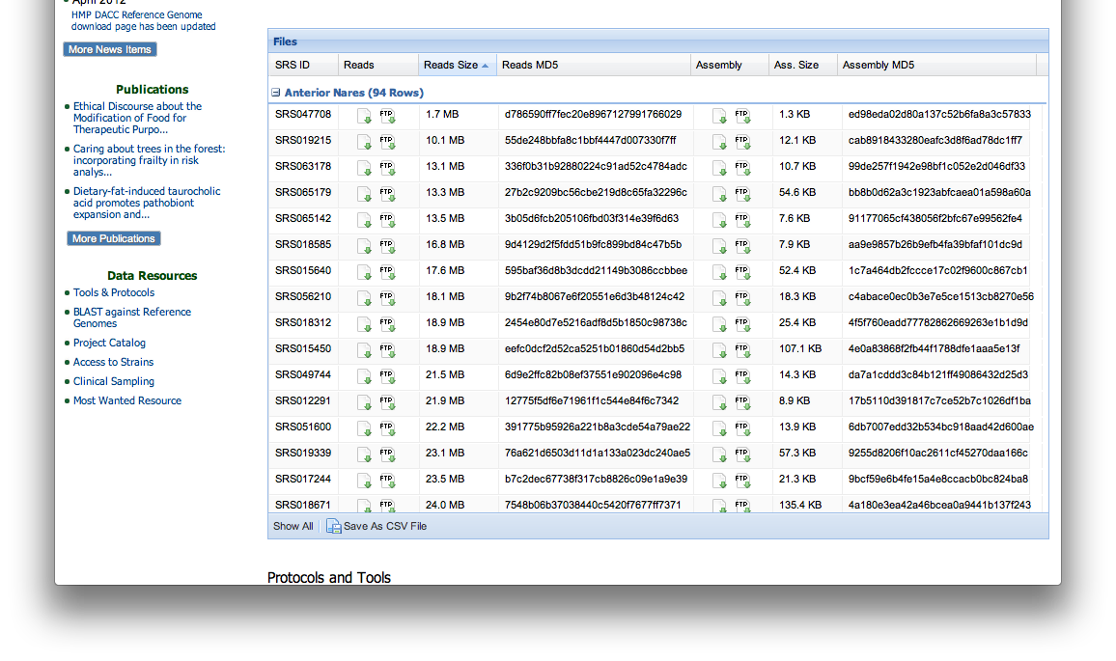
Getting some HMP data
Don’t click on anything!
Check out what’s available

Slide 18
Getting some (prepped) HMP data
Connect to the server instead
cd to your favorite directory and run:
for S in `ls ~/workshop_data/metagenomics/biobakery/data/7*.fasta`; do ln -s $S; done
These are subsamples of six HMP files:
SRS014459.tar.bz2 ➔ 763577454-SRS014459-Stool.fasta
SRS014464.tar.bz2 ➔ 763577454-SRS014464-Anterior_nares.fasta
SRS014470.tar.bz2 ➔ 763577454-SRS014470-Tongue_dorsum.fasta
SRS014472.tar.bz2 ➔ 763577454-SRS014472-Buccal_mucosa.fasta
SRS014476.tar.bz2 ➔ 763577454-SRS014476-Supragingival_plaque.fasta
SRS014494.tar.bz2 ➔ 763577454-SRS014494-Posterior_fornix.fasta
All six shotgunned body sites from
One subject, first visit
Subsampled to 20,000 reads

Slide 19
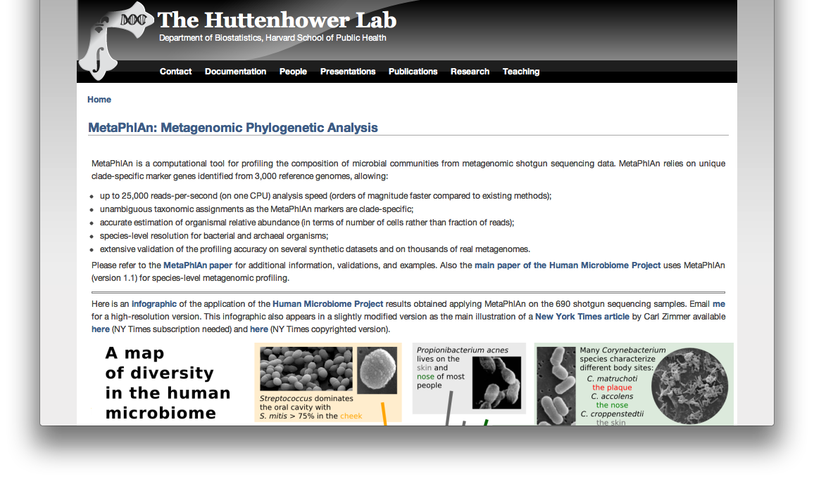
Who’s there: MetaPhlAn1
We won’t use it today, but the first version of MetaPhlAn is at: http://huttenhower.sph.harvard.edu/metaphlan

Slide 20
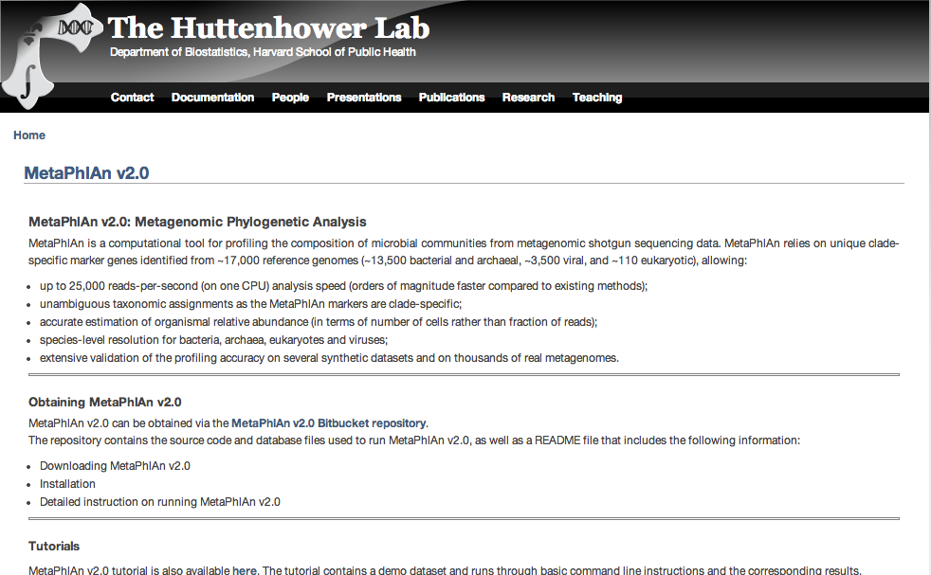
Who’s there: MetaPhlAn2
Instead, go to http://huttenhower.sph.harvard.edu/metaphlan2
You could download MetaPhlAn2 by clicking here

Slide 21
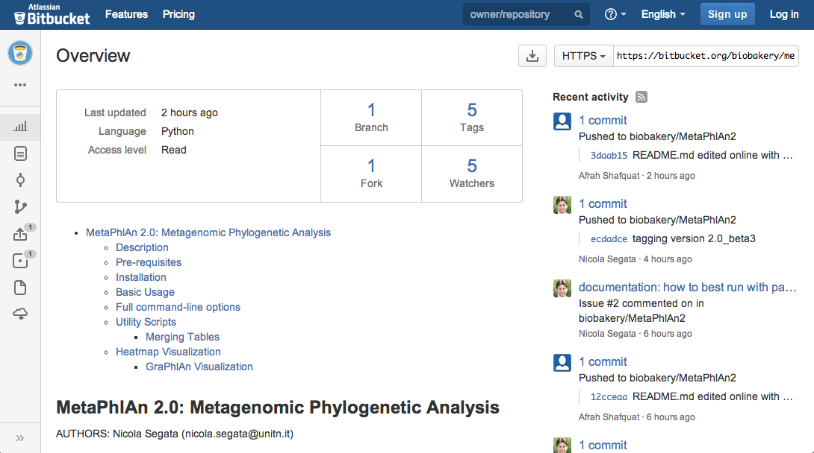
Who’s there: MetaPhlAn2
But don’t! Instead, we’ve installed MetaPhlAn already for you by clicking here on the development site, http://bitbucket.org/biobakery/metaphlan2

Slide 22
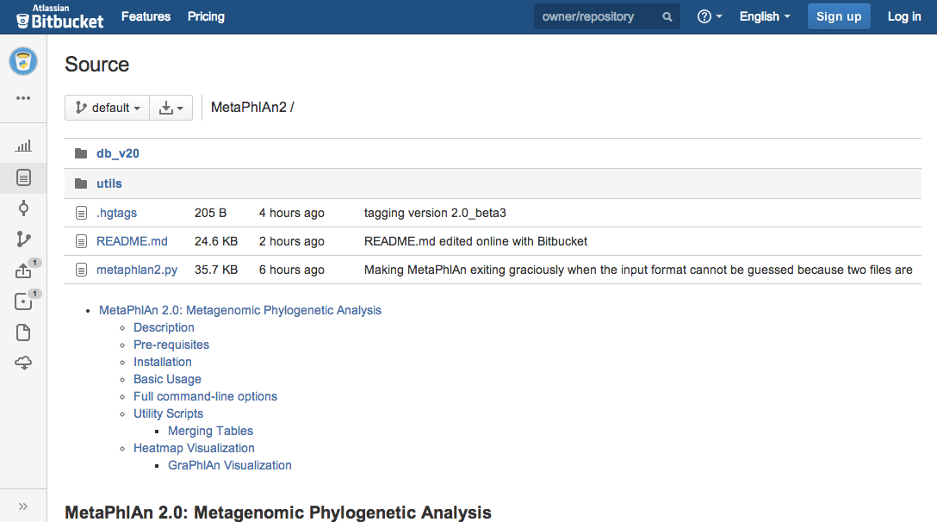
Who’s there: MetaPhlAn2
The complete MetaPhlAn2 install is in ~/workshop_data/metagenomics/biobakery/software/metaphlan2

Slide 23
From the command line...
To see what you can do, run:
metaphlan2.py -h | less
Use the arrow keys to move up and down, q to quit back to the prompt

Slide 24
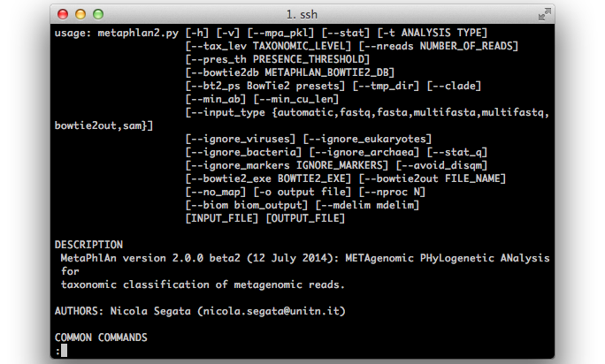
Who’s there: MetaPhlAn2

Slide 25
Who’s there: MetaPhlAn2
To launch your first analysis, run:
metaphlan2.py --mpa_pkl ~/workshop_data/metagenomics/db_v20/mpa_v20_m200.pkl --bowtie2db ~/workshop_data/metagenomics/db_v20/mpa_v20_m200 --input_type fasta ./763577454-SRS014459-Stool.fasta ./763577454-SRS014459-Stool.txt
This will run for ~3-4 minutes
What did you just do?
Two new output files:
763577454-SRS014459-Stool.fasta.bowtie2out.txt
Contains a mapping of reads to MetaPhlAn markers
763577454-SRS014459-Stool.txt
Contains taxonomic abundances as percentages

Slide 26
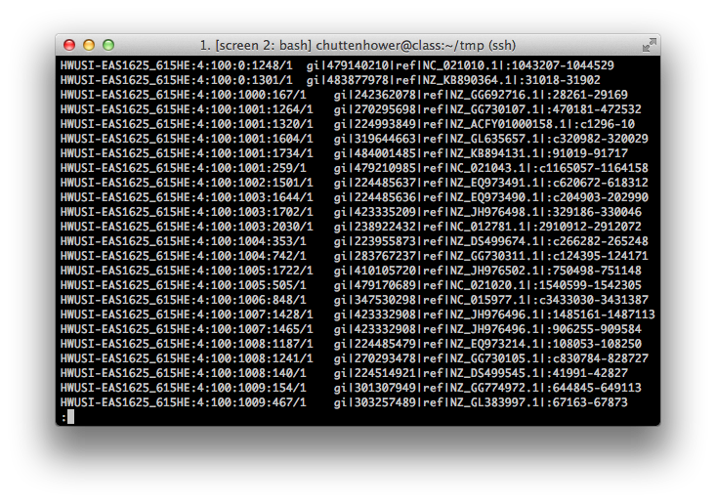
Who’s there: MetaPhlAn
less 763577454-SRS014459-Stool.fasta.bowtie2out.txt

Slide 27
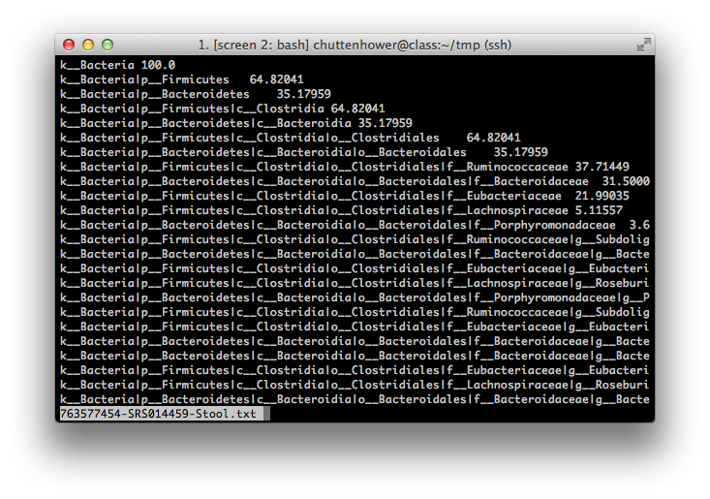
Who’s there: MetaPhlAn
less 763577454-SRS014459-Stool.txt

Slide 28
Who’s there: MetaPhlAn2
You can finish the job if you like:
metaphlan2.py --mpa_pkl ~/workshop_data/metagenomics/db_v20/mpa_v20_m200.pkl --bowtie2db ~/workshop_data/metagenomics/db_v20/mpa_v20_m200 --input_type fasta ./763577454-SRS014464-Anterior_nares.fasta ./763577454-SRS014464-Anterior_nares.txt ...
Note that you can use the up arrow key to make your life easier!
Or you can copy the rest pre-calculated:
cp ~/workshop_data/metagenomics/biobakery/results/metaphlan/*.txt .

Slide 29
Who’s there: MetaPhlAn2
Let’s make a single table containing all six samples:
mkdir tmp
mv *.bowtie2out.txt tmp
~/workshop_data/metagenomics/biobakery/software/metaphlan2/utils/merge_metaphlan_tables.py *.txt > 763577454.tsv
You can look at this file using less
Note 1: The arguments less -x4 -S will help
Note 2: You can set this “permanently” using export LESS="-x4 -S"

Slide 30
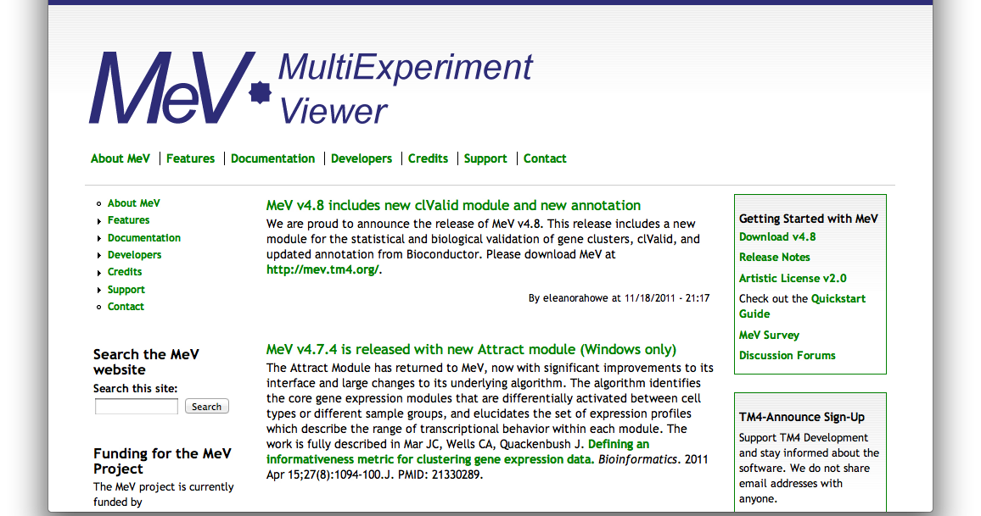
Who’s there: MetaPhlAn
But it’s easier using MeV; go to http://www.tm4.org/mev.html
Or use the pre-installed version:
tmev.sh
Click “Download”

Slide 31
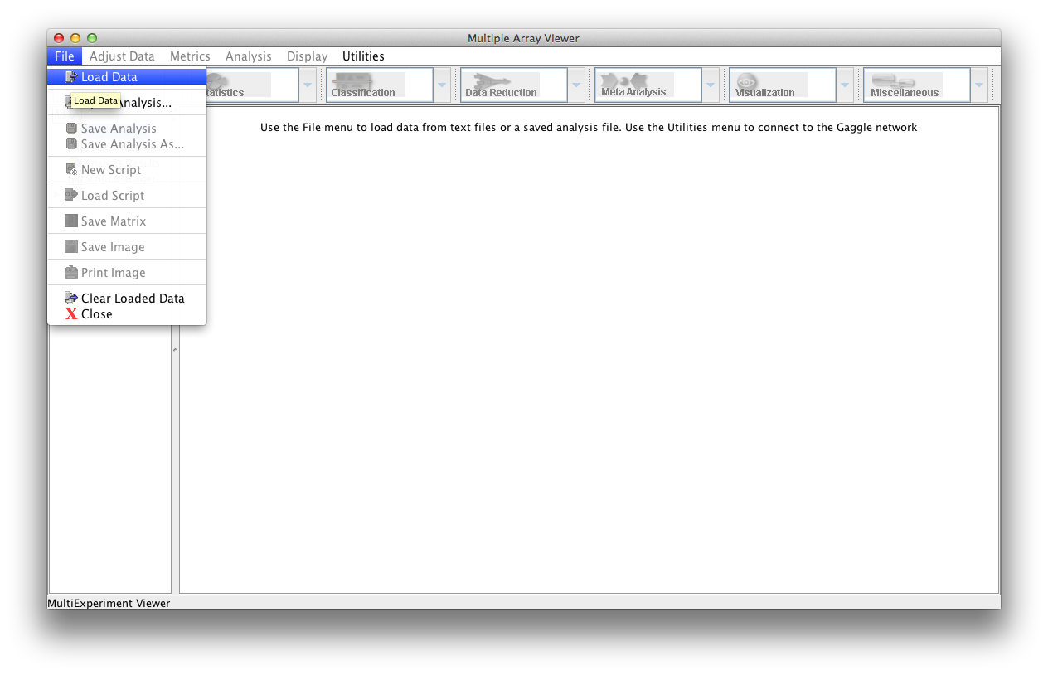
An interlude: MeV
Launch MeV, and select File/Load data

Slide 32
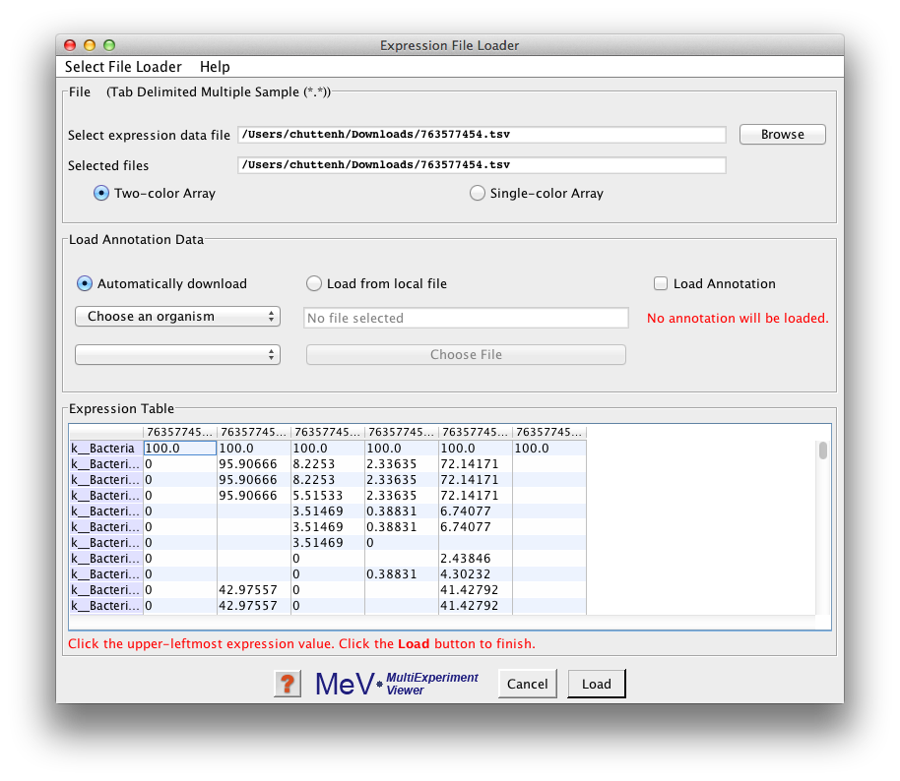
An interlude: MeV
Click “Browse” to your TSV file (763577454.tsv), then
Tell MeV it’s a two-color array
Uncheck “Load annotation”
Click on the upper-leftmost data value

Slide 33
An interlude: MeV
“Load” your data, then make it visible by:
Display/Set Color Scale Limits
Choose Single Gradient, min 0, max 10

Slide 34
An interlude: MeV
Finally, to play around a bit:
Display/Set Element Size/whatever you’d like
Clustering/Hierarchical Clustering
Optimize both gene and sample order
And select Manhattan Distance (imperfect!)

Slide 35
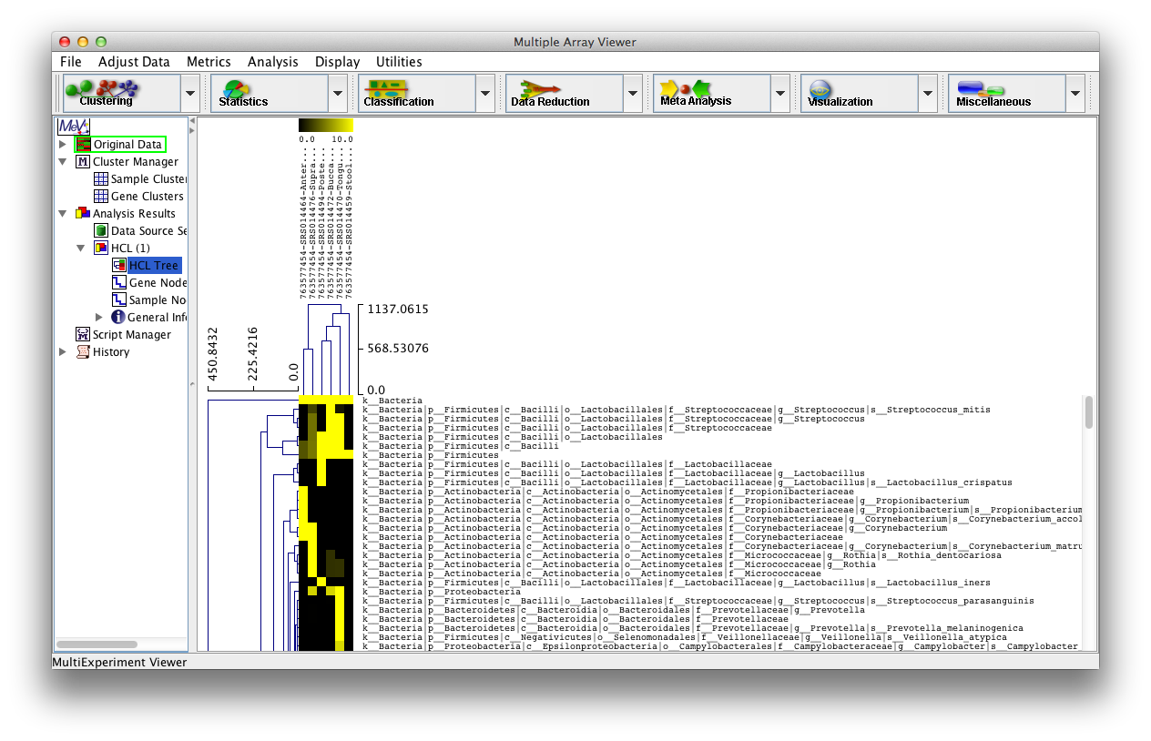
An interlude: MeV
If you’d like, you can
Display/Sample-Column Labels/Abbr. Names

Slide 36
An interlude: MeV
MeV is a tool; imperfect, but convenient
You should likely include just “leaf” nodes
Species, whose names start include “s__”
You can filter your file using: cat 763577454.tsv | grep -E '(Stool)|(s__)' > 763577454_species.tsv
You can, but might not want to, z-score normalize
Adjust Data/Gene-Row Adjustments/Normalize Genes-Rows
Many other tools built in – experiment!

Slide 37
The two big questions…
Who is there?
What are they doing?

Slide 38
The two three big questions…
Who is there?
What are they doing?
What does it all mean?

Slide 39
Properties of microbiome data
Compositional nature (Σ = 1)
Abundance is relative, not absolute
High dynamic range
Often sparse (sample dominated by a few species)
Noisy
Hierarchical organization

Slide 40
Properties of microbiome data
General problem: correlate microbiome features with metadata (potentially controlling for other features)
Intuitively summarize the results

Slide 41
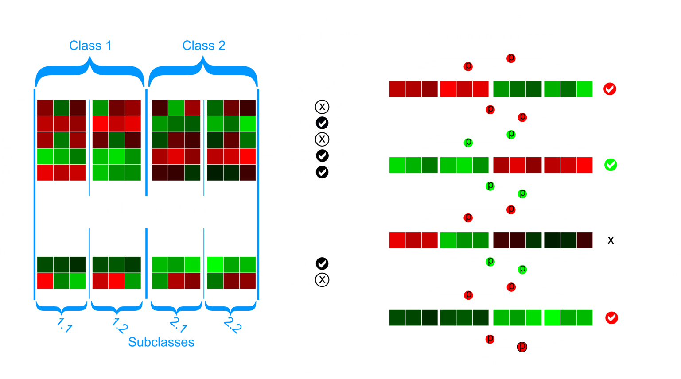
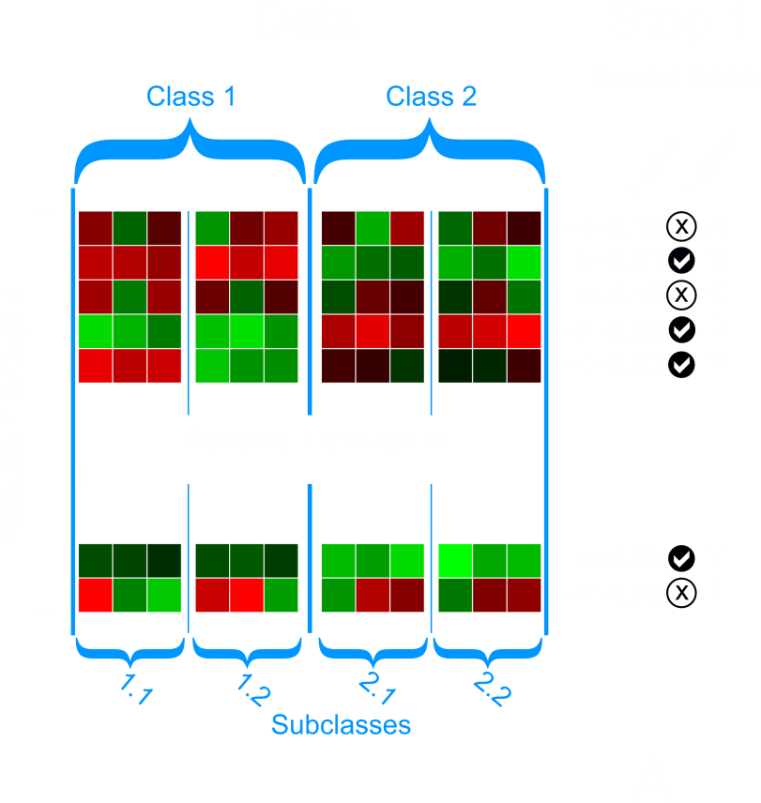
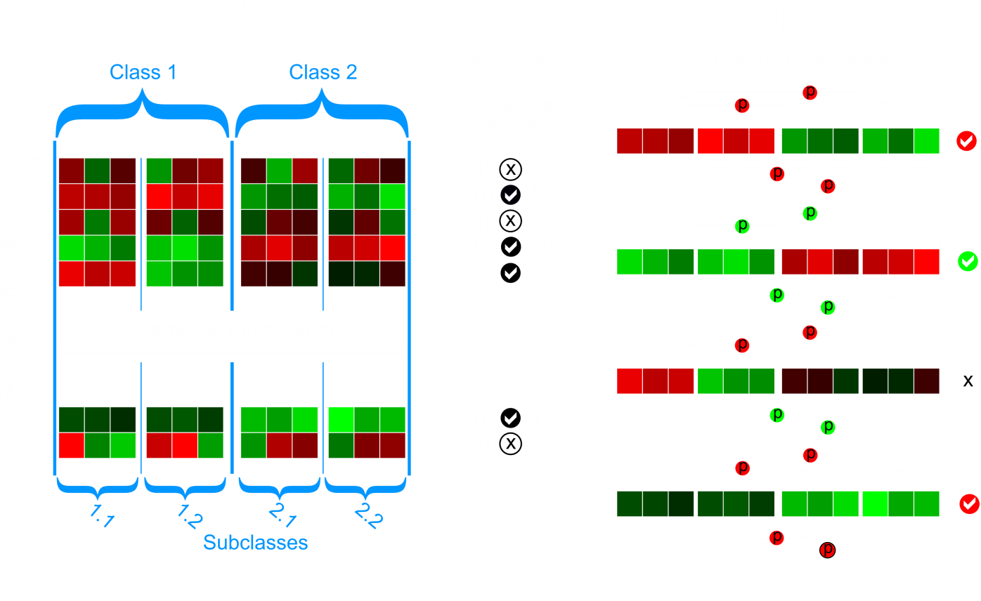
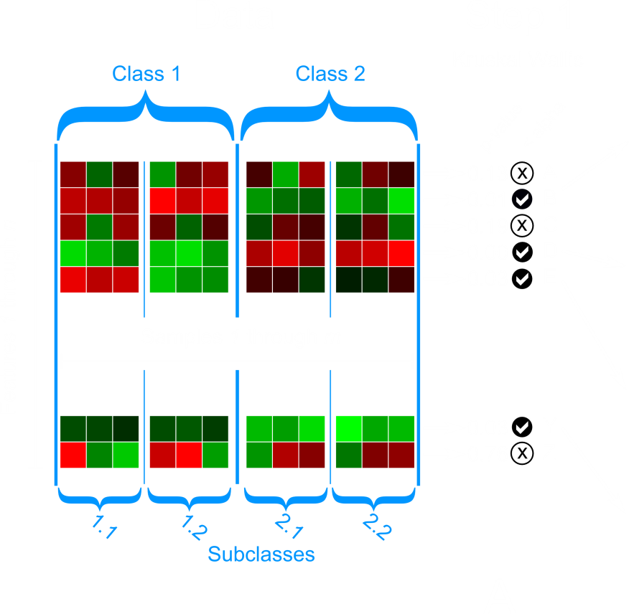
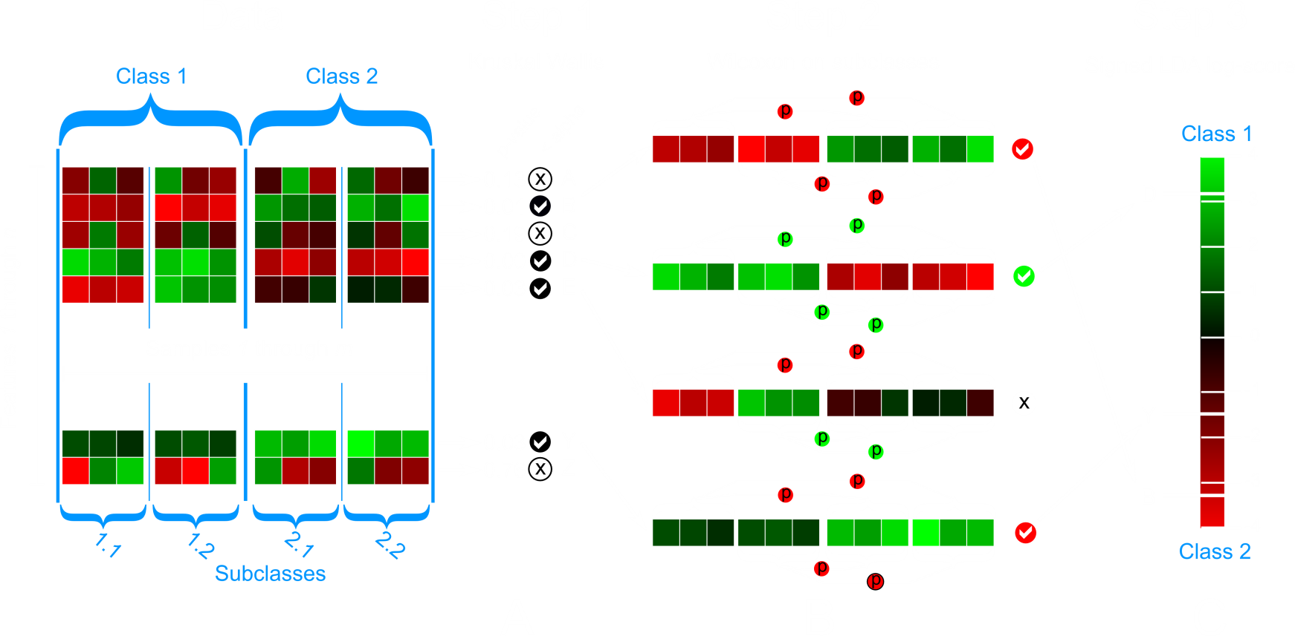
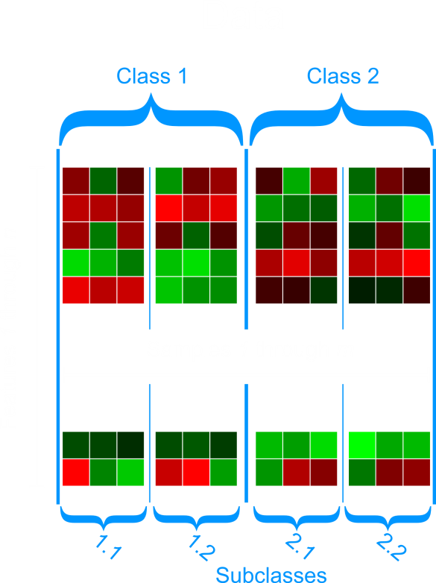
LEfSe: LDA Effect Size
Finding metagenomic biomarkers
Nicola
Segata
Statistical
consistency
Biological
consistency
Biological
Effect size

Slide 42
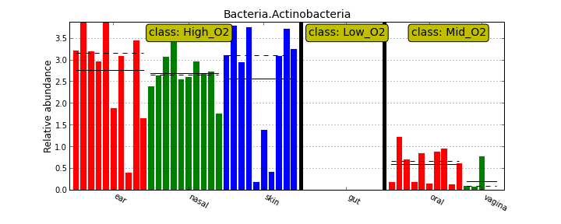
Example LEfSe application:
Find O₂-loving bugs (controlling for body site)

Slide 43
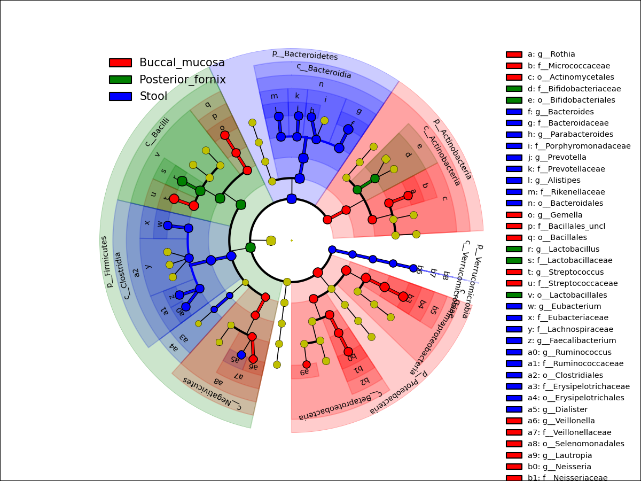
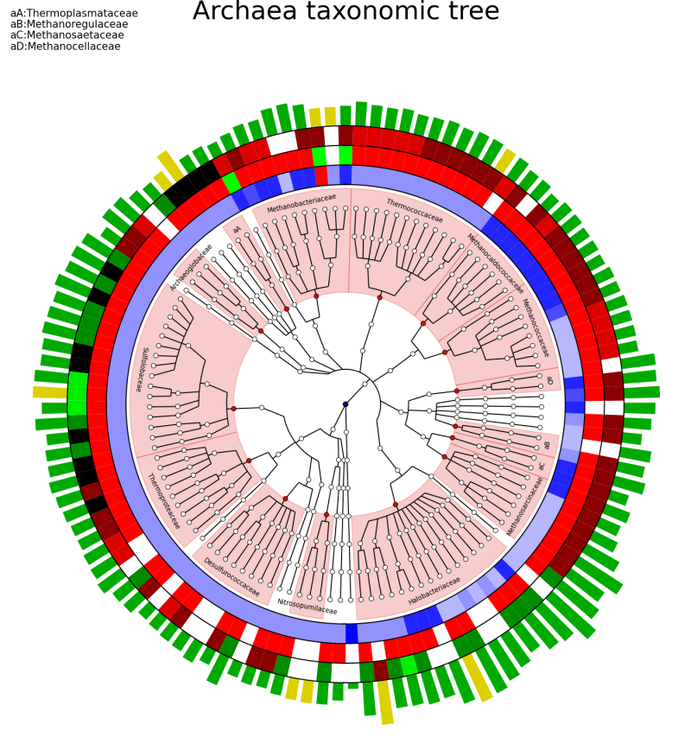
Superimpose enrichments on the tree of life
using GraPhlAn
LEfSe Associations
Metadata Rings
http://huttenhower.sph.harvard.edu/graphlan

Slide 44
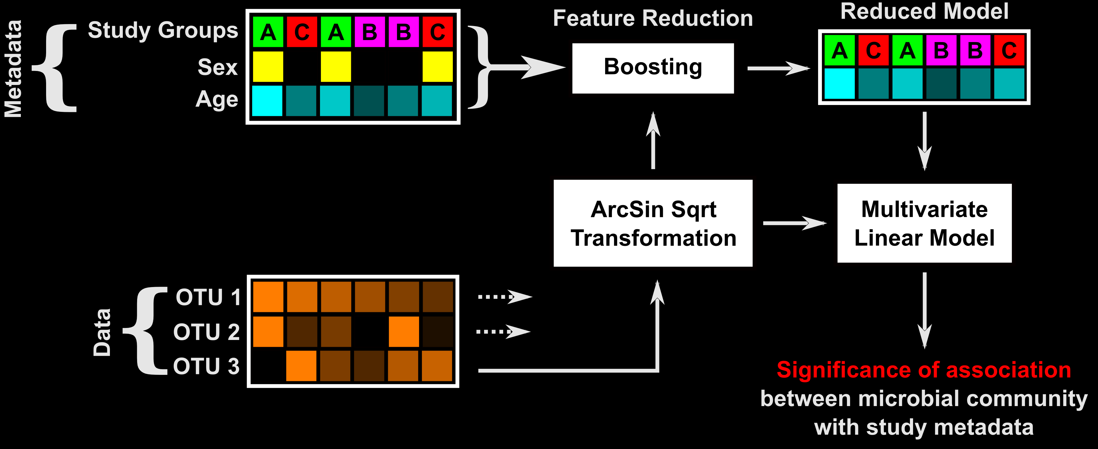
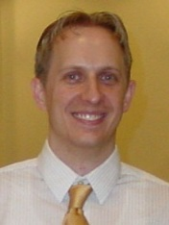
MaAsLin Multivariate microbial Association with Linear models
A more general solution for finding significant metagenomic associations in metadata-rich studies
Tim
Tickle
http://huttenhower.sph.harvard.edu/maaslin
Notes:
The truth is, seemly innocuous factors like diet, age, type of birth have been shown to influence the microbiome and are areas of active research. Knowing these factors influence our study, how do we associate the measurements of the microbiome with our phenotype? We’ll you might of guessed we developed MaAsLin. Say you have a study with rich metadata and microbial relative abundance (derived from either 16S or WCS data). For each OTU, metadata is evaluated with boosting to select the most informative metadata. These metadata are kept as a reduced model to associate with the data with a multivariate regression.
Arcsin(sqrt(yi))= Bo + sigma BpXip +ei i= 1…n
44

Slide 45
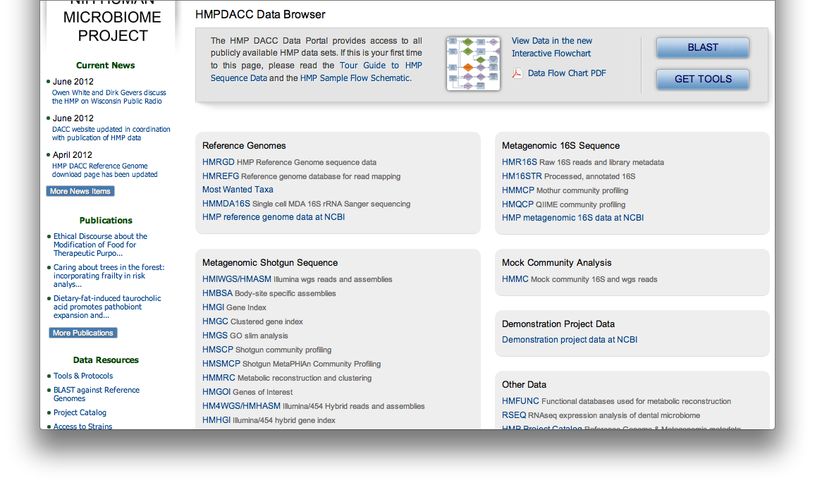
What it means: LEfSe
Let’s get all of the HMP species data: http://hmpdacc.org/resources/data_browser.php
Click “HMSMCP”

Slide 46
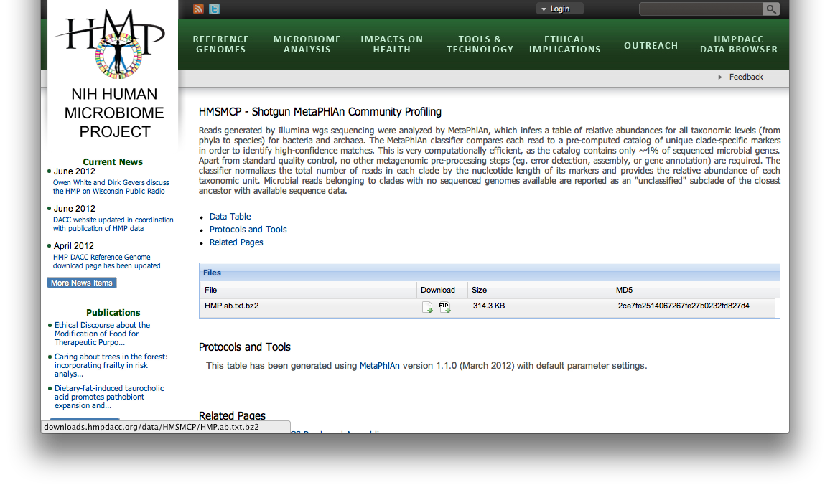
What it means: LEfSe
Download the MetaPhlAn1 table for all 700 samples
Right click this irritatingly tiny icon

Slide 47
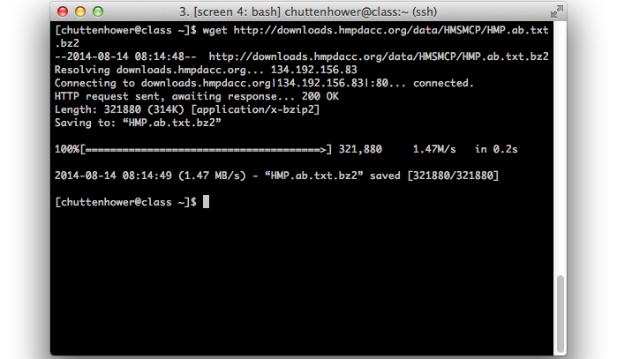
Downloading from the command line
Instead of saving this, download it by:
Right-click to copy the URL
Run wget <paste URL here>
Note: curl –O <URL> works just as well

Slide 48
What it means: LEfSe
Make sure this file is in your current directory, and expand it:
bunzip2 HMP.ab.txt.bz2
Look at the result
less HMP.ab.txt
IMPORTANT!!!
This file’s too big to analyze directly today
ln -s ~/workshop_data/metagenomics/biobakery/data/HMP.ab.filtered.txt
This is great – tons of data, but no metadata
Scripts and data from HUMAnN to the rescue:
~/workshop_data/metagenomics/biobakery/software/util/metadata.py ~/workshop_data/metagenomics/biobakery/data/hmp_metadata.dat < HMP.ab.filtered.txt > HMP.ab.filtered.metadata.tsv
NOW take a look again

Slide 49
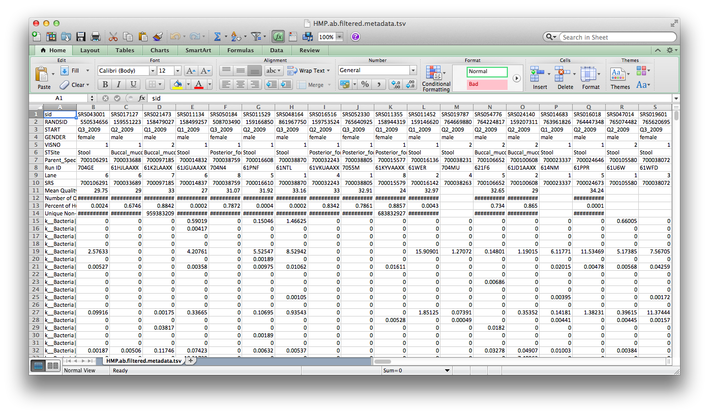
What it means: LEfSe
Let’s modify this file to be LEfSe-compatible
You could open it up in Excel…

Slide 50
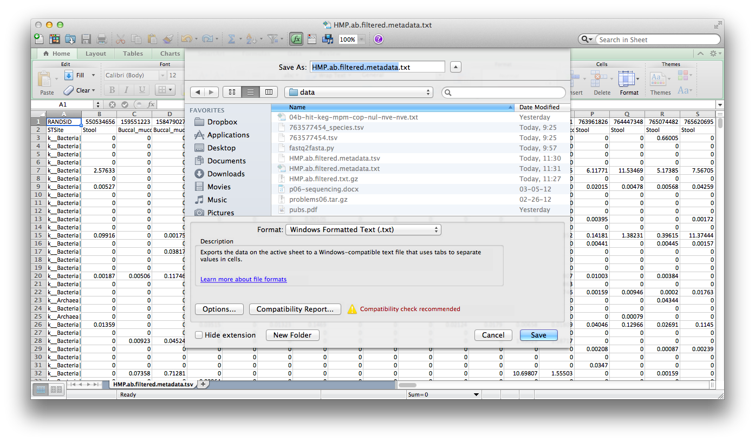
What it means: LEfSe
…and delete all of the metadata rows except:
RANDSID and STSite
Save it as tab-delimited text: HMP.ab.filtered.metadata.txt

Slide 51
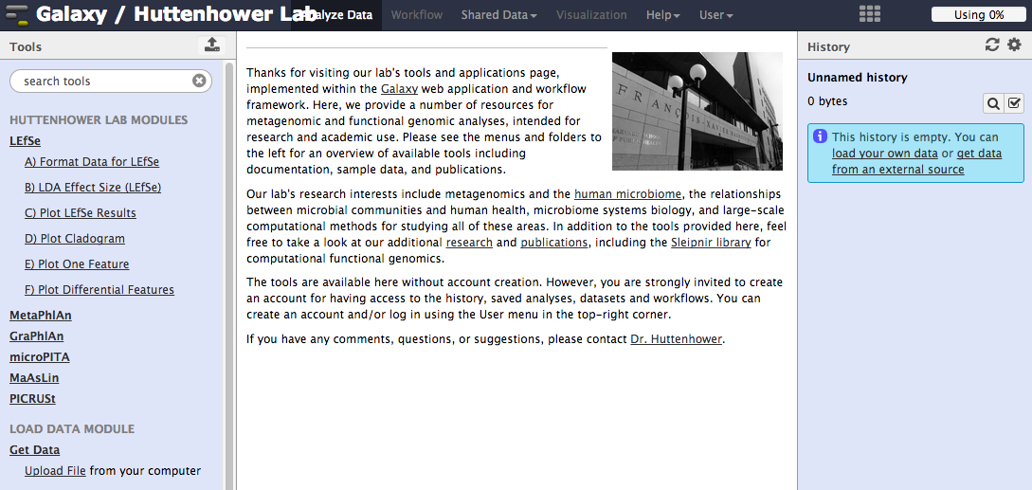
What it means: LEfSe
But instead we’ll run it from the server!
Visit LEfSe at: http://huttenhower.sph.harvard.edu/galaxy
First click here

Slide 52
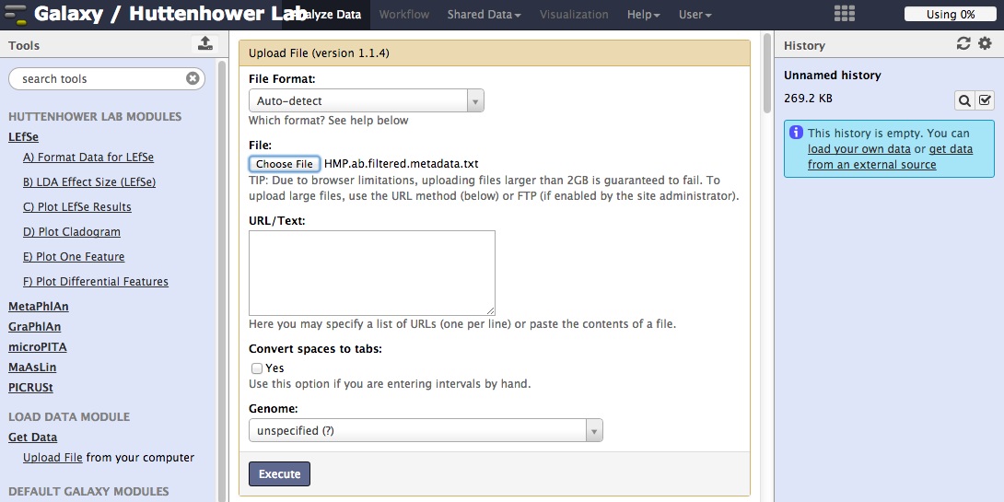
What it means: LEfSe
Then upload your formatted table
~/workshop_data/metagenomics/biobakery/results/lefse/HMP.ab.filtered.metadata.txt
After you upload, wait for the progress meter to turn green!
1. Click here, browse to HMP.ab.filtered.metadata.txt
3. Then watch here
2. Then here

Slide 53
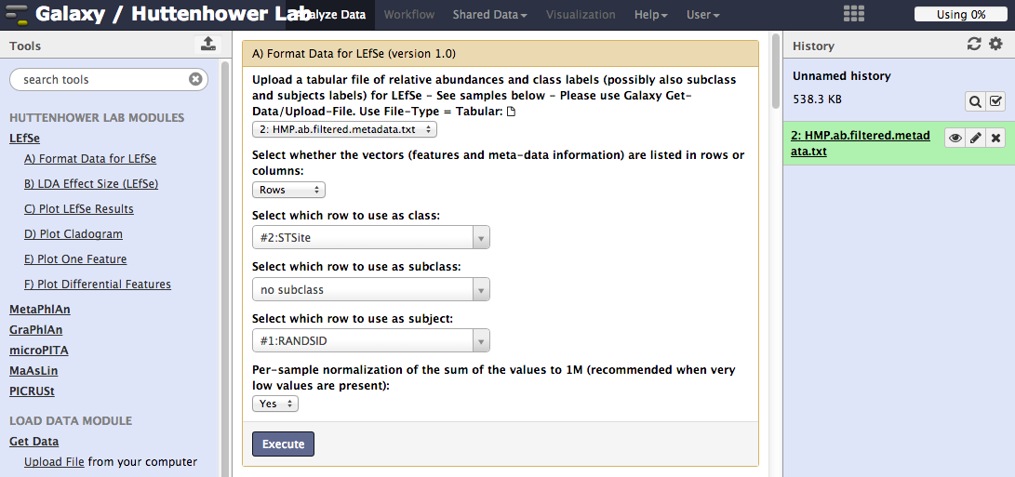
What it means: LEfSe
Then tell LEfSe about your metadata:
1. Click here
2. Then select STSite
3. Then select RANDSID
4. Then here

Slide 54
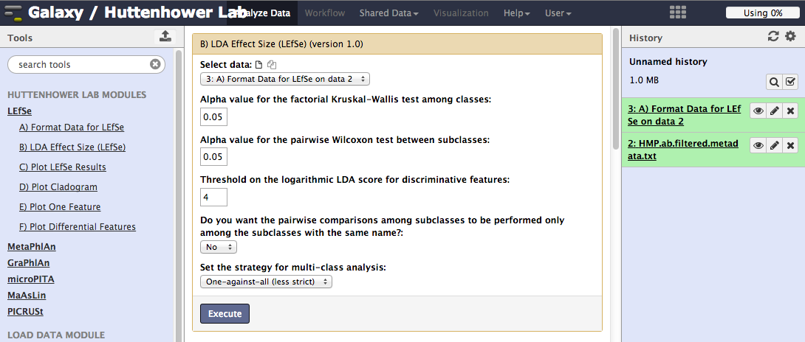
What it means: LEfSe
Then select LDA=4, “One-against-all,” and run LEfSe!
You can change other default statistical parameters if desired
1. Click here
2. Then “4” here
(finds only very extreme differences)
3. Then “one” here
(finds differences in at least one condition rather than in all conditions)
4. Then GO!

Slide 55
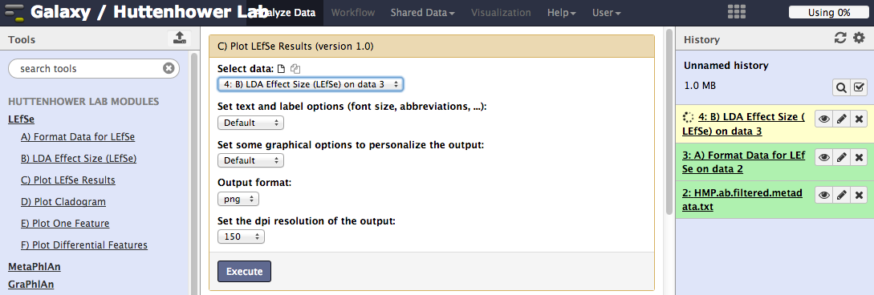
What it means: LEfSe
You can plot the results as a bar plot
Again, lots of graphical parameters to modify if desired
1. Click here
2. Then here

Slide 56
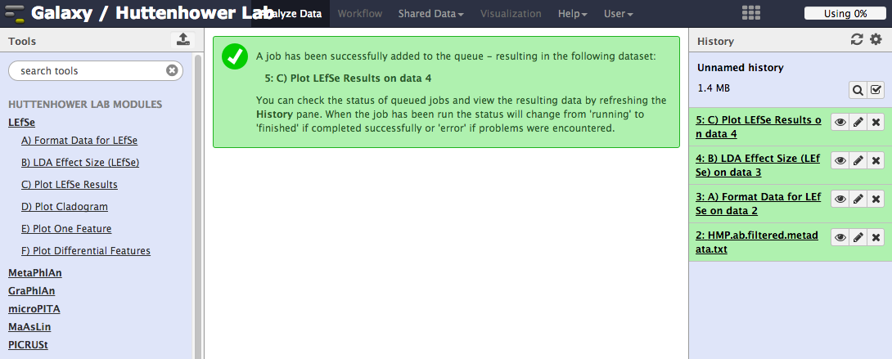
What it means: LEfSe
In Galaxy, view a result by clicking on its “eye”
Click here

Slide 57
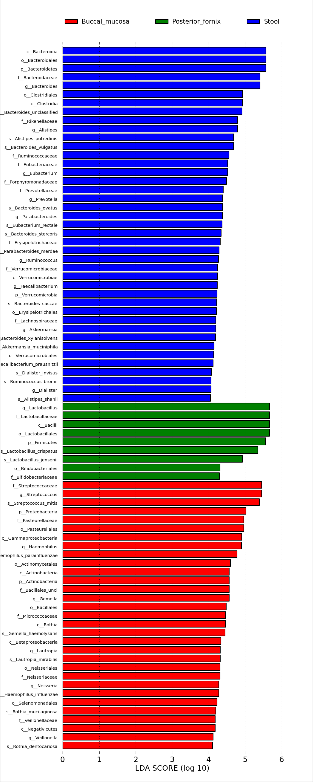
What it means: LEfSe

Slide 58
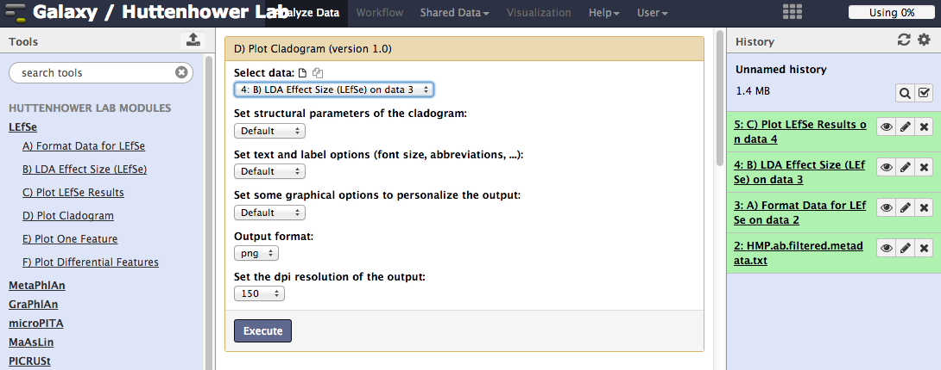
What it means: LEfSe
You can plot the results as a cladogram
Lots and lots of graphical parameters to modify if desired
1. Click here
2. Then here

Slide 59
What matters: LEfSe

Slide 60
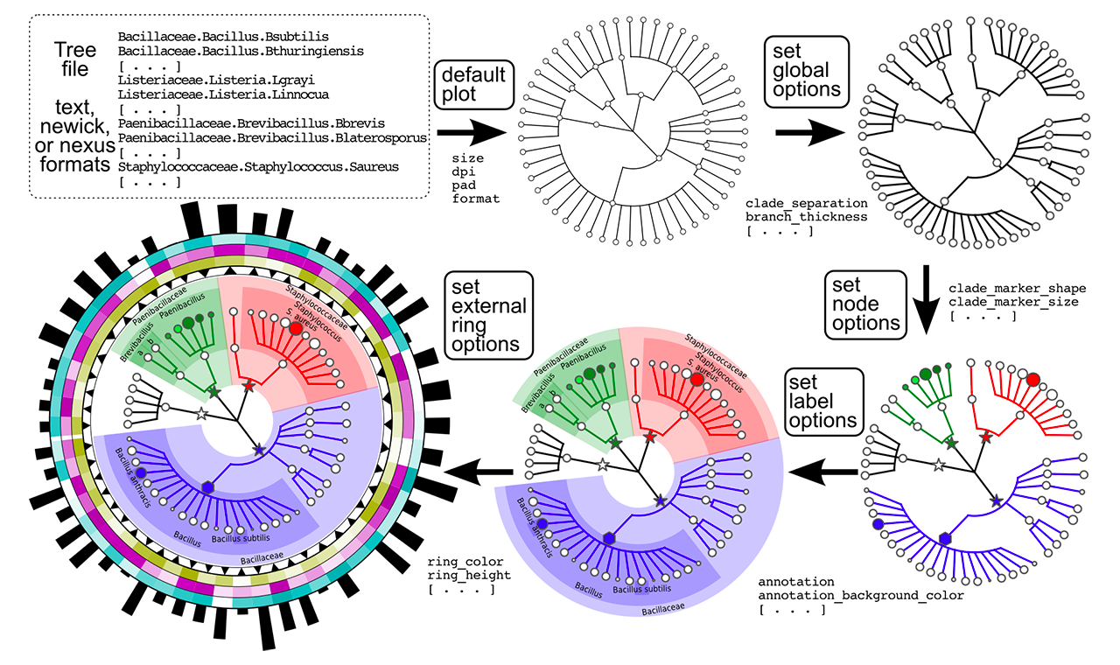
An aside: GraPhlAn
You can use this visualization for other purposes as well
Available online through Galaxy
Available offline as open source Python
http://huttenhower.sph.harvard.edu/graphlan

Slide 62
What it means: LEfSe
Finally, you can see the raw data for individual biomarkers
These are generated as a zip file of individual plots
1. Click here
2. Then selected your formatted data here
3. Then here

Slide 63
What it means: LEfSe
Click here
In Galaxy, download a result by clicking on its “disk”
Then here

Slide 64
What it means: LEfSe
Actinobacteria
Strep. mitis
Veillonellaceae

Slide 65
Summary
MetaPhlAn2
Evolution of MetaPhlAn1
Viruses, euks, subspecies, speed
And a LOT more reference data!
Raw metagenomic reads in
Tab-delimited species relative abundances out
LEfSe
Tab-delimited, stratified relative abundances in
Significantly differentially abundant features out

Slide 66
Thanks!
http://huttenhower.sph.harvard.edu
Human Microbiome Project 2
Lita Procter
Jon Braun
Dermot McGovern
Subra Kugathasan
Ted Denson
Janet Jansson
Bruce Birren
Chad Nusbaum
Clary Clish
Joe Petrosino
Thad Stappenbeck
Alex Kostic
Levi Waldron
Xochitl Morgan
Tim Tickle
Daniela Boernigen
Lauren McIver
Dirk Gevers
Human Microbiome Project
George Weingart
Emma Schwager
Eric Franzosa
Boyu Ren
Tiffany Hsu
Jane Peterson
Sarah Highlander
Barbara Methe
Karen Nelson
George Weinstock
Owen White
Ali Rahnavard
Ramnik Xavier
Ayshwarya Subramanian
Jim Kaminski
Regina Joice
Koji Yasuda
Kevin Oh
Galeb Abu-Ali
Wendy Garrett
Nicola Segata
Gautam Dantas
Molly Gibson
Afrah Shafquat
Randall Schwager
Chengwei Luo
Keith Bayer
Moran Yassour
Alexandra Sirota
Andy Chan
Katherine Lemon
Brendan Bohannan
James Meadow

