Slide 1
Meta’omic functional profiling with ShortBRED
Curtis Huttenhower
09-19-15
Harvard School of Public Health
Department of Biostatistics
U. Oregon

Slide 2
The two big questions…
Who is there?
(taxonomic profiling)
What are they doing?
(functional profiling)

Slide 3
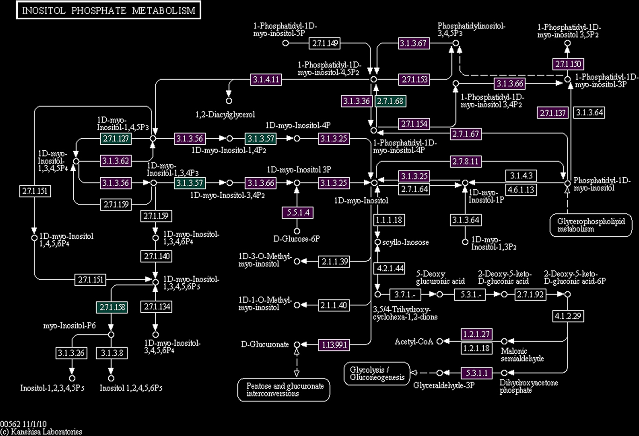
(What we mean by “function”)

Slide 4
HUMAnN
HMP Unified Metabolic Analysis Network
Short reads + protein families
Translated BLAST search
A₁
A₂
A₃
B₁
B₂
C₁
C₂
C₃
Weight hits by significance
Sum over families
Adjust for sequence length
Repeat for each metagenomic
or metatranscriptomic sample

Slide 5
HUMAnN
HMP Unified Metabolic Analysis Network
Millions of hits are collapsed into
thousands of gene families (KOs)
(still a large number)
Map genes to KEGG pathways modules
Use MinPath (Ye 2009) to find simplest pathway explanation for observed genes
?
Remove pathways unlikely to be present due to low organismal abundance
Smooth/fill gaps
Collapsing KO abundance into KEGG module abundance (or presence/absence)
yields a smaller, more tractable feature set

Slide 6
HUMAnN accuracy
Validated against synthetic metagenome samples
(similar to MetaPhlAn validation)
Gene family abundance and pathway presence/absence calls beat naïve best-BLAST-hit strategy

Slide 7
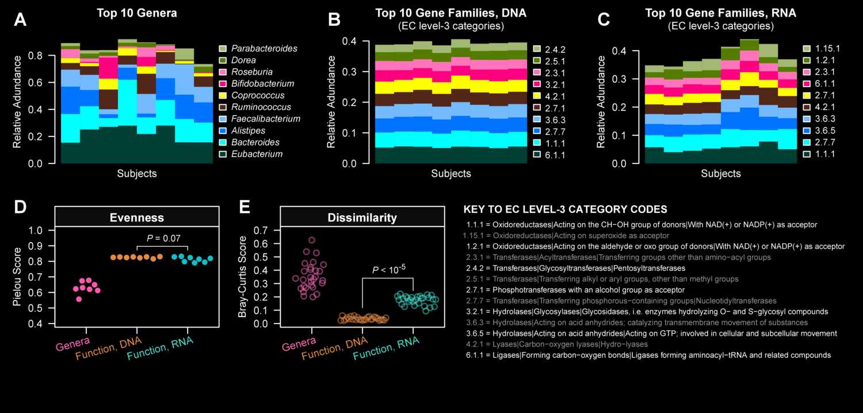
HUMAnN in action
Franzosa et al. PNAS 11:E2329-38 (2014)

Slide 8
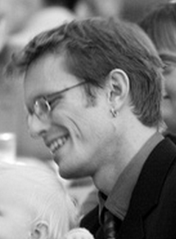
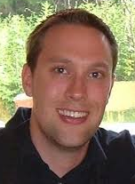
PICRUSt: Inferring community metagenomic potential from marker gene sequencing
With Rob Knight, Rob Beiko
Seq. genomes
Gene families in median HMP stool sample
One can recover general community function with reasonable accuracy from 16S profiles.
http://picrust.github.com
Metagenomic abundance
16S predicted abundance
Pathways and modules
Orthologous gene families
Taxon abundances
Jesse Zaneveld
HUMAnN
Reconstructed “genomes”
Morgan Langille
Relative abundance
Notes:
PI-CRUST has been an excellent collaboration among three groups, ours, Rob Knight’s, and Rob Beiko’s, with the goal being to relate 16S-based taxonomic profiles with metabolic or functional profiles as might be recovered from shotgun metagenomic data. If you consider a 16S profile to identify the relative abundances of organisms from without a phylogenetic tree, often an exact reference genome is available that can quite specifically identify the functional potential of an organism. Sometimes a nearby genome is available instead, allowing an educated guess, and sometimes a more complex ancestral state reconstruction is needed to determine the most likely functional profile of an organism. Given such ancestral state reconstructions with appropriate confidence intervals, however, each reconstruction’s gene catalog can then be “multiplied” by the corresponding organism’s 16S abundance to infer community gene abundances. I honestly never expected this to work well, but when comparing inferred and real gene abundance profiles in communities from the HMP where both are available, the reconstruction actually performs remarkably well, even when I don’t cherry pick just the best few examples to show you. Morgan Langille from Rob Beiko’s group has an excellent poster detailing this process, and what it means in our context of IBD is that we can reasonably accurately go from 16S organismal abundances to gene family abundances, which can then be reconstructed into pathways using the same HUMAnN tool mentioned earlier for metagenomes.

Slide 9
What’s there: ShortBRED
Jim Kaminski
ShortBRED is a tool for quantifying protein families in metagenomes
Short Better REad Dataset
Inputs:
FASTA file of proteins of interest
Large reference database of protein sequences (FASTA or blastdb)
Metagenomes (FASTA/FASTQ nucleotide files)
Outputs:
Short, unique markers for protein families of interest (FASTA)
Relative abundances of protein families of interest in each metagenome (text file, RPKM)
Compared to BLAST (or HUMAnN), this is:
Faster
More specific

Slide 10
What’s there: ShortBRED algorithm
Cluster proteins of interest into families
Record consensus sequences
Identify and common areas among proteins
Compared against each other
Compared against reference database
Remove all of these
Remaining subseqs. uniquely ID a family
Record these as markers for that family

Slide 11
What’s there: ShortBRED marker identification
Prots of
interest
Reference
database
Cluster into
families
Identify short,
common regions
True Marker
Junction Marker
Quasi Marker

Slide 12
What’s there: ShortBRED family quantification
Metagenome
reads
Translated search for
high ID hits
Normalize
relative abundances
ShortBRED
markers

Slide 13
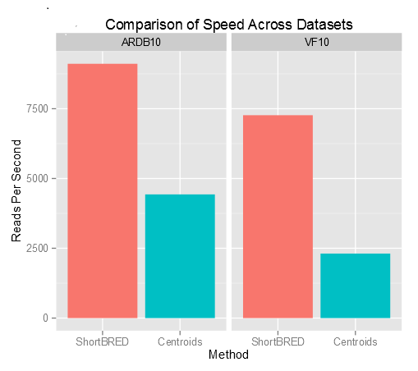
What’s there: ShortBRED’s fast
Six synthetic metagenomes from GemSim, spiked with known proteins of interest:
ARDB = Antibiotic Resistance
VFDB = Virulence Factors

Slide 14
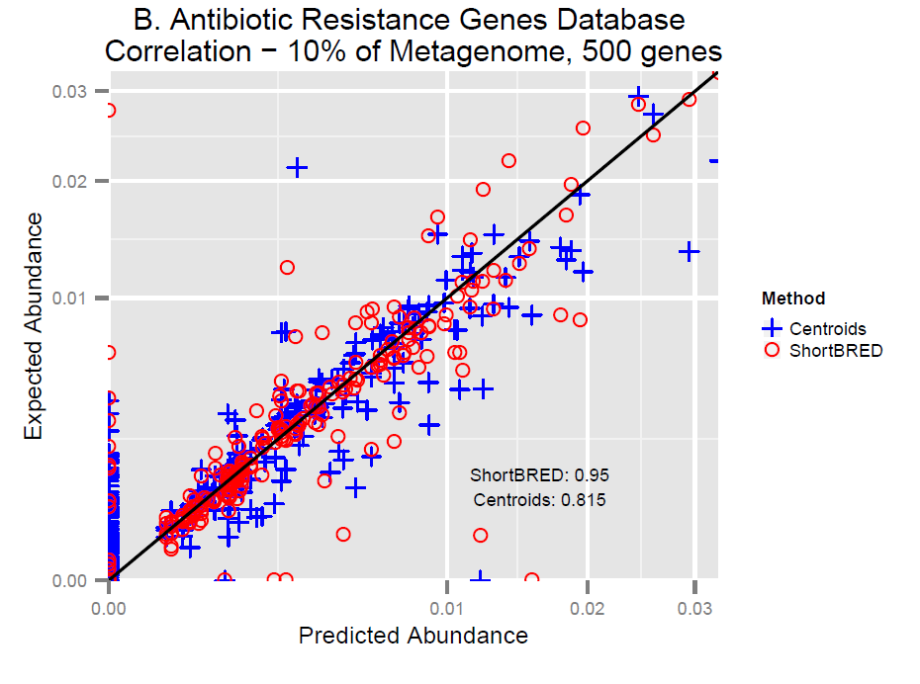
What’s there: ShortBRED’s accurate
Six synthetic metagenomes from GemSim, spiked with known proteins of interest:
ARDB = Antibiotic Resistance
VFDB = Virulence Factors

Slide 15
Setup notes reminder
Slides with green titles or text include instructions not needed today, but useful for your own analyses
Keep an eye out for red warnings of particular importance
Command lines and program/file names appear in a monospaced font.
Commands you should specifically copy/paste are in monospaced bold blue.

Slide 16
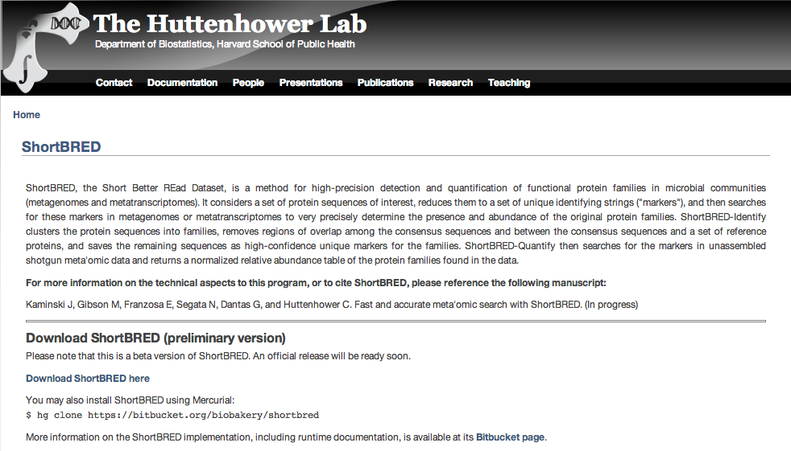
What’s there: ShortBRED
ShortBRED is available athttp://huttenhower.sph.harvard.edu/shortbred
You could download ShortBRED by clicking here

Slide 17
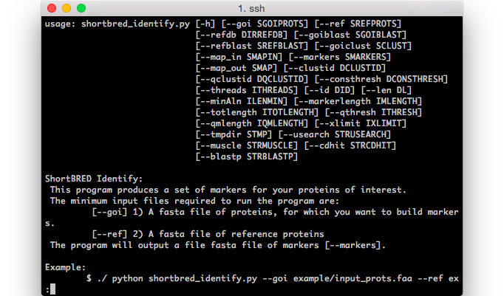
From the command line...
But don’t!
Instead, we’ve installed ShortBRED already for you
To see what you can do, run:
shortbred_identify.py -h | less
shortbred_quantify.py -h | less

Slide 18
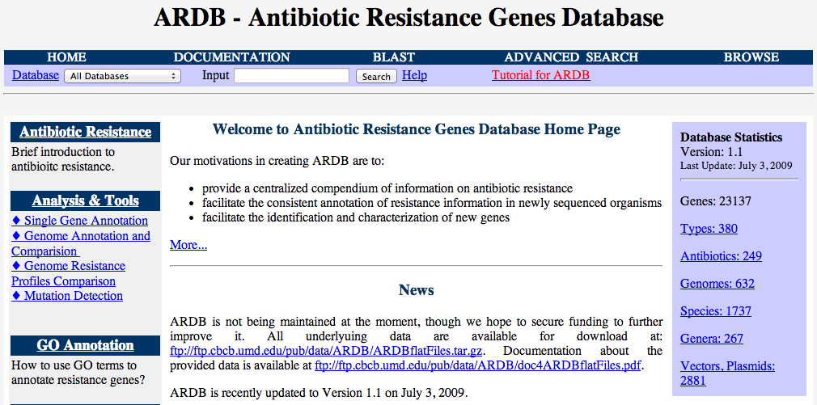
Getting some annotated protein sequences
You could download the ARDB protein sequences here
Go to http://ardb.cbcb.umd.edu

Slide 19
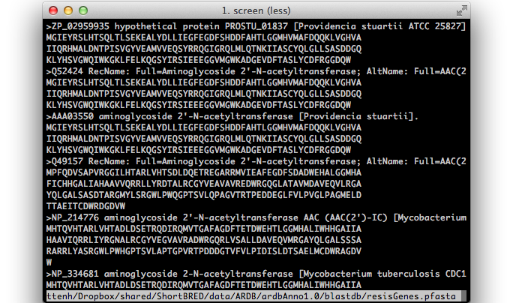
From the command line...
But don’t!
Instead, we’ve downloaded the important file for you
Take a look by running:
less ~/workshop_data/metagenomics/biobakery/data/resisGenes.pfasta

Slide 20
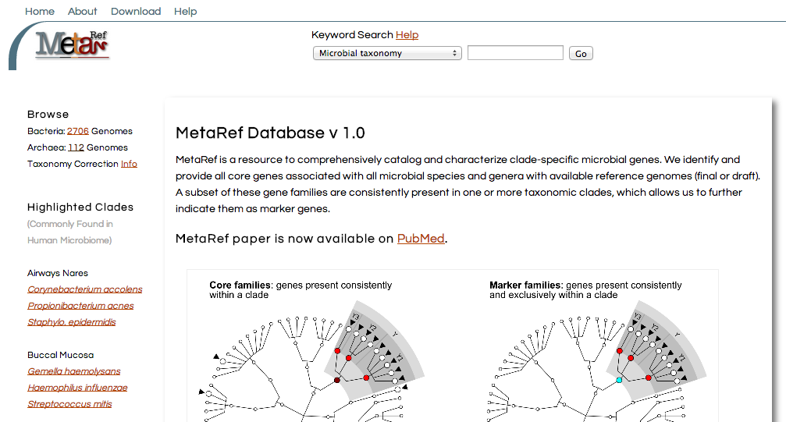
Getting some reference protein sequences
Go to http://metaref.org
You could download the MetaRef protein sequences here

Slide 21
Running ShortBRED-Identify
But don’t!
We’ll use an example mini reference database for speed
Lets make some antibiotic resistance markers by running:
ln -s /usr/bin/cdhit /home/ubuntu/Programs/cd-hit
shortbred_identify.py --goi ~/workshop_data/metagenomics/biobakery/data/resisGenes.pfasta --ref ~/workshop_data/metagenomics/biobakery/software/shortbred/example/ref_prots.faa --markers ardb_markers.faa
less ardb_markers.faa
This should take ~5 minutes
If you get bored waiting, kill it and copy:
~/workshop_data/metagenomics/biobakery/results/shortbred/ardb_markers.faa
It will produce lots of status output as it runs

Slide 22
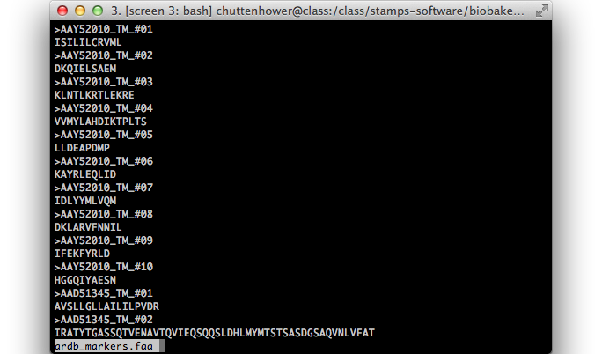
ShortBRED markers
True Markers at the top

Slide 23
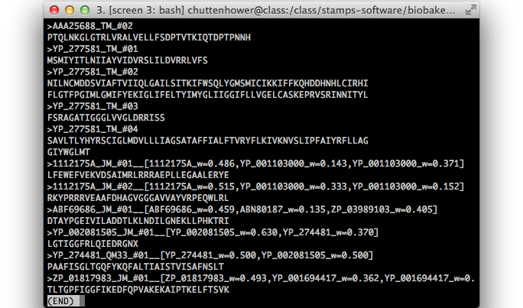
ShortBRED markers
Junction/Quasi Markers at the bottom

Slide 24
Running ShortBRED-Quantify
Using your existing HMP data subset, you can search for antibiotic resistance proteins in the oral cavity by running:
shortbred_quantify.py --markers ardb_markers.faa --wgs 763577454-SRS014472-Buccal_mucosa.fasta --results 763577454-SRS014472-Buccal_mucosa-ARDB.txt
less 763577454-SRS014472-Buccal_mucosa-ARDB.txt
This should just a few seconds
It will again produce lots of status output as it runs

Slide 25
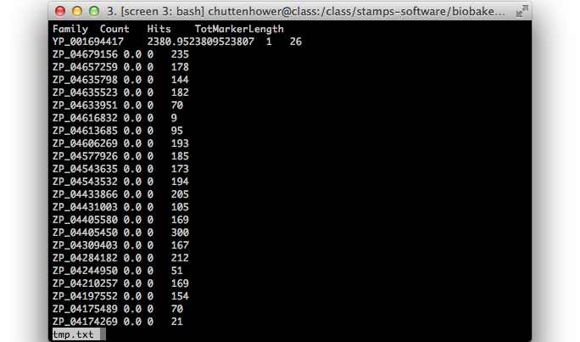
ShortBRED marker quantification
RPKMs and raw hit count
Other columns are family name and total AAs among all family makers

Slide 26
AR proteins in the human gut
That’s boring! Let’s get some real data
scp the file to your own computer (optional):
~/workshop_data/metagenomics/biobakery/data/shortbred_ardb_hmp_t2d.tsv
This is the result of running:
ShortBRED-Identify on the real ARDB + reference
ShortBRED-Quantify on the real HMP + T2D data (Qin Nature 2014)
Summing each sample’s RPKMs for families in each ARDB resistance class

Slide 27
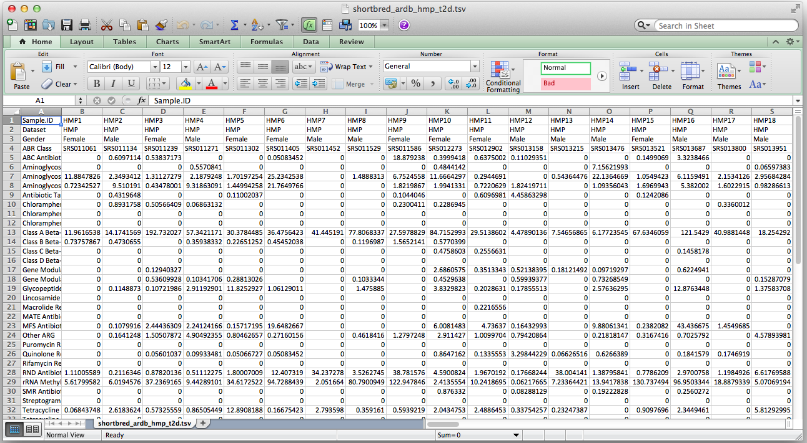
AR proteins in the human gut

Slide 28
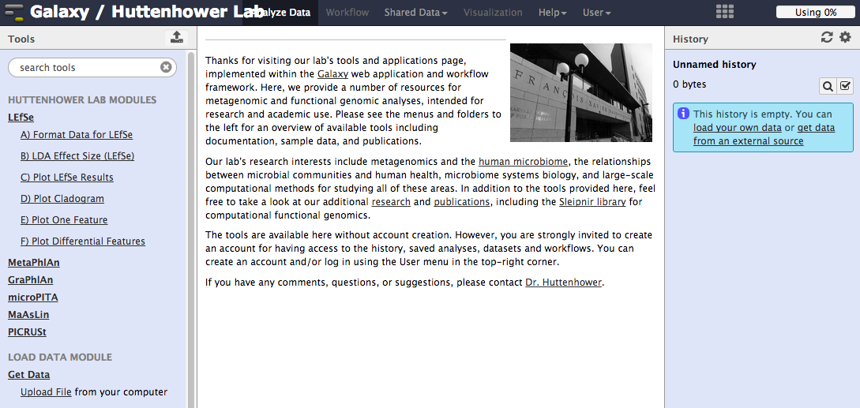
What it means: LEfSe
Visit LEfSe at: http://huttenhower.sph.harvard.edu/galaxy/
First click here

Slide 29
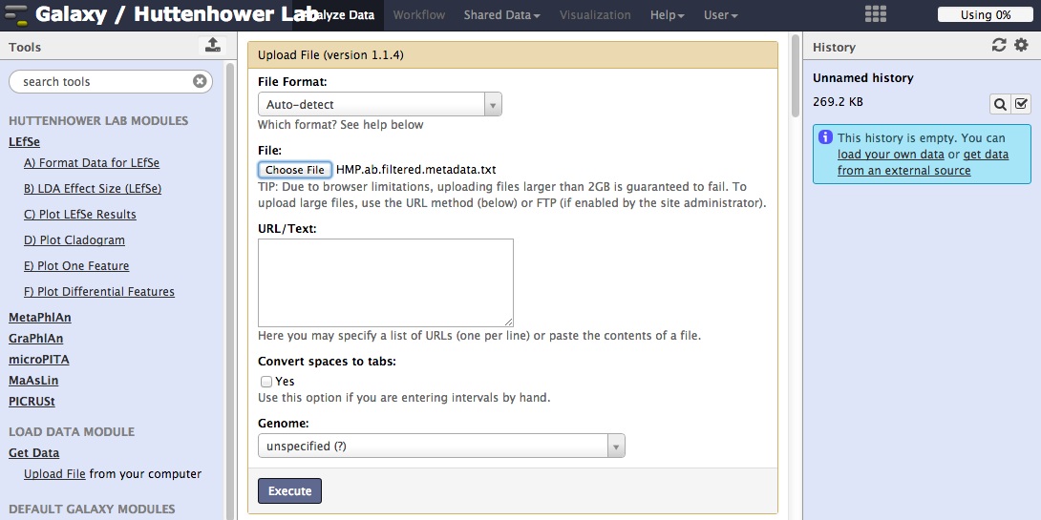
What it means: LEfSe
Then upload your formatted table
After you upload, wait for the progress meter to turn green!
1. Click here, browse to shortbred_ardb_hmp_t2d.tsv
3. Then watch here
2. Then here

Slide 30
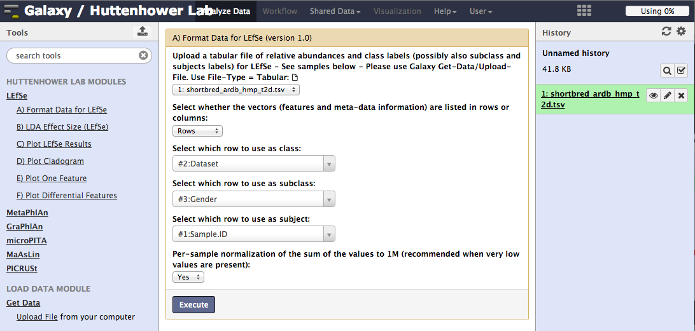
What it means: LEfSe
Then tell LEfSe about your metadata:
1. Click here
2. Then select Dataset
3. Then Gender
4. Then SampleID
5. Then click here

Slide 31
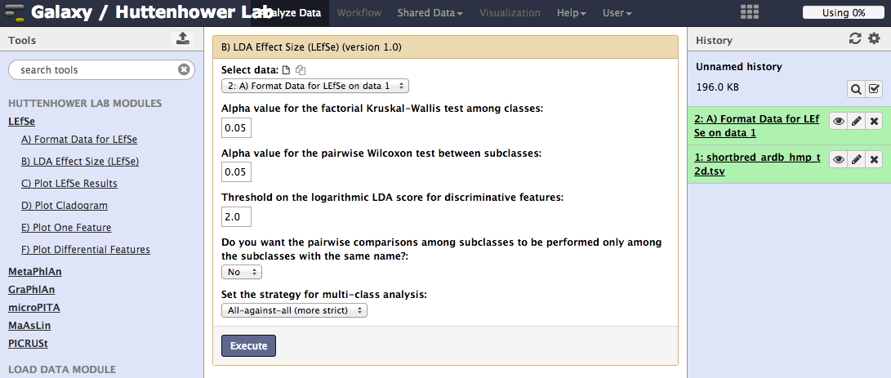
What it means: LEfSe
Leave all parameters on defaults, and run LEfSe!
You can try playing around with these parameters if desired
1. Click here
2. Then GO!

Slide 32
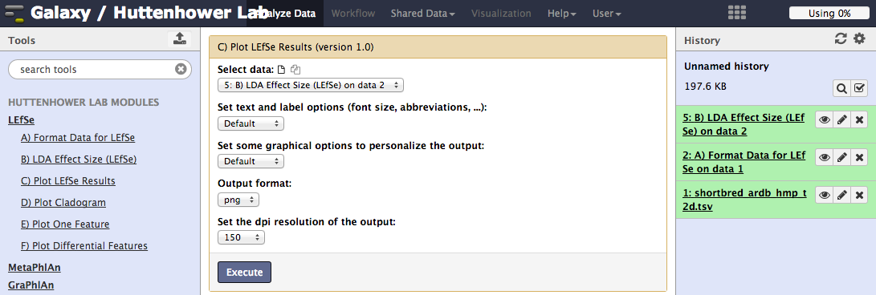
What it means: LEfSe
You can plot the results as a bar plot
Again, lots of graphical parameters to modify if desired
1. Click here
2. Then here

Slide 33
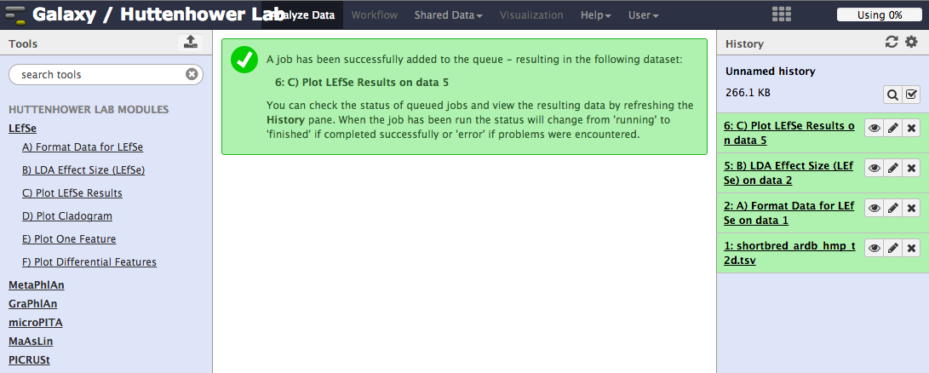
What it means: LEfSe
In Galaxy, view a result by clicking on its “eye”
Click here

Slide 34
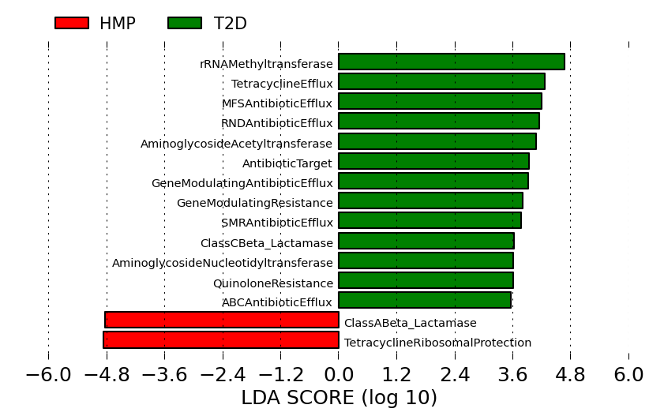
What it means: LEfSe

Slide 35
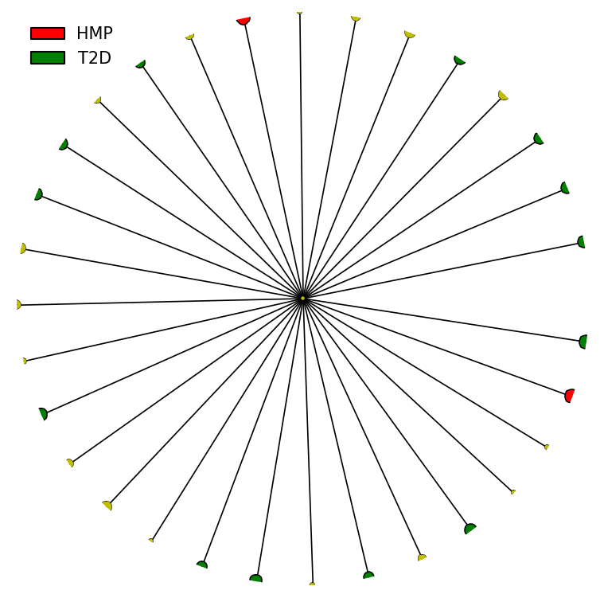
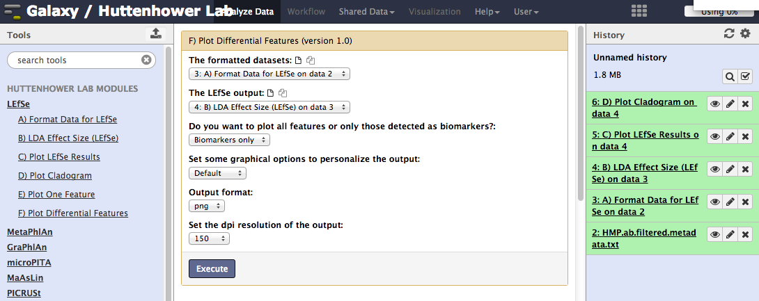
What it means: LEfSe
There’s no really any reason to plot a cladogram
Although it will work!
But you can see the raw data for individual biomarkers
These are generated as a zip file of individual plots
1. Click here
2. Then selected your formatted data here
3. Then here

Slide 36
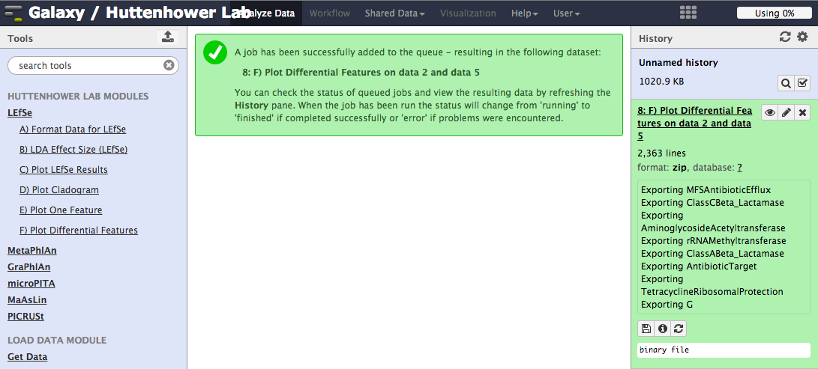
What it means: LEfSe
Click here
In Galaxy, download a result by clicking on its “disk”
Then click here

Slide 37
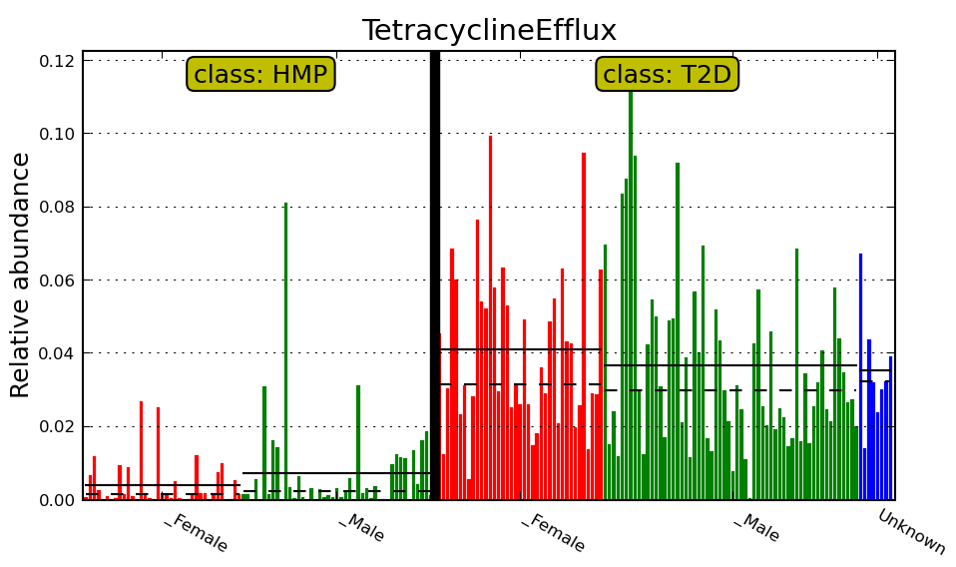
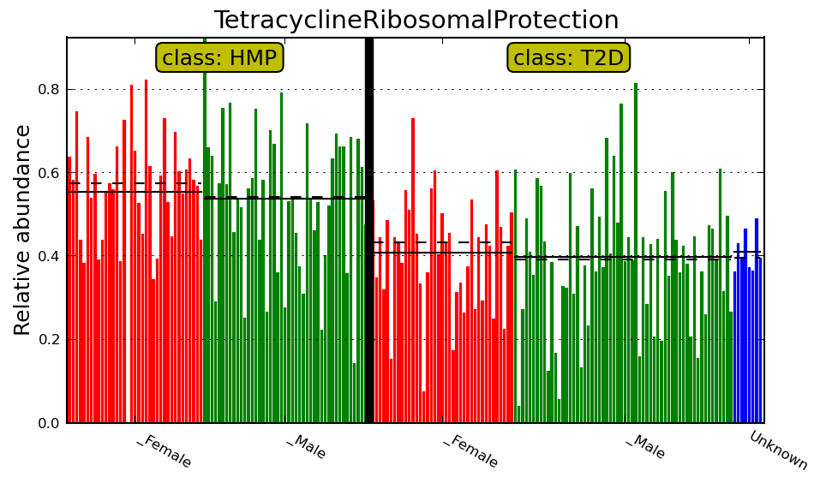
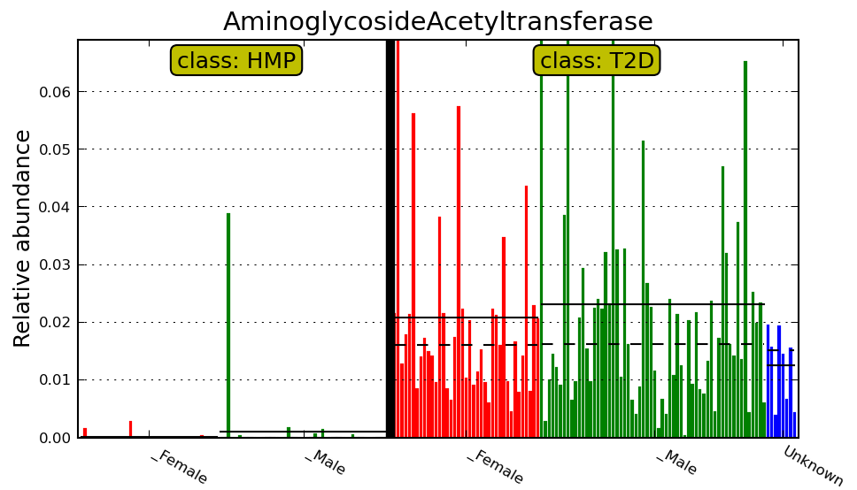
What it means: LEfSe
Tetracycline Efflux Pumps
Tet. Ribosomal Blockers
Aminoglycoside Acetyltransferases

Slide 38
Summary
HUMAnN
Quality-controlled metagenomic reads in
Tab-delimited gene, module, and pathway relative abundances out
ShortBRED
Raw metagenomic reads, Proteins of interest, and Protein reference database in
Tab-delimited gene family rel. abundances out

Slide 39
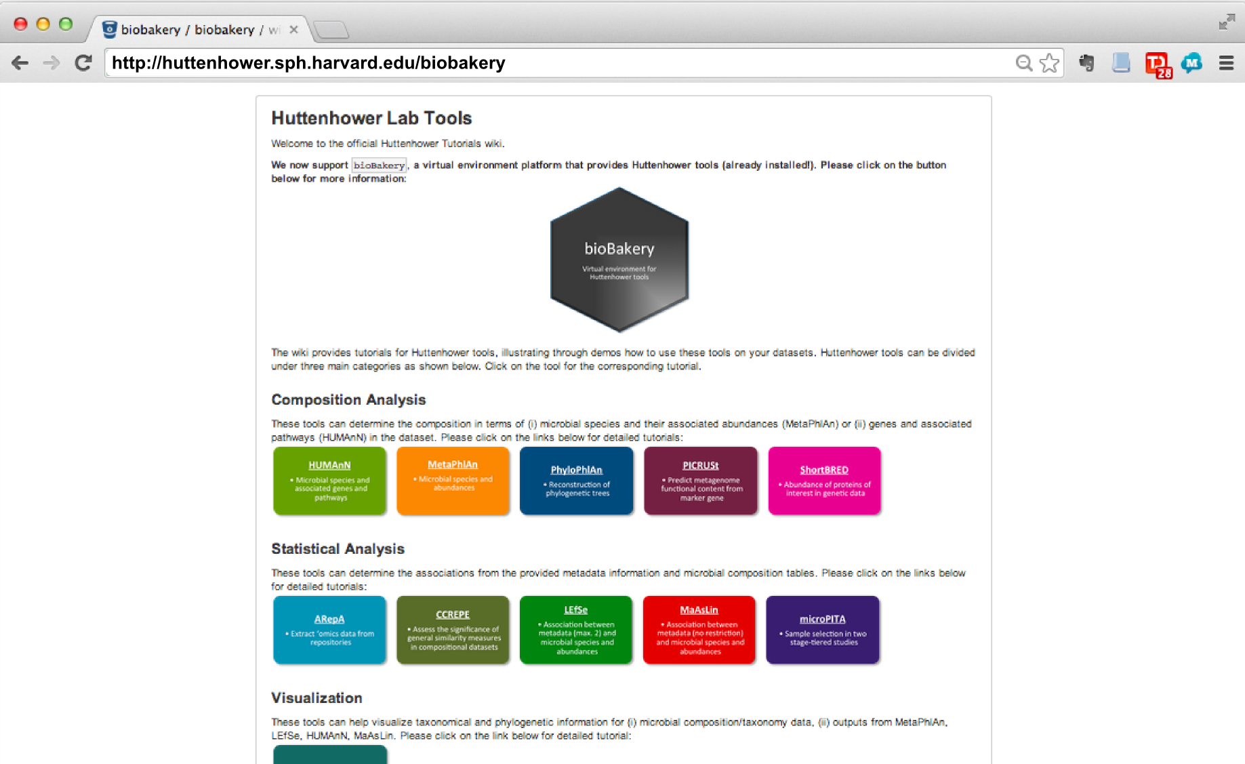

Slide 40
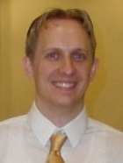
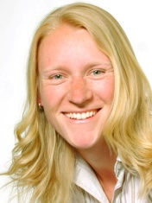
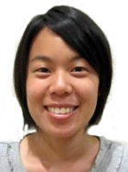
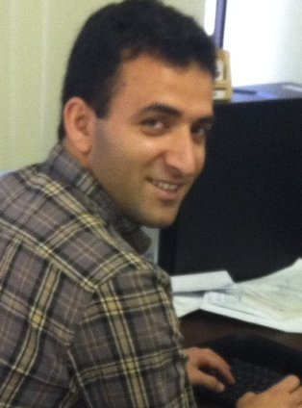
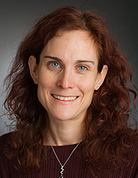
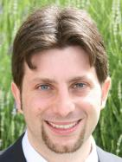
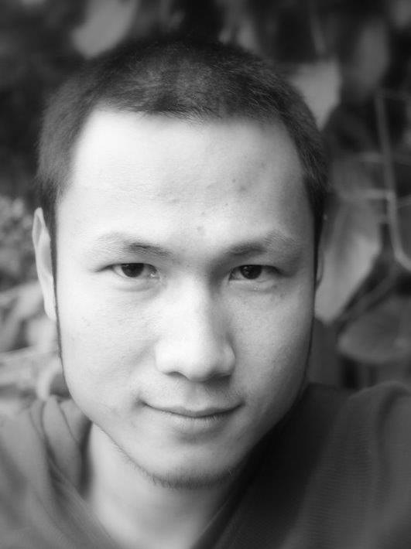
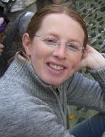
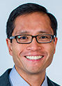
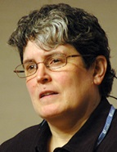
Thanks!
http://huttenhower.sph.harvard.edu
Human Microbiome Project 2
Lita Procter
Jon Braun
Dermot McGovern
Subra Kugathasan
Ted Denson
Janet Jansson
Bruce Birren
Chad Nusbaum
Clary Clish
Joe Petrosino
Thad Stappenbeck
Alex Kostic
Levi Waldron
Xochitl Morgan
Tim Tickle
Daniela Boernigen
Lauren McIver
Dirk Gevers
Human Microbiome Project
George Weingart
Emma Schwager
Eric Franzosa
Boyu Ren
Tiffany Hsu
Jane Peterson
Sarah Highlander
Barbara Methe
Karen Nelson
George Weinstock
Owen White
Ali Rahnavard
Ramnik Xavier
Ayshwarya Subramanian
Jim Kaminski
Regina Joice
Koji Yasuda
Kevin Oh
Galeb Abu-Ali
Wendy Garrett
Nicola Segata
Gautam Dantas
Molly Gibson
Afrah Shafquat
Randall Schwager
Chengwei Luo
Keith Bayer
Moran Yassour
Alexandra Sirota
Andy Chan
Katherine Lemon
Brendan Bohannan
James Meadow

