Slide 1
Meta’omic functional profiling with HUMAnN
Curtis Huttenhower
01-19-15
Harvard School of Public Health
Department of Biostatistics
U. Oregon

Slide 2
The two big questions…
Who is there?
(taxonomic profiling)
What are they doing?
(functional profiling)

Slide 3
Setup notes reminder
Slides with green titles or text include instructions not needed today, but useful for your own analyses
Keep an eye out for red warnings of particular importance
Command lines and program/file names appear in a monospaced font.
Commands you should specifically copy/paste are in monospaced bold blue.

Slide 4
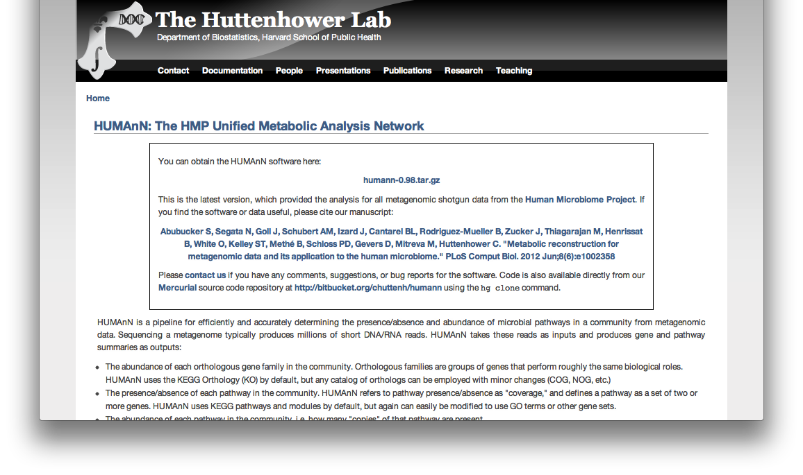
What they’re doing: HUMAnN
As a broad functional profiler, you could download HUMAnN at: http://huttenhower.sph.harvard.edu/humann
Click here

Slide 5
What they’re doing: HUMAnN
...but instead we’ve already downloaded it
Expand HUMAnN (no install!)
Cd ~/workshop_data/metagenomics
tar -xzf ~/workshop_data/metagenomics/biobakery/software/humann-v0.99.tar.gz
Set up a link to the KEGG reference DB:
ln -s ~/workshop_data/metagenomics/biobakery/data/kegg.reduced.udb
And although you would normally download USEARCH from here:
http://www.drive5.com/usearch/download.html
We’re going to use it preinstalled instead

Slide 6
What they’re doing: HUMAnN
If we weren’t all running this, you’d need to:
Get KEGG – used to be free, now it’s not!
Fortunately, we have a HUMAnN-compatible distributable version; contact me...
Index it for USEARCH:
usearch -makeudb_usearch kegg.reduced.fasta -output kegg.reduced.udb
This takes a minute or two, so we’ve precomputed it; thus, forge ahead...

Slide 7
What they’re doing: HUMAnN
Did you notice that we didn’t QC our data at all?
MetaPhlAn is very robust to junk sequence
HUMAnN is pretty robust, but not quite as much
We’ve already run a standard metagenomic QC:
Quality trim by removing bad bases (typically Q ~15)
Length filter to remove short sequences (typically <75%)

Slide 8
What they’re doing: HUMAnN
Must start from FASTQ files to do this
Quality trim by removing bad bases:
FASTX: fastx_trimmer
ea-utils: fastq-mcf
Length filter by removing short sequences:
75% of original length is standard (thus 75nt from 100nt reads)
FASTX: fastx_quality_filter
USEARCH: fastq_filter
Now convert your FASTQ to a FASTA:
FASTX: fastq_to_fasta
USEARCH: fastq_filter
Some final caveats:
If you’re using paired end reads, match filters!
See my course homeworks at http://huttenhower.sph.harvard.edu/bio508
Aren’t you glad you’re not doing this today?

Slide 9
What they’re doing: HUMAnN
Enter the humann directory and fetch the data
ln -s ~/workshop_data/metagenomics/biobakery/data/763577454-SRS014459-Stool.fasta
cd humann-0.99
Run your first translated BLAST search:
usearch -usearch_local ../763577454-SRS014459-Stool.fasta -db ../kegg.reduced.udb -id 0.8 -blast6out input/763577454-SRS014459-Stool.txt
What did you just do?
less input/763577454-SRS014459-Stool.txt
Recall BLAST’s tab-delimited output headers:
qseqid sseqid pident length mismatch gapopen qstart qend sstart send evalue bitscore
Rinse and repeat for the remaining samples

Slide 10
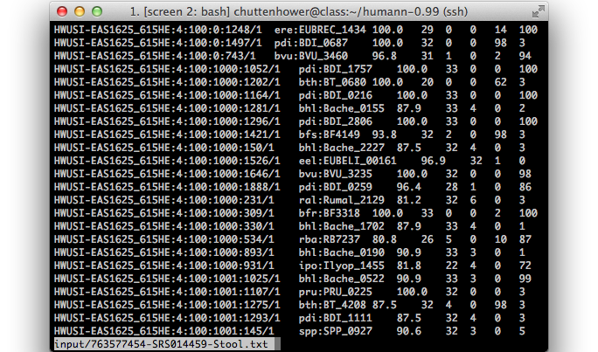
What they’re doing: HUMAnN

Slide 11
What they’re doing: HUMAnN
Normally you’d need to install SCons from:
http://www.scons.org
Instead, we’ll use it preinstalled as well, so...
GO!
~/workshop_data/metagenomics/biobakery/software/ext/scons-2.3.2/bin/scons
You should see a bunch of text scroll by
Note: you can run scons -j8 to parallelize tasks

Slide 12
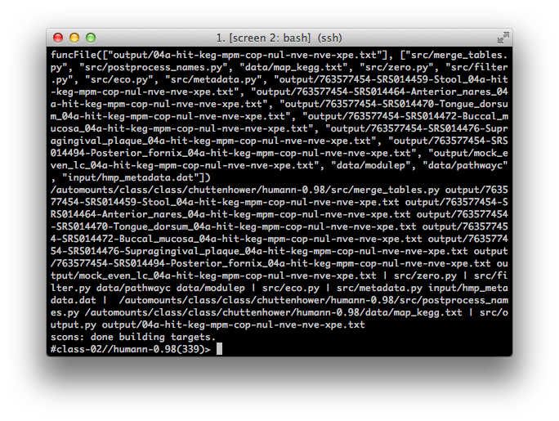
What they’re doing: HUMAnN
After a minute or two, you should see:

Slide 13
What they’re doing: HUMAnN
This has created four main files:
Two each for pathways (big) and modules (small)
Two each for coverage and relative abundance
Each is tab-delimited text with one column per sample
All four are in the output directory:
output/04a-hit-keg-mpt-cop-nul-nve-nve-xpe.txt
Coverage (a) of pathways (t)
output/04a-hit-keg-mpm-cop-nul-nve-nve-xpe.txt
Coverage (a) of modules (m)
output/04b-hit-keg-mpt-cop-nul-nve-nve.txt
Abundance (b) of pathways (t)
output/04b-hit-keg-mpm-cop-nul-nve-nve.txt
Abundance (b) of modules (m)
I almost always just use 04b-mpm (module abundances)

Slide 14
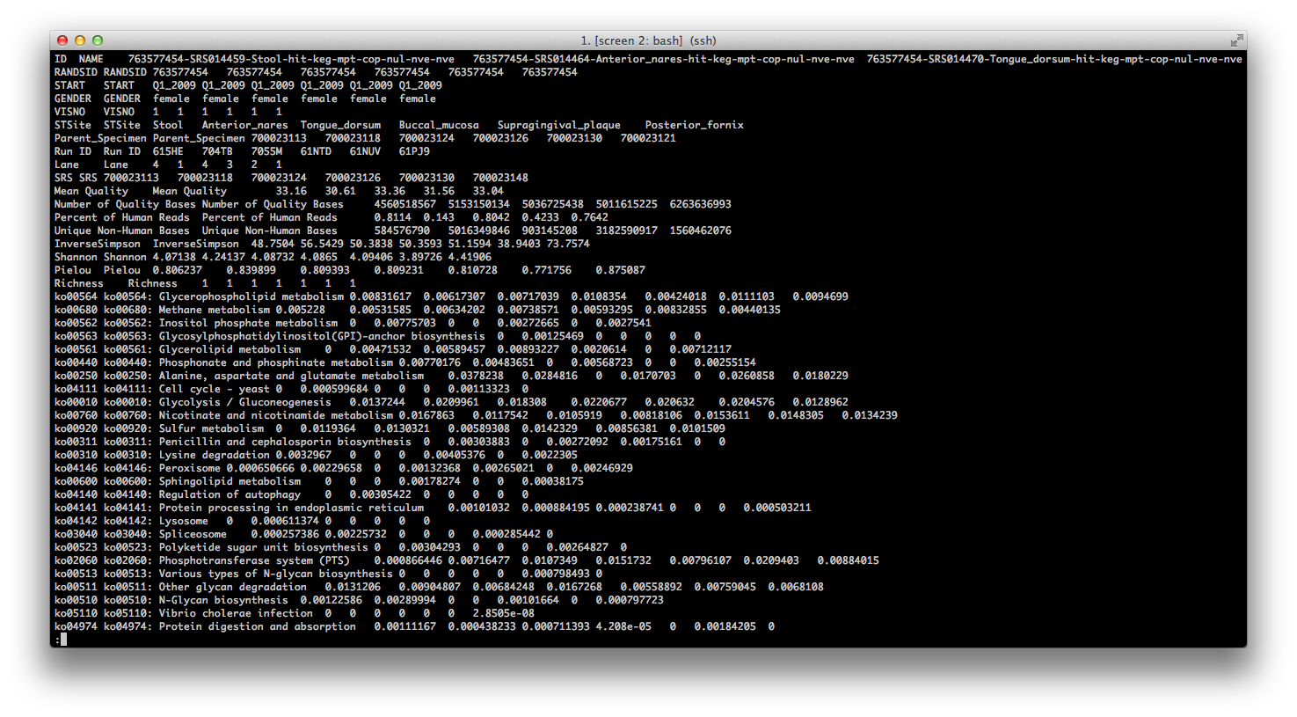
What they’re doing: HUMAnN
Let’s take a look:
less output/04b-hit-keg-mpm-cop-nul-nve-nve.txt

Slide 15
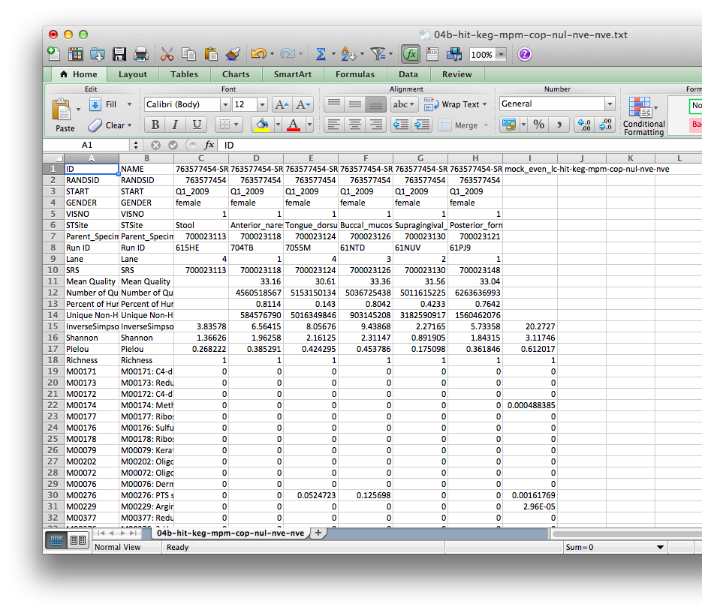
What they’re doing: HUMAnN
That’s ugly; it gets much better in Excel
Note: this is very sparse since we’re using a small subset of KEGG
Note: the mock community demo data is included on the right

Slide 16
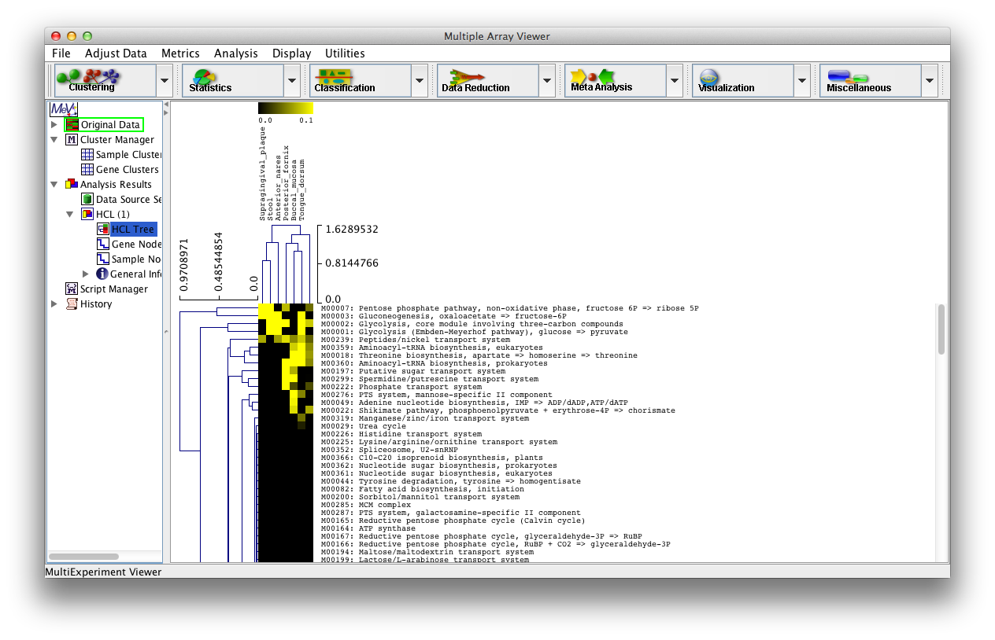
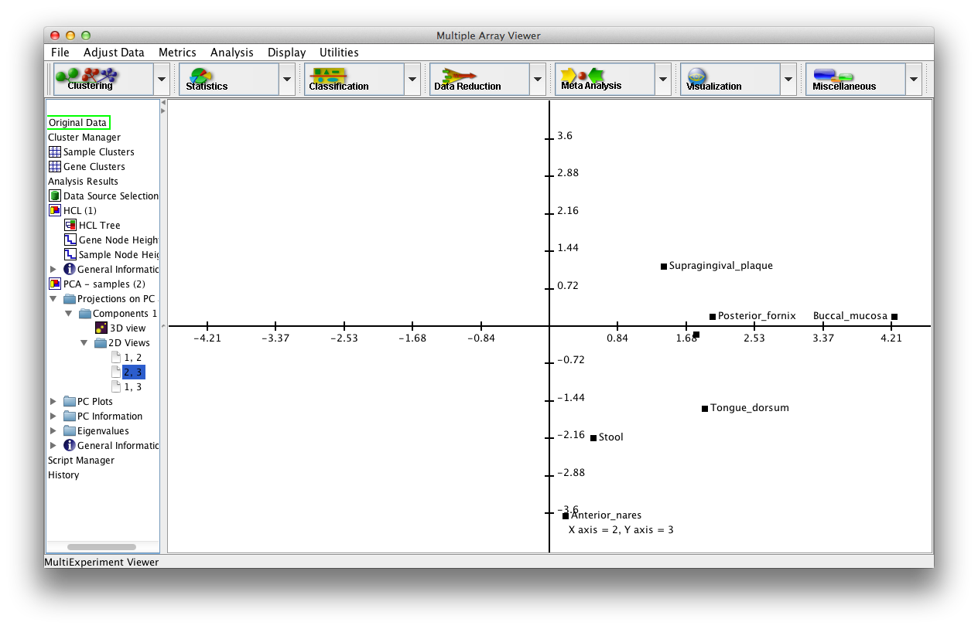
What they’re doing: HUMAnN
And there’s nothing stopping us from using MeV
Or R, or QIIME, or LEfSe, or anything that’ll read tab-delimited text

Slide 17
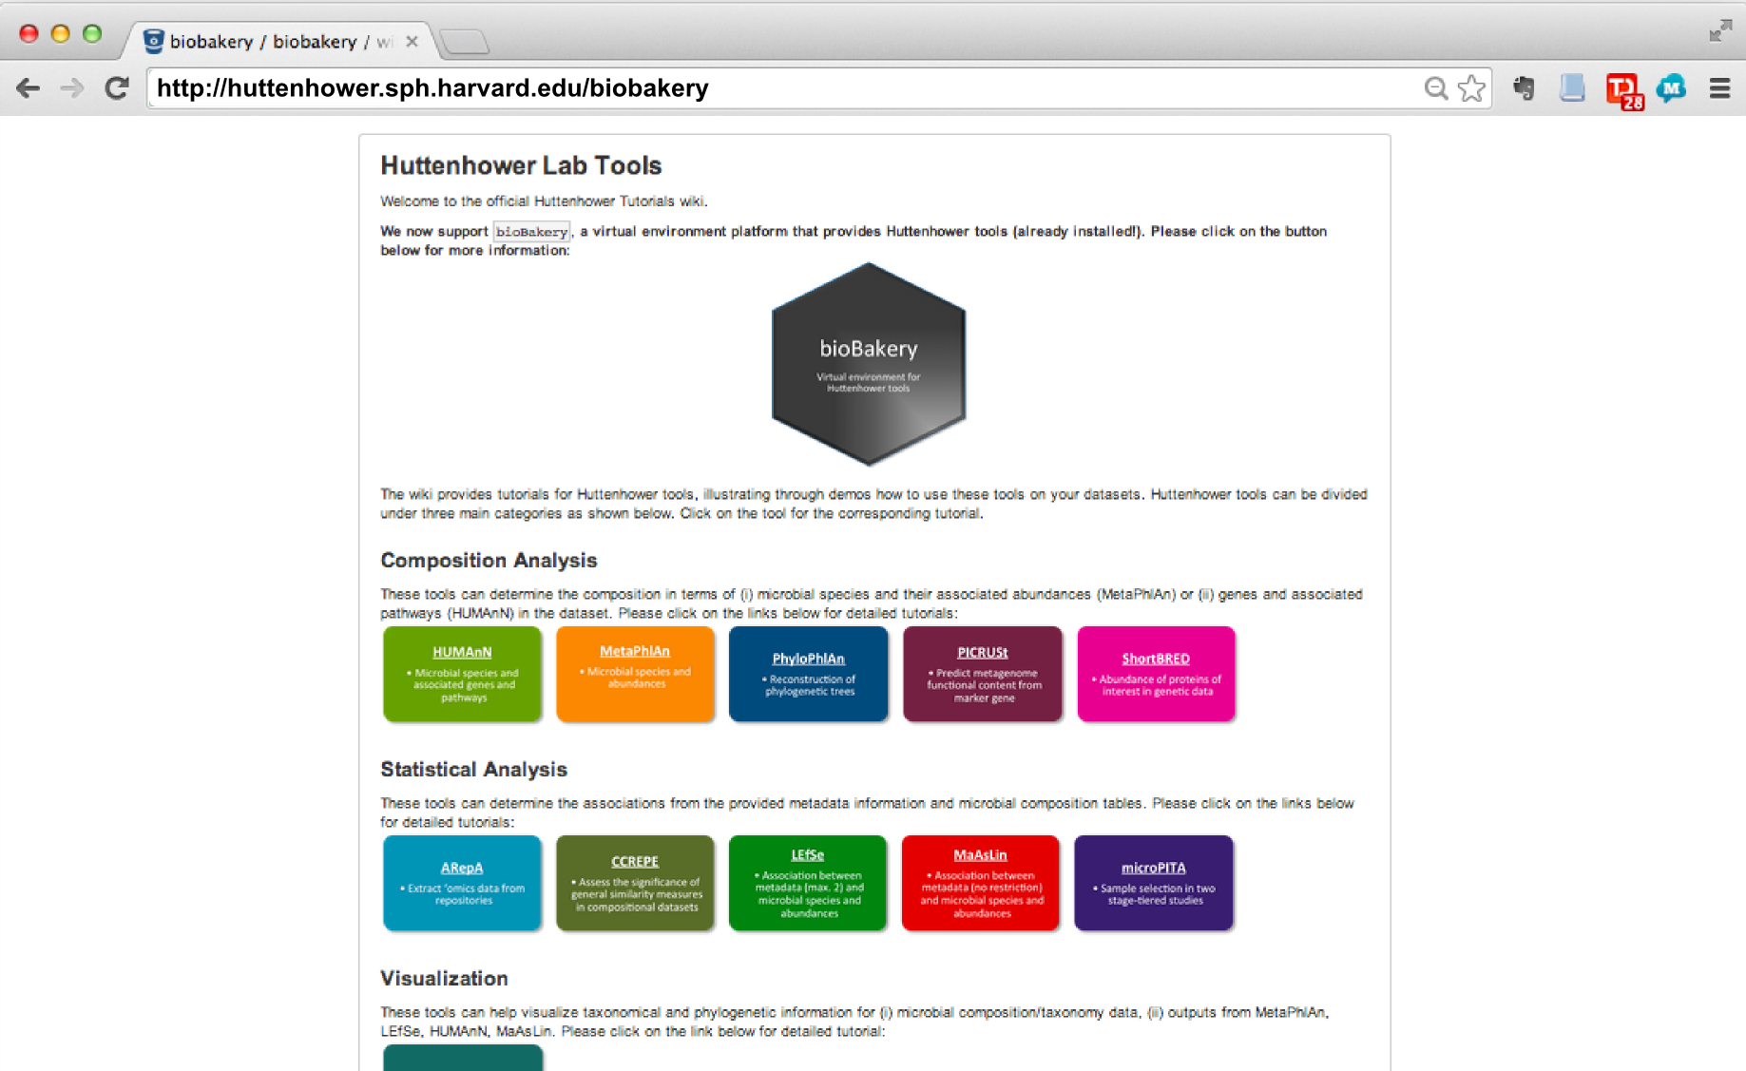

Slide 18
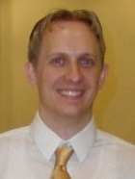
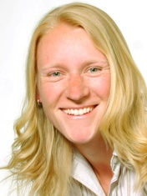
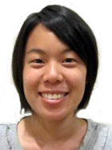
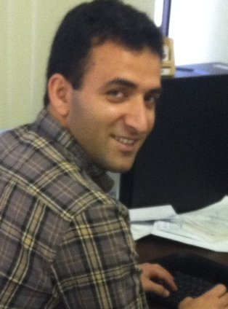
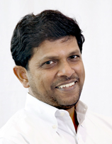
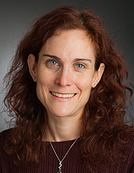
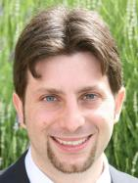
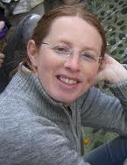
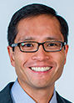
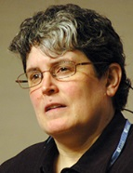
Thanks!
http://huttenhower.sph.harvard.edu
Human Microbiome Project 2
Lita Procter
Jon Braun
Dermot McGovern
Subra Kugathasan
Ted Denson
Janet Jansson
Bruce Birren
Chad Nusbaum
Clary Clish
Joe Petrosino
Thad Stappenbeck
Alex Kostic
Levi Waldron
Xochitl Morgan
Tim Tickle
Daniela Boernigen
Lauren McIver
Dirk Gevers
Human Microbiome Project
George Weingart
Emma Schwager
Eric Franzosa
Boyu Ren
Tiffany Hsu
Jane Peterson
Sarah Highlander
Barbara Methe
Karen Nelson
George Weinstock
Owen White
Ali Rahnavard
Ramnik Xavier
Ayshwarya Subramanian
Jim Kaminski
Regina Joice
Koji Yasuda
Kevin Oh
Galeb Abu-Ali
Wendy Garrett
Nicola Segata
Gautam Dantas
Molly Gibson
Afrah Shafquat
Randall Schwager
Chengwei Luo
Keith Bayer
Moran Yassour
Alexandra Sirota
Andy Chan
Katherine Lemon
Brendan Bohannan
James Meadow

