Slide 1
An introduction to shotgun metagenomics
Matt Hayward
Postdoctoral Fellow in the Kwon lab,
Ragon Institute of MGH, MIT and Harvard
12th October 2018 Durban, SA
mhayward2@mgh.harvard.edu

Slide 2
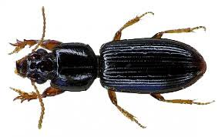
My academic path
Entomologist
Microbiologist
Computational biologist

Slide 3
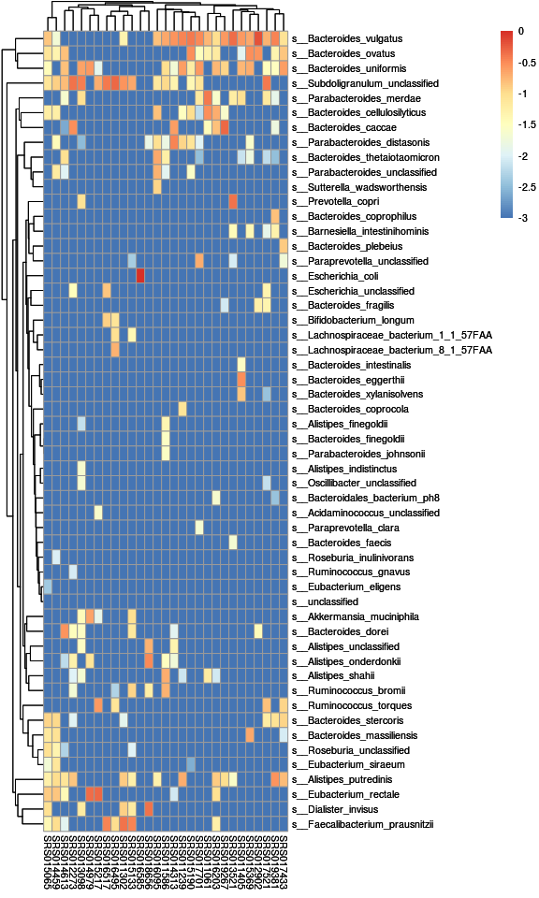
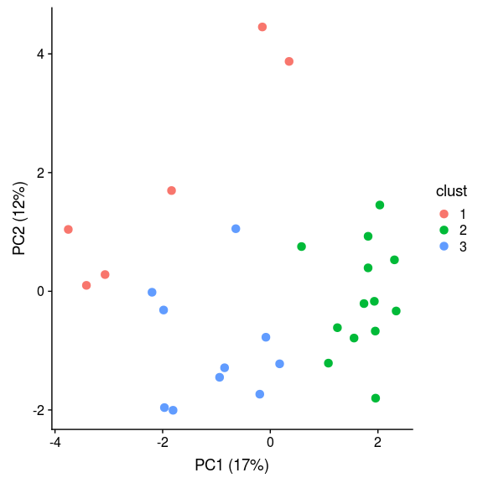
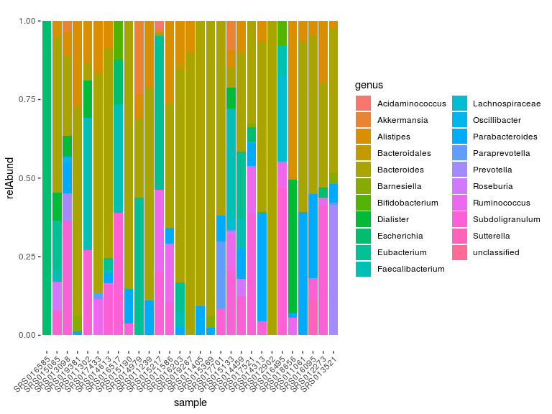
Outline
What is shotgun metagenomic sequencing and how does it differ from 16S?
Interactive session
Case study: The microbiome of the female genital tract, inflammation and HIV acquisition risk
SSSSSSSSSSSSSSSSS

Slide 4
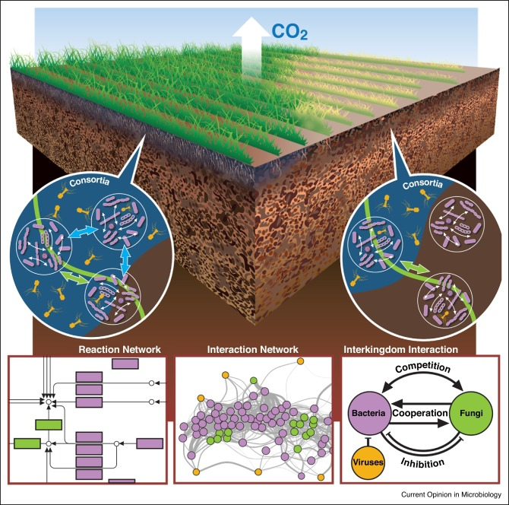
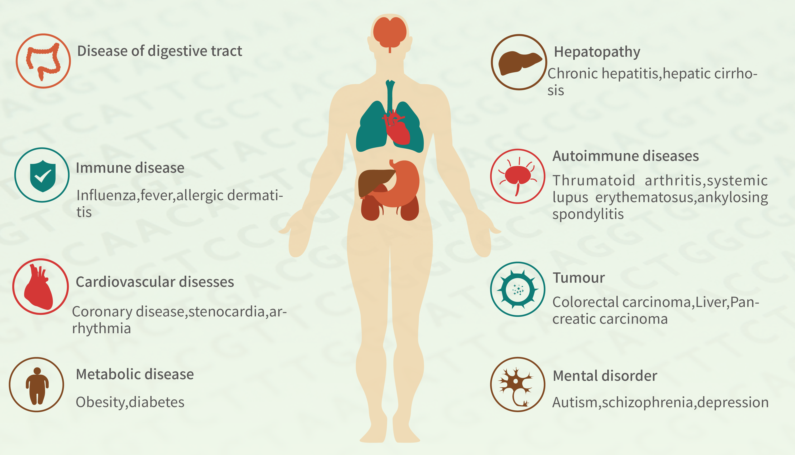
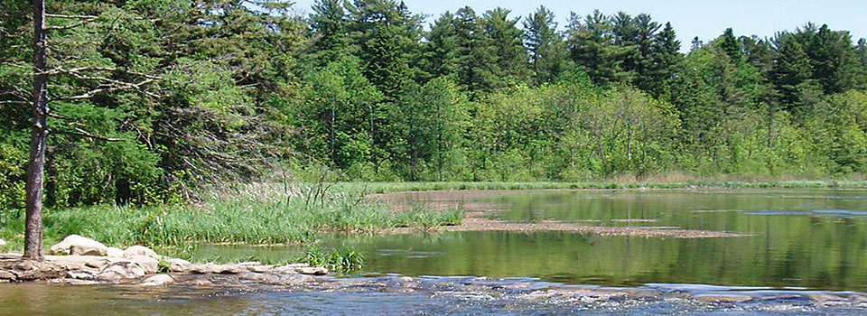
So why might we want to do metagenomics?
www.grandomics.com
http://www.mississippi-metagenome-project.umn.edu/

Slide 5
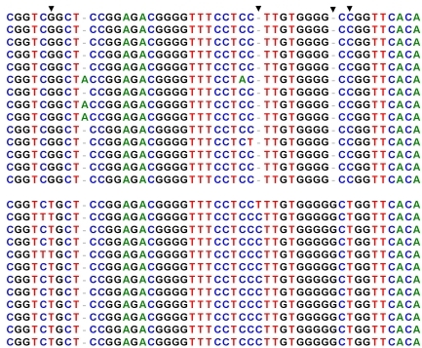
What do we mean by shotgun and how does it differ from 16S?
Clean, blunt ended alignments
Microbial genome
Targeted excision of a single universal piece of DNA
V4: 255bps
16S sequencing

Slide 6
What do we mean by shotgun and how does it differ from 16S?
Alignment to reference sequences (indels, gaps…) or de novo assembly
Microbial genome
Non-targeted sequencing of DNA fragments
Shotgun (WGS) sequencing

Slide 7
Benefits of 16S
16S
16S | Shotgun
A single taxonomic unit | Random genome fragments
Reagent contamination | Reagent and human contamination
20,000 reads is good | 60,000,000 reads is OK
Cheap | Very expensive
Analysis is standardised | Analysis is bespoke
Analysis on PC | Analysis on Computing Cluster
Microbial genome
$18
Shotgun
Microbial genome
$300
R
Python
Perl
C

Slide 8
Shotgun achieves higher taxonomic resolution then 16s
Kingdom
16s (QIIME 1)
Shotgun
Phylum
Class
Order
Bacterial taxon associations
Universal Functions
Family
Genus
16s (ASVs)
Person specific strains
Strain tracking
Functional inference
Species
Sub-species
Strain

Slide 9
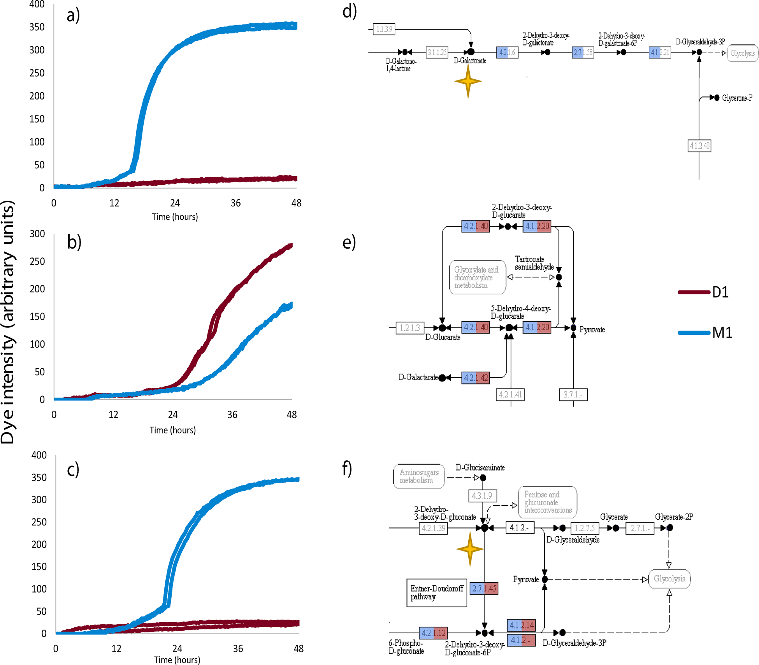
Why does this matter? (metabolism)
Salmonella enterica subspecies enterica
Limit of 16s
There is a lot of functional diversity below the species-level
Metabolism matters when designing probiotics and prebiotics
Hayward et al 2013
Hayward et al 2015

Slide 10
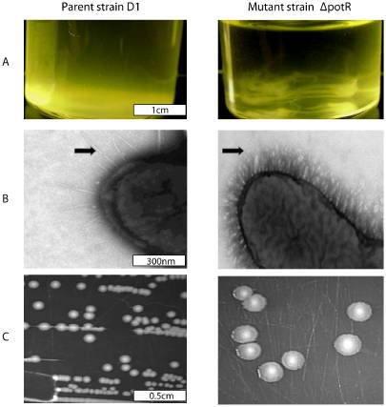
Why does this matter? (virulence)
Salmonella enterica subspecies enterica serovar Derby
L1
L2
Limit of 16s
L1
L2
Hayward et al 2016
Hayward et al 2014

Slide 11
Summary to part 1
If you are looking for microbial associations
your samples have a lot of contamination
And you have limited funds/computational resources
SSSS
SSSS
SSSS
SSSS
If you are looking to make functional associations
Track strains
Explore functional diversity

Slide 12
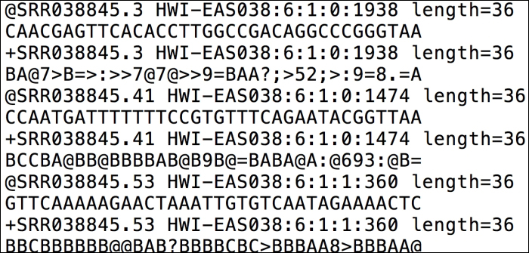
Interactive session: From reads to results in just 1.5 hours

Slide 13
Aims
Using publicly available shotgun metagenome sequences:
Determine the species composition of these samples
Produce an abundance table
Visualise the results

Slide 14
Data
Stool metagenomic sequences
30 samples from 30 healthy North Americans
Reads were quality trimmed
Human reads were removed by mapping to the human genome
Human Microbiome Project
HMP, Nature 2012

Slide 15
Python
All my scripts are written in either Python or R
Python is another language much like R and Unix (though much friendlier)
Here are some resources to begin your journey:
http://mechanicalmooc.org/
https://pythonforbiologists.com/
https://www.codecademy.com/catalog/language/python
https://www.datacamp.com/

Slide 16
Open Rmarkdown (Rmd)

Slide 17
Set working directory

Slide 18
Make a folder structure
Before
Sequences are in the temp_sequences directory
Click this
1.
3.
After
“sample_file” contains a list of the sample names
2.
Each sample now has it’s own folder and it’s sequences have been moved in to it
Rmd works out the language

Slide 19
The metaphlan2 approach to taxonomic profiling
Metaphlan2 is the leading method for identifying the microbial composition of shotgun metagenome samples
It can identify microbes at all taxonomic levels from Kingdom down to sub-species
Metaphlan2 is reference dependent
A genome must exist for a microbe to be identified in a sample

Slide 20
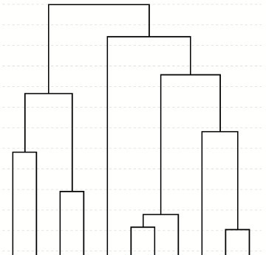
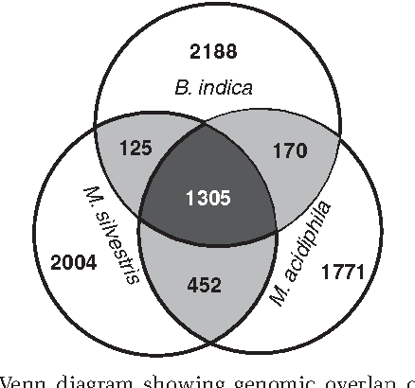
The reference (included with metaphlan2): Species specific marker genes
Identify a set of genes that are unique to a species
Species specific
P. bivia
Genus specific
Species 3
P. timonensis
P. copri
Non-specific (core)
Fake data!!!!!

Slide 21
Step 1) Map reads to species specific marker genes
Sample 1 (reads)
Keep all genes with at least one uniquely mapped read
Species A
Species B
Species C
Species D

Slide 22
Step 2): Determine taxon abundance (at desired level)
Order abund: 5 + 3 + 4 + 8 + 9 + 6 = 35 reads
Family abund: 8 + 9 + 6 = 23 reads
Genus abund: 6 + 9 = 15 reads
Species abund: 6 reads
5
3
4
8
9
6
Number of reads mapping to species-specific genes

Slide 23
To do this when you get home:
To download metaphlan2 and all it’s dependencies:
1) Install conda
https://conda.io/miniconda.html
2) Install Metaphlan2 (Bowtie2 will come with it), run in the command prompt:
conda install -c bioconda metaphlan2

Slide 24
Taxonomic profiling: 1) map reads to marker genes
1.
2. Run the script
Note: Looping through all the samples
Note: Fill in the sample name and send to BASH

Slide 25
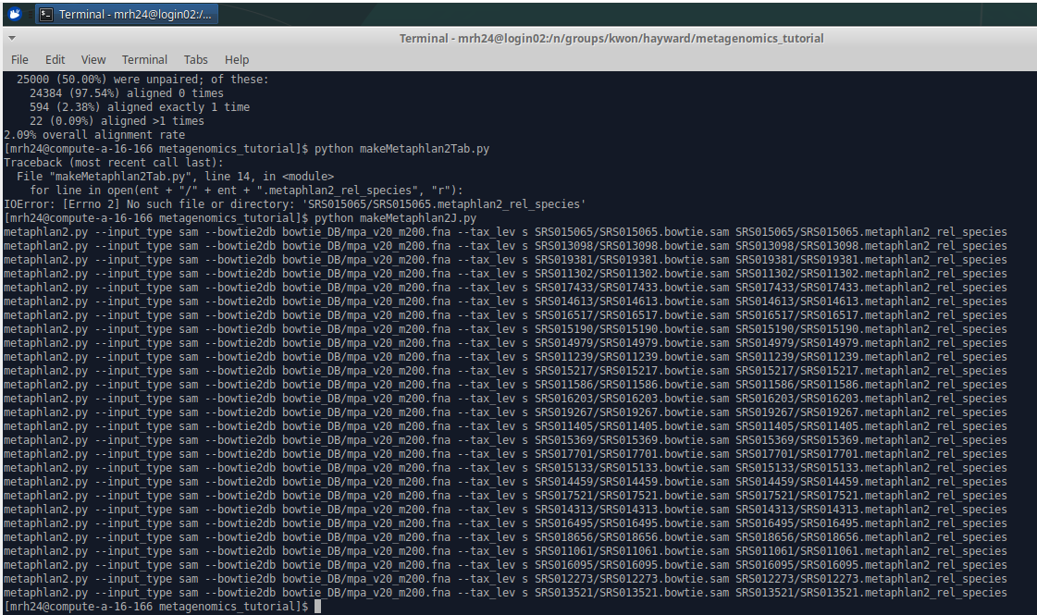
This is why we use loops
You’d have to type all 30 jobs out

Slide 26
Bowtie2 console output (about 5 mins)
All this output relates to one sample
Pretty easy to understand. We won’t need any of this info later!

Slide 27
Taxonomic profiling: 2) Summarise species abundances (metaphlan2)
1) Open script
2) Replace this command with this one
3) Run the script (there will be no output printed to the console!)

Slide 28
Questions and coffee break 30 mins!

Slide 29
Taxonomic profiling: 3) Make a species abundance table (bespoke)
Run makeMetaphlan2Tab.py
Species abundances are only returned when seen, since metaphlan2 doesn’t fill in 0 we have to do it ourselves for each sample

Slide 30
Data analysis and visualisation: Quick and easy (20 mins)
2) Now you are all Rmarkdown pros run through this script, read the comments and take a quick look at the plots
1)

Slide 31
If you want to do this again, this is probably not the way to do it!
I only gave you 0.03% of a full sequence file (20,000 reads) and we ran only one at a time, to do this for a full sample (60,000,000 reads) will take 10s of hours and to do it for all 30 will take weeks.
For efficient and effective analysis you will need to use a high performance computing cluster wherein you can submit multiple jobs in parallel with huge amounts of RAM and multiple cores

Slide 32
Questions and coffee break 15 mins!

