Slide 1
Downloading workshop files to your computer
Karin Steffen
Workshop on Genomics 2020

Slide 2
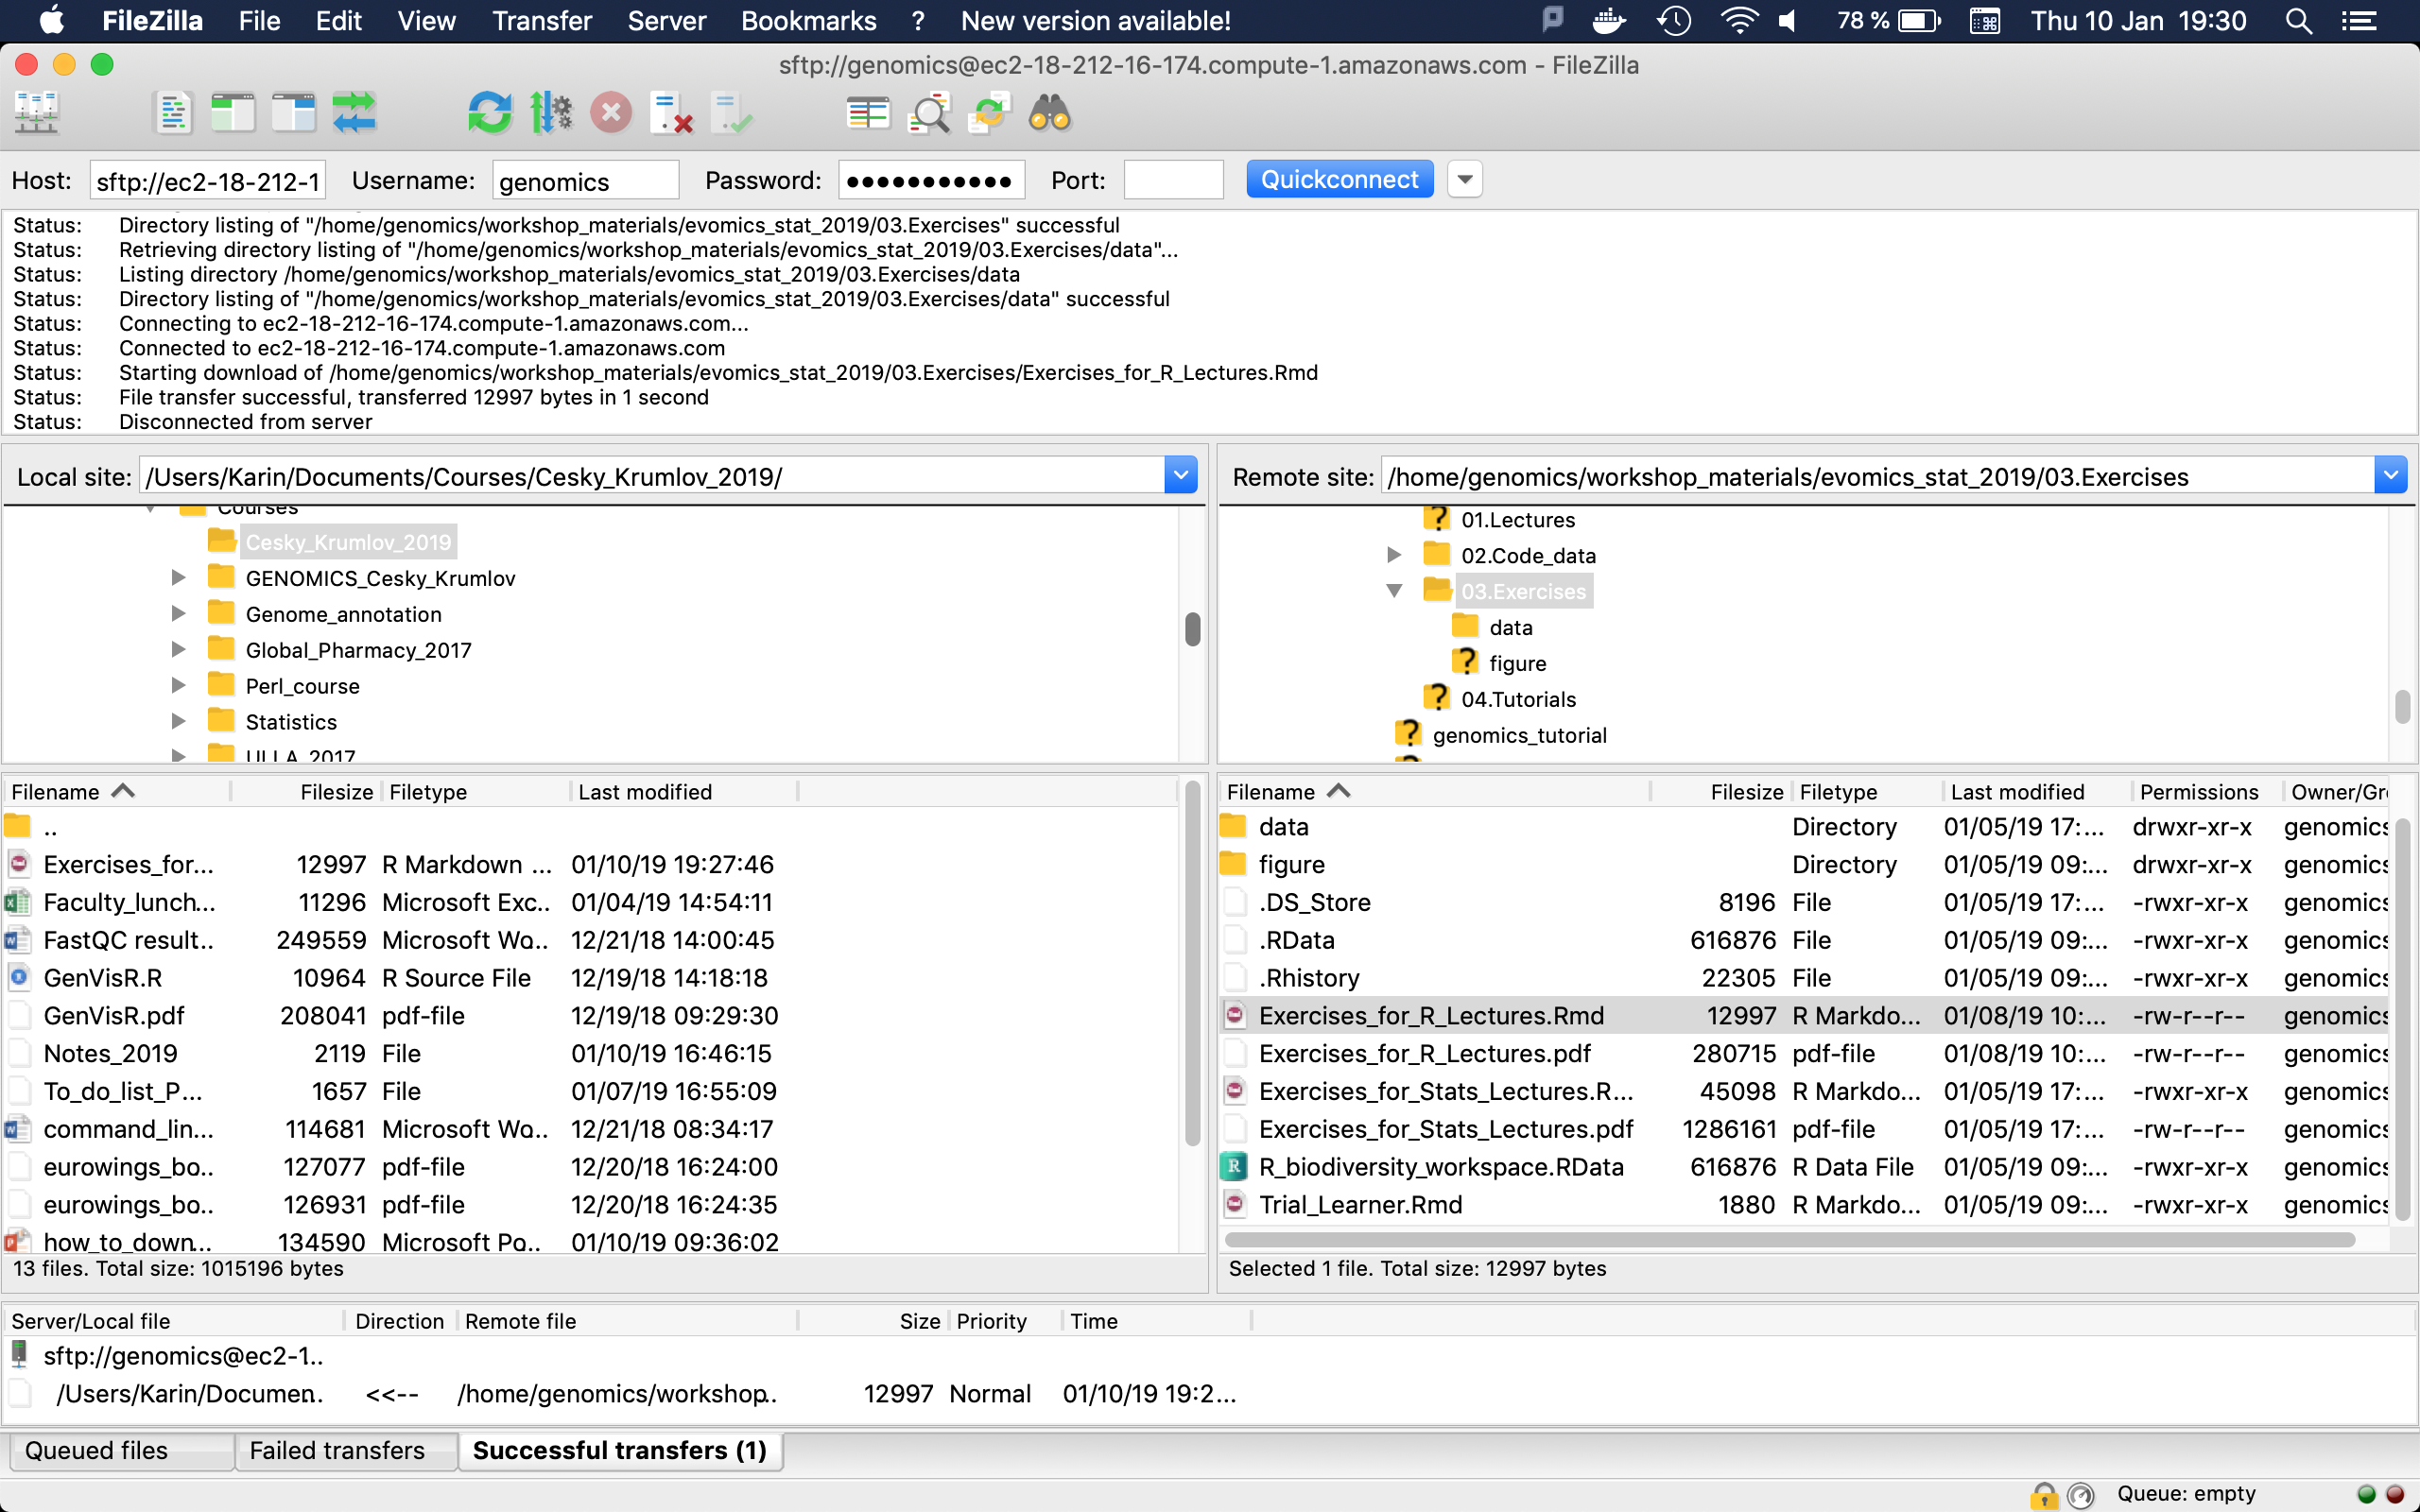
GUI: Filezilla https://sourceforge.net/projects/filezilla/
22
Instance address
Username
Password
Drag & Drop
Notes:
FileZilla® is a cross-platform FTP, SFTP, and FTPS client with a vast list of features, which supports Windows, Mac OS X, Linux, and more. FileZilla's dynamic tools help you move files between your local machine and your Web site's server effortlessly. For example, Filezilla lets you compare your files with in-directory server files to manage file syncing.

Slide 3
Terminal: rsync (scp …)
Download your file of interest
$ rsync -avz genomics@ec2-3-228-217-92.compute-1.amazonaws.com:/home/genomics/workshop_materials/pop_gen/stairwayplot .
$ scp genomics@ec2-3-228-217-92.compute-1.amazonaws.com:/home/genomics/workshop_materials/pop_gen/stairwayplot .
How large are the files?
$ ls –lh
How to get the right path? Open a second terminal window to navigate and find the files you’re interested in.
$ ssh genomics@ec2-3-228-217-92.compute-1.amazonaws.com

