Slide 1
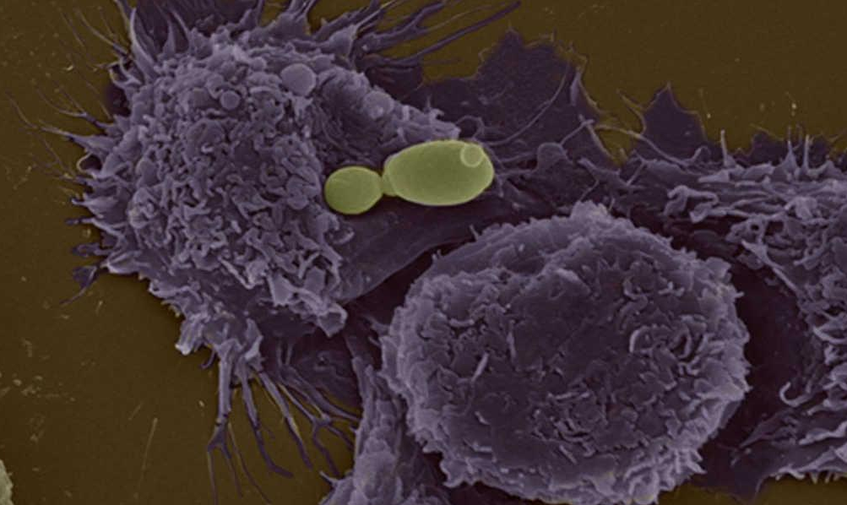




A Pathogen’s Odyssey
Tracing the emergence and adaptation of fungal pathogens
Toni Gabaldón
Inst. for Research in Biomedicine (IRB) and Barcelona Supercomputing Centre (BSC), Barcelona, Spain
<number>
@gabaldonlab
www.cgenomics.org

Slide 2
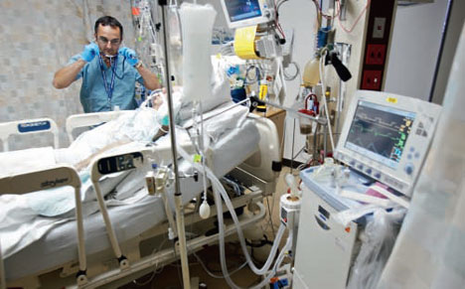

Slide 3
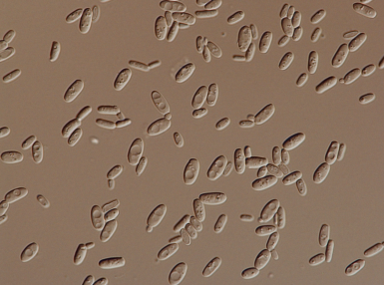
The killer: an underscribed new hybrid species of yeast

Slide 4
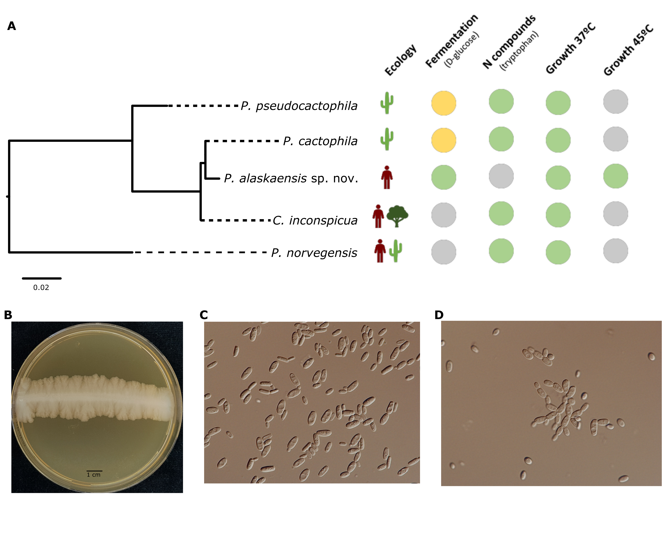

Slide 5
Hybrid
Pathogens!

Slide 6
What this story illustrates:
- Fungal pathogens are neglected (also in the clinics)
(but each year they affect 25% of the population, and kill over 1,5 Mill ppl)
- They often affect persons with weaken or depressed
immune systems
(They are often the cause of death of hospital patients after transplant, cancer treatment, etc.)
- Fungal taxonomy sucks and needs to be re-worked
- Fungal diagnostics is hard (only genomics worked in this case)
- Drug resistance is an issue (only three types of drugs available, resistance growing)
- Hybridization may be a neglected source of rare deadly pathogens. Most cases like this one would be left with an ambiguous (non-albicans Candida) or wrong clasification (C. inconspicua)
- We have no idea where these rare pathogens come from
- We have no idea what confers some yeasts a pathogenic potential
- We do not know how they adapt to us

Slide 7

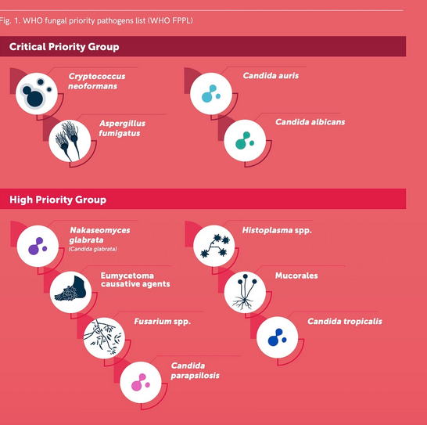

Slide 8
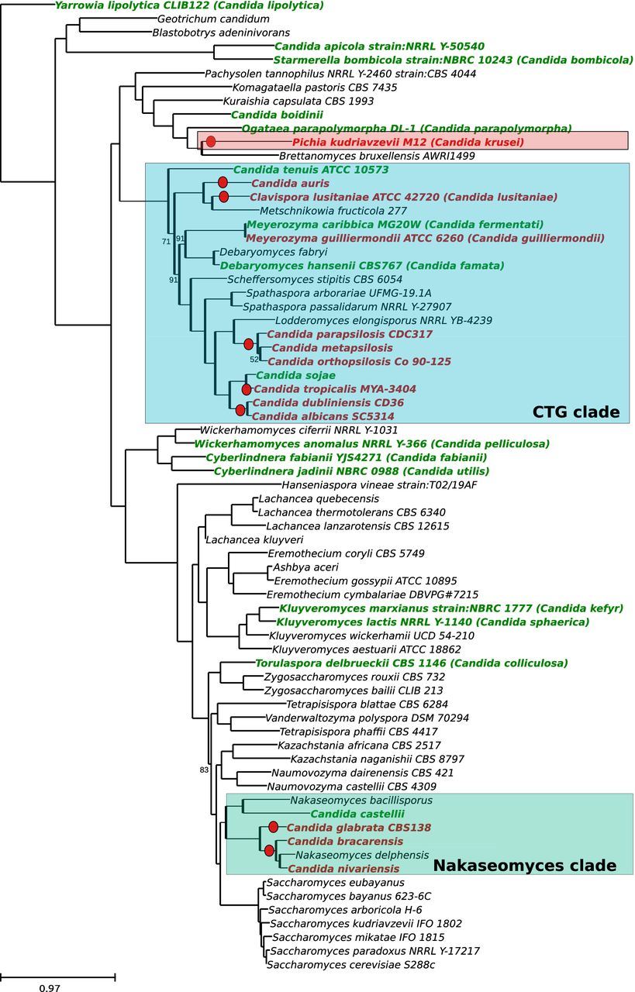
C. krusei
2%
other Candida
spp 4%
C. tropicalis
7%
C. parapsilosis
14%
C. glabrata
21%
C. albicans
52%

Slide 9

RELATED
COMMENSAL/PATHOGEN
HOST

Slide 10
RELATED
COMMENSAL/PATHOGEN
HOST
(immunocompromised)

Slide 11
Comparison of closely-related pathogens and non-pathogen species pairs (or groups) can reveal genomic changes underlying the emergence of pathogenesis.
Recent technical developments allows cost-effective sequencing of targeted genomes, thus allowing the increase in resolution of the genomic comparisons.

Slide 12
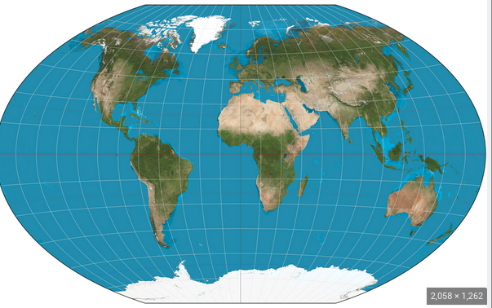
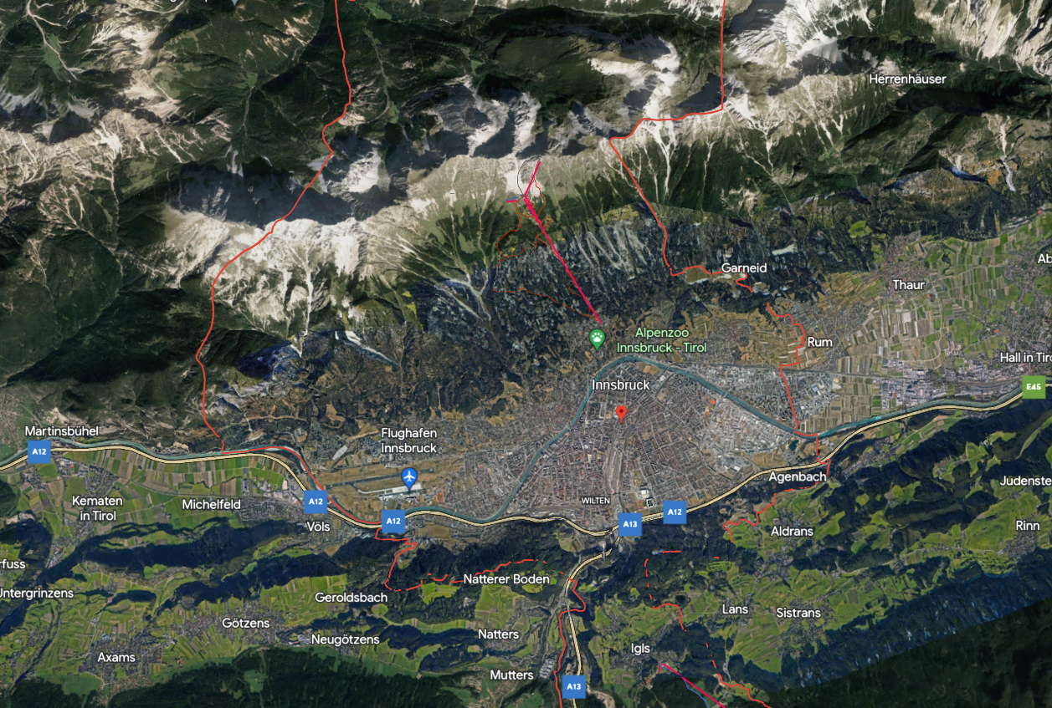
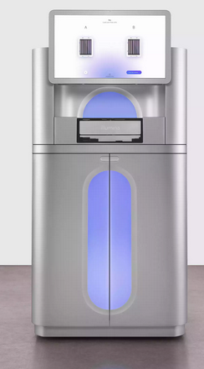
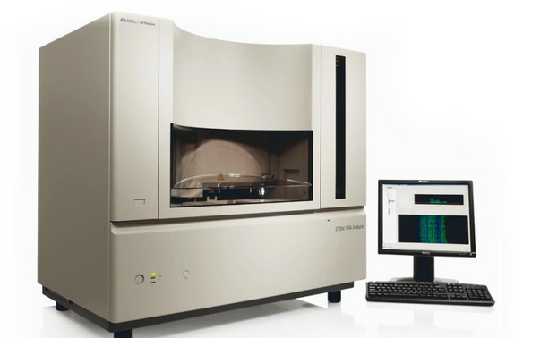
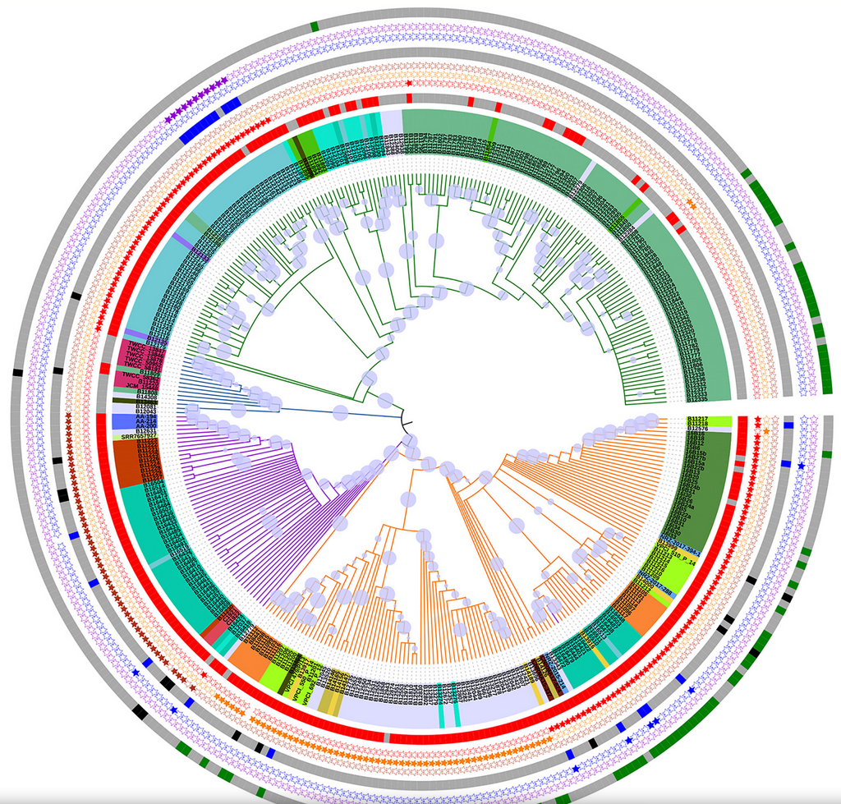
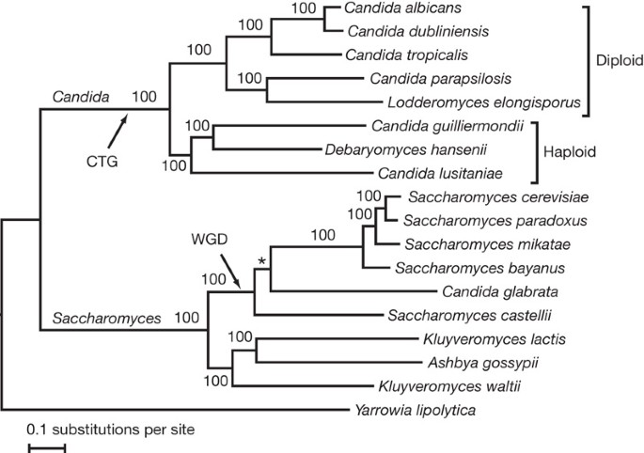

Slide 13
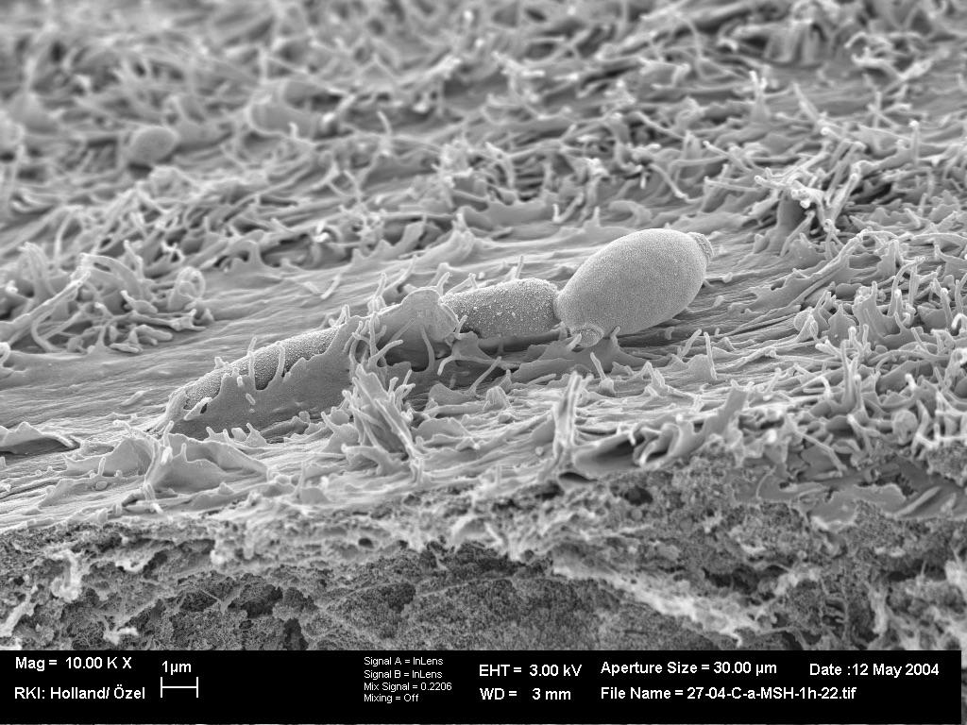
How they emerged?
What makes a succesful pathogen?
How they
become drug
Resistant?
How they
adapted to us?

Slide 14
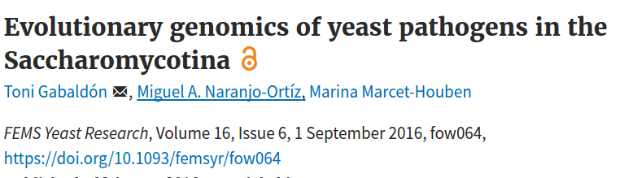
C. krusei
2%
other Candida
spp 4%
C. tropicalis
7%
C. parapsilosis
14%
C. glabrata
21%
C. albicans
52%

Slide 15
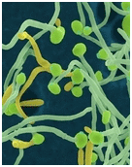
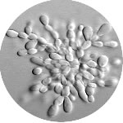
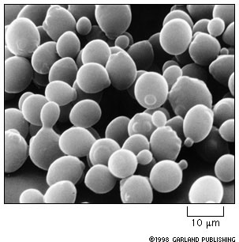
Fungal Pathogens - C. albicans & C. glabrata
Candida albicans
Candida glabrata
Saccharomyces cerevisiae
~ 800 million years evolution......
Diploid (No Sex) Haploid (No Sex) Haploid/Diploid
~6500 genes ~5600 genes ~5800 genes
Yeast/Hyphae Yeast/Pseudohyphae Yeast/Pseudohyphae
Pathogenic (~55%) Pathogenic (~30%) NON-pathogenic
(Maier et. al. 2014 PloS Pathogens)

Slide 16
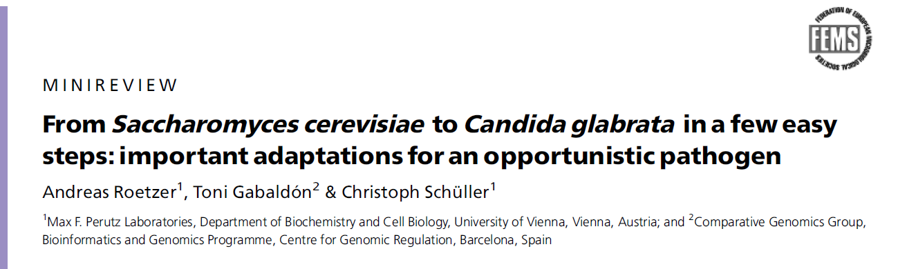
In the begining
- Stress response
- Adherence
- Higher dependance of the host (e.g loss of BNA and other pathways)
- Growth at 37 degrees
- etc.

Slide 17
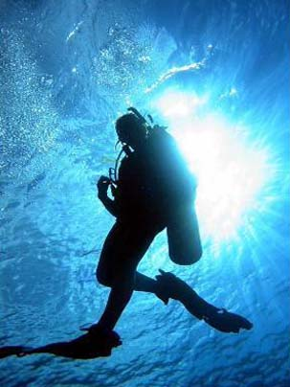
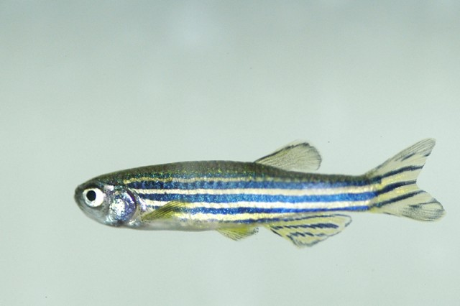
At the sequence level, C. glabrata and S. cerevisiae are as divergent as human and fish
We need to increase the resolution

Slide 18
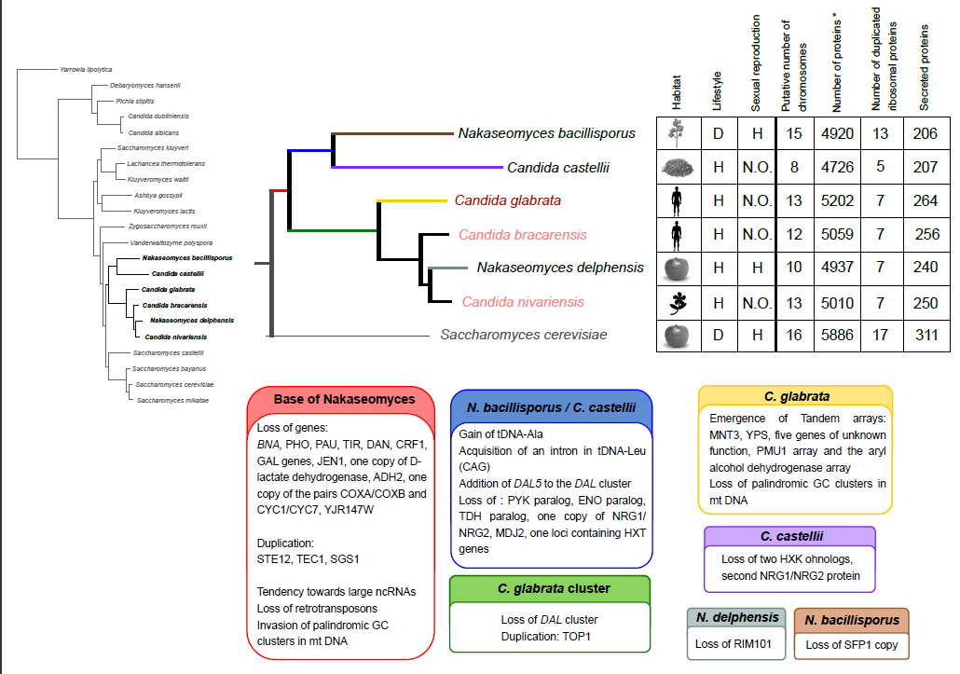
Sequencing of the whole Nakaseomyces clade
Gabaldón et. al. (2013)

Slide 19
EPA-like adhesins provide a link between recent genome evolution and
The emergence of pathogenesis in the Nakaseomyces.
EPA-like adhesins
0
0
14
10
1
8

Slide 20
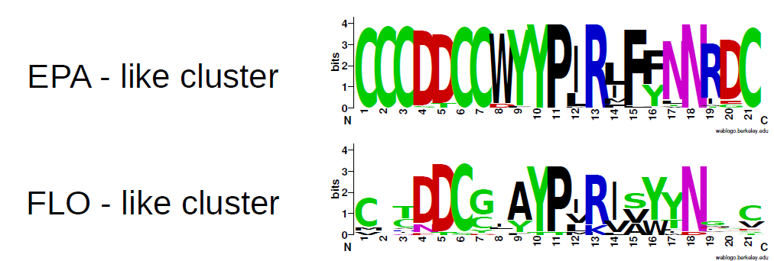
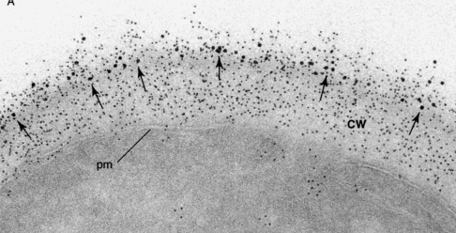
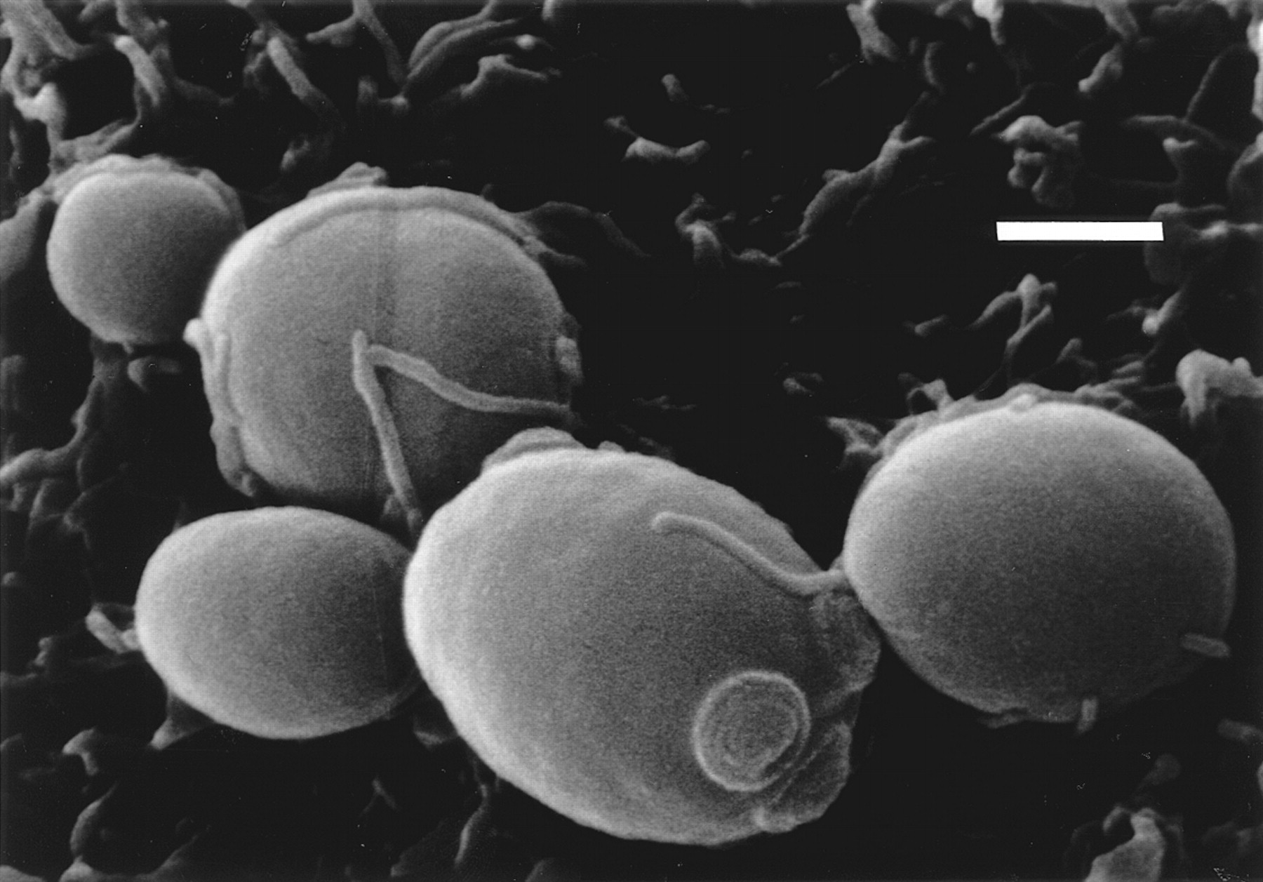
EPA-like adhesins (distantly related to FLO in S. cerevisiae)
mediate host-cell adherence in C. glabrata.
And have been shown to be important for virulence

Slide 21
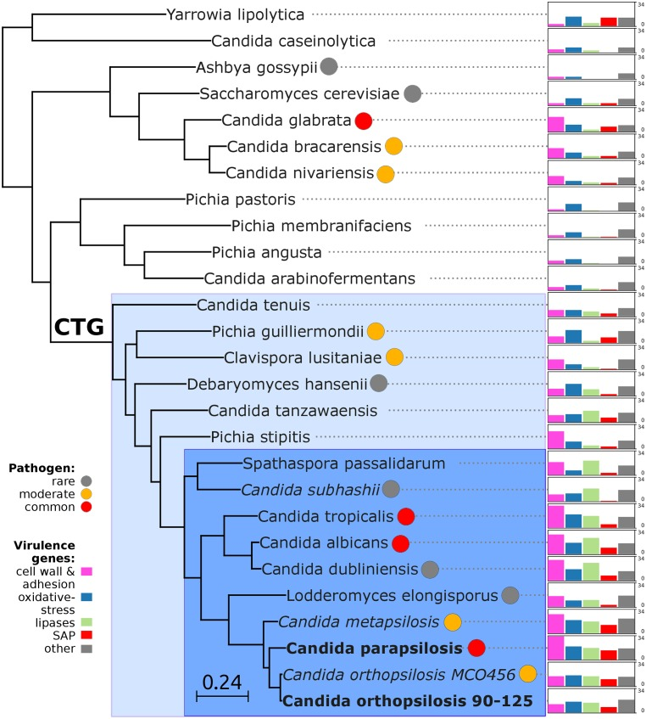
Candida pathogens typically have large cell-wall protein repertoires

Slide 22
- Stress response
- Adherence
- Higher dependance of the host (e.g loss of BNA and other pathways)
- Growth at 37 degrees
- etc.

Slide 23
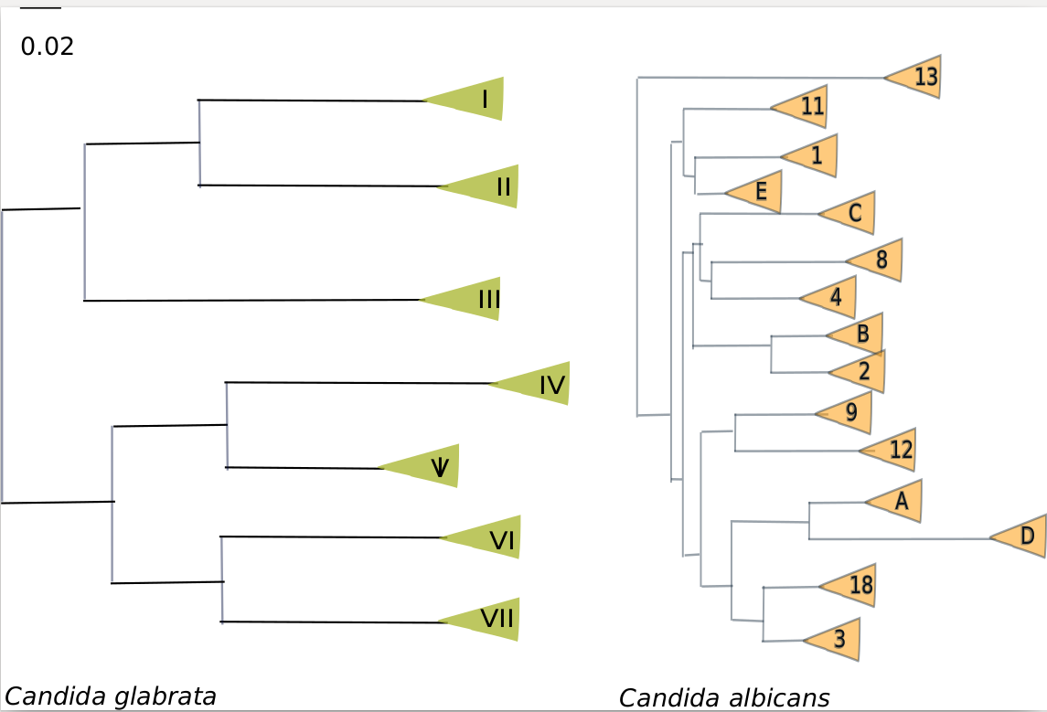
(Recently)
Adapted to humans?

Slide 24
(Recently)
Adapted to humans?
(most) species present large intra-specific diversity, with divergent clades each of then with worldwide distribution ……. suggesting divergence predates human colonization and recent, multiple convergent colonization
Virulence traits are generally ancient and most shared with non-pathogenic relatives…. Suggesting co-option rather than innovation
Gabaldón et. al. BMC Gen. 2013
Carreté et. al. Curr. Biol. 2018

Slide 25
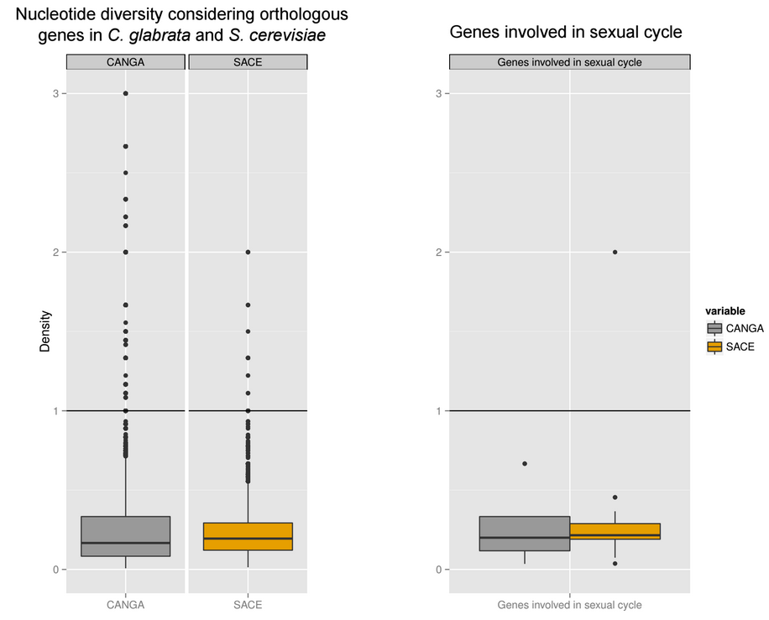
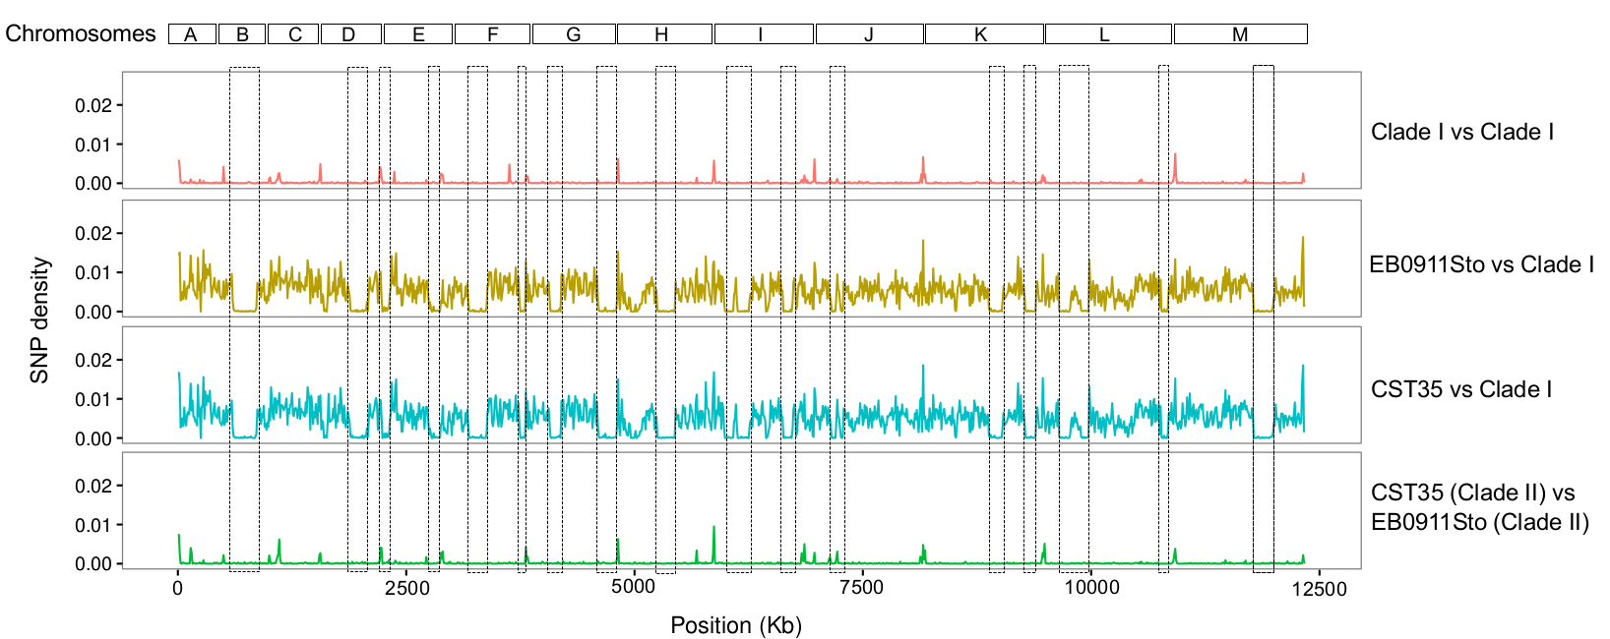
Asexual?

Slide 26
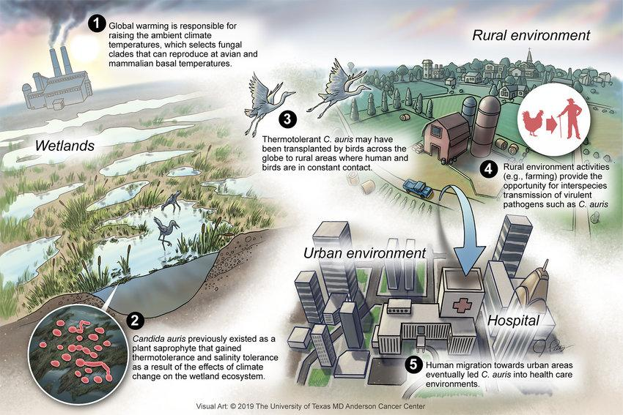
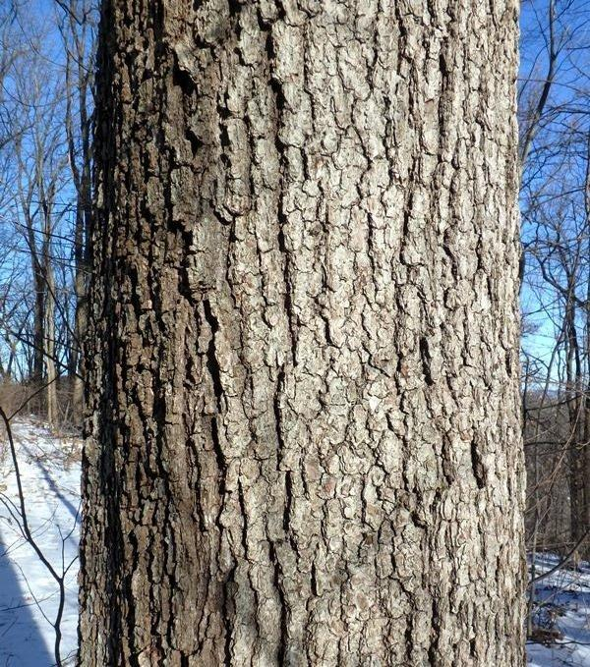
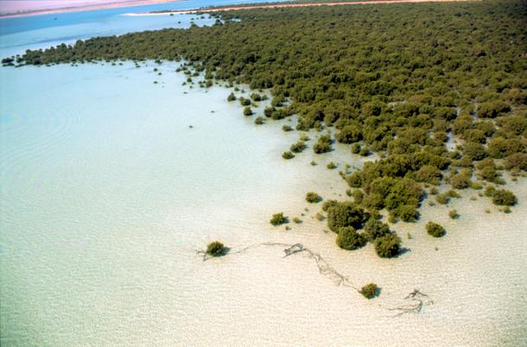
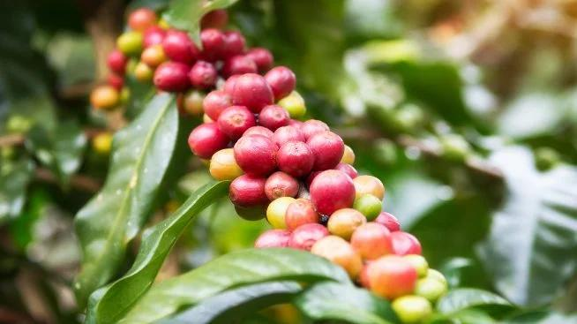
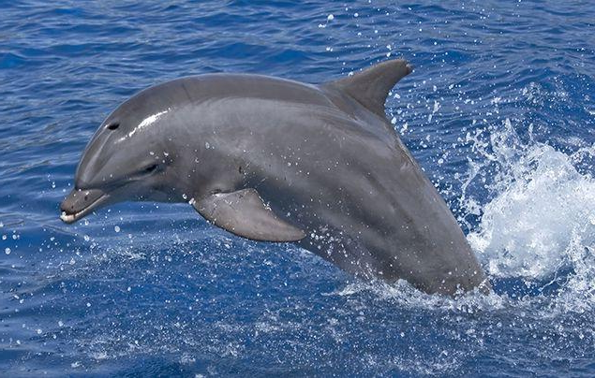

Commensal
opportunistic pathogens?
Found in multiple environments, environmental/clinical isolates do not form separate clades….
suggesting ongoing environmental transmission

Slide 27
Asexual
Commensal
opportunistic
pathogens
(Recently)
Adapted to humans

Slide 28
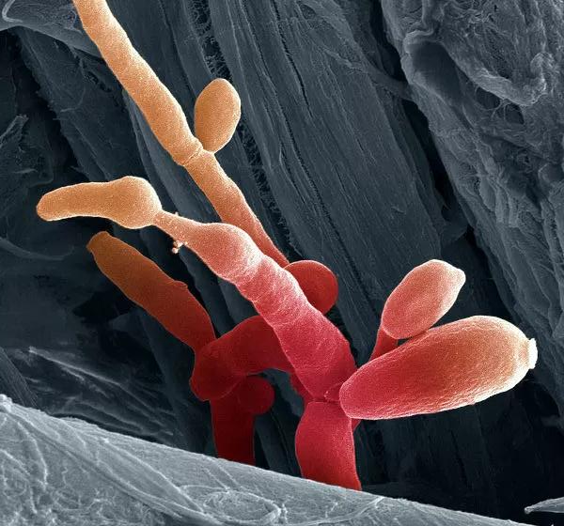
“human pathogenesis”
is just a hobby
We thrive
in other niches
Yes, we have
Sex!
And
we hybridize!
And we will
become resistant
to all your drugs!

Slide 29
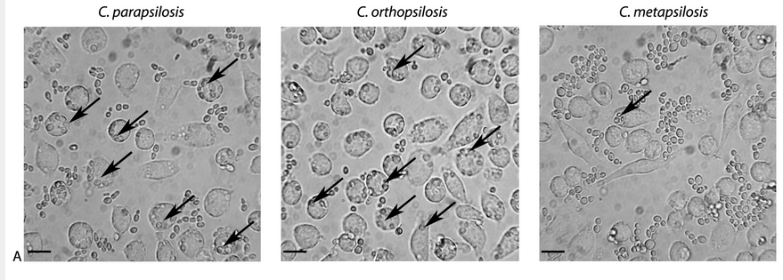
Virulence
Németh et. al. (2013)

Slide 30

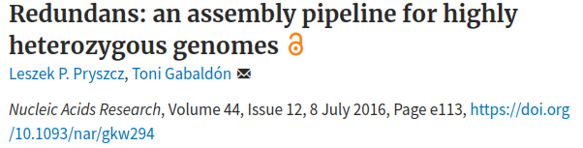
Candida orthopsilosis, Candida metapsilosis
Strains with >2000 scaffolds, >20 Mb assembly size?
Even with four libraries combined (pair-end 600 insert-size, mate-pairs 5kb insert size, myseq overlapping reads), 1000x coverage.
High heterozygosity

Slide 31
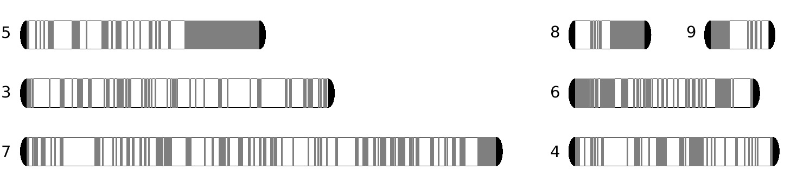
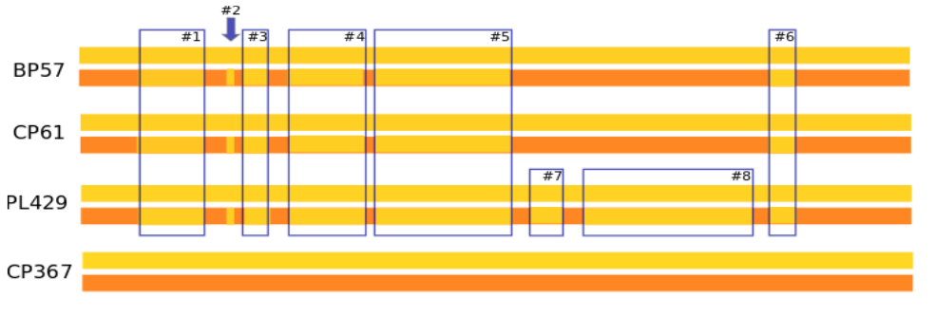
Hybrid genomes shaped by loss of heterozygosity

Slide 32
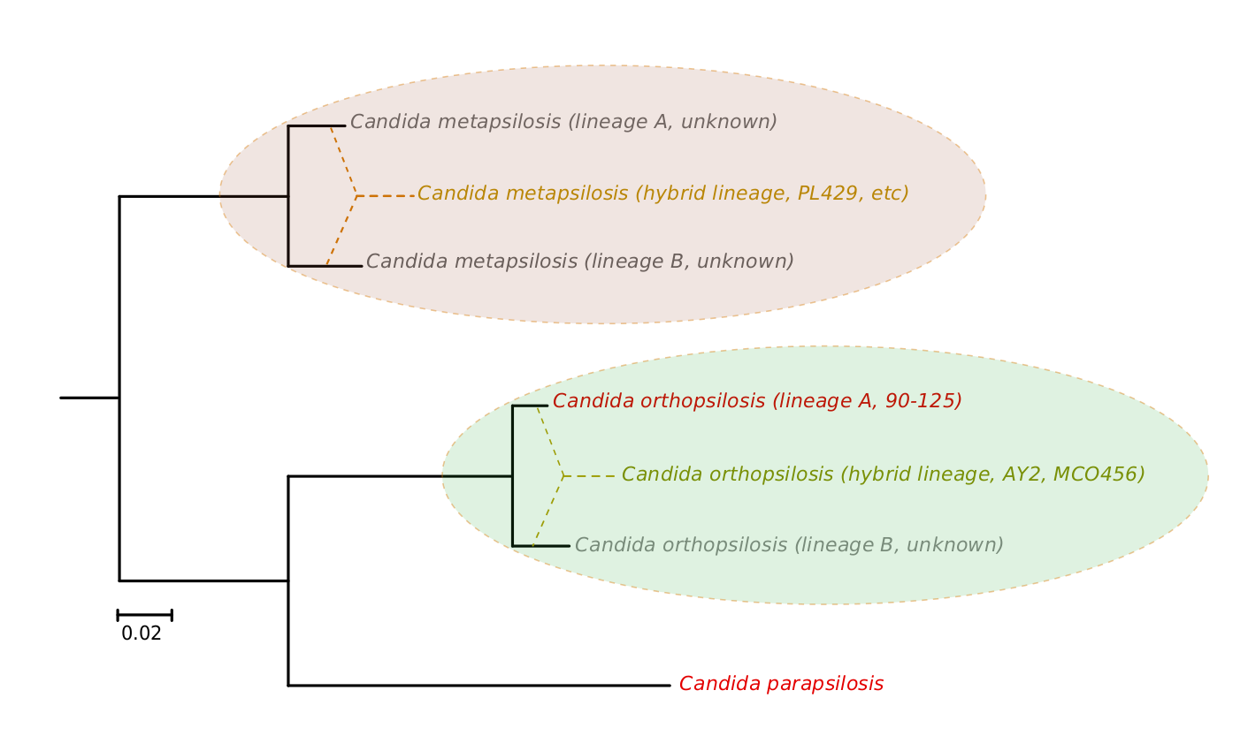
Redefining the Candida parapsilosis species complex
25 clinical strains
(all hybrids)
40 clinical strains
(38 hybrids)
(2 parental A)
Pryszcz et. al. 2015. PloS Gen.

Slide 33
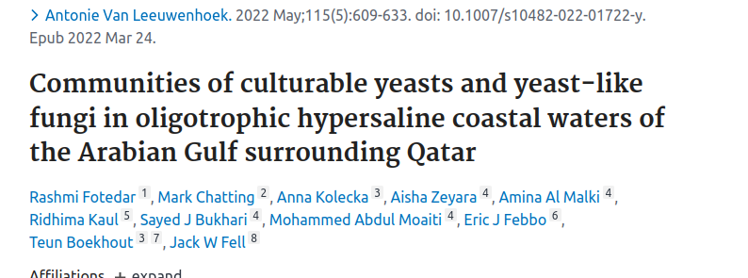
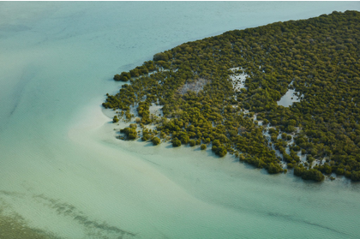
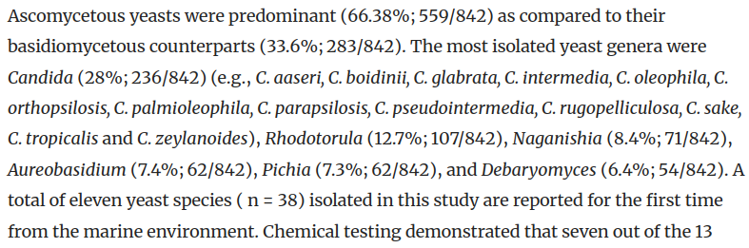

Slide 34
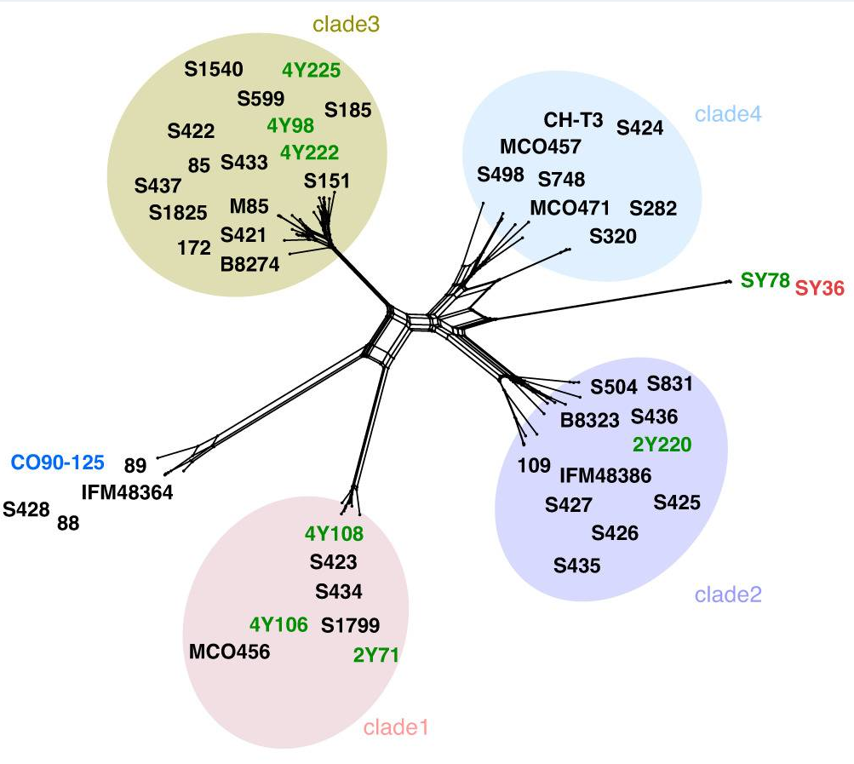
Clinical reference (parent A)
clinical strains from around the globe
Qatar environmental isolates
Qatar environmental isolate

Slide 35
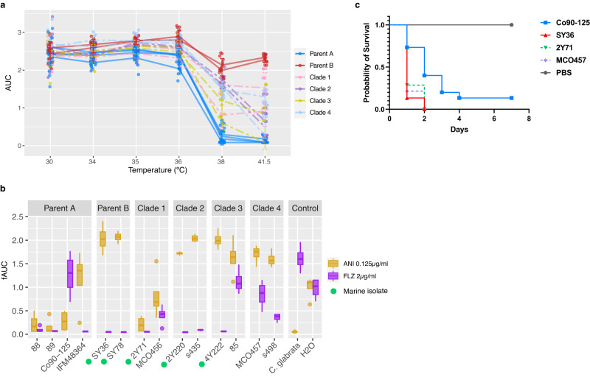
a- Parent B can grow at higher temperatures, hybrids are intermediate, parent A less
b- Parent B and hybrids show higher virulence (in a Galleria model) than parent A
c- Parent B shows anidulafungin resistant, some hybrids as well (intrinsic?)
d- Only some clinical strains show fluconazole resistance (selected in clinics?)

Slide 36
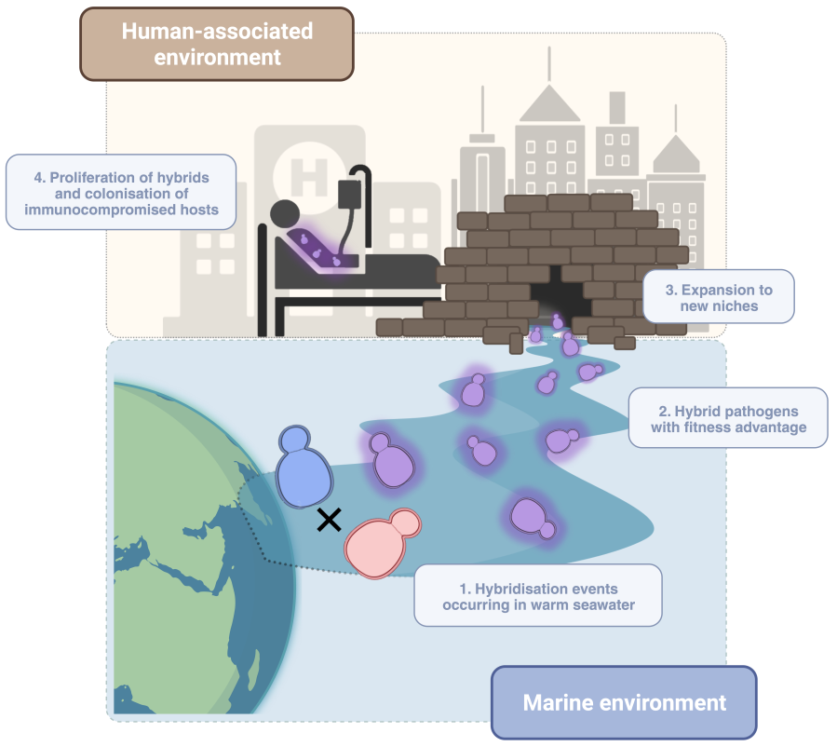

Slide 37
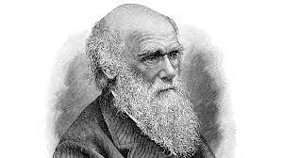
The problem:
If Candida pathogens are only opportunistic colonizers of humans,
and their traits (including those useful to colonize/infect humans)
mostly result from adaptation to other niches….
Then…… evolutionary analysis will not necessarily inform on what signatures
are relevant to human colonization/infection
?

Slide 38

The problem:
If Candida pathogens are only opportunistic colonizers of humans,
and their traits (including those useful to colonize/infect humans)
mostly result from adaptation to other niches….
Then…… evolutionary analysis will not necessarily inform on what signatures
are relevant to human colonization/infection
The solution:
Focus on recent mutations acquired within clinical isolates

Slide 39
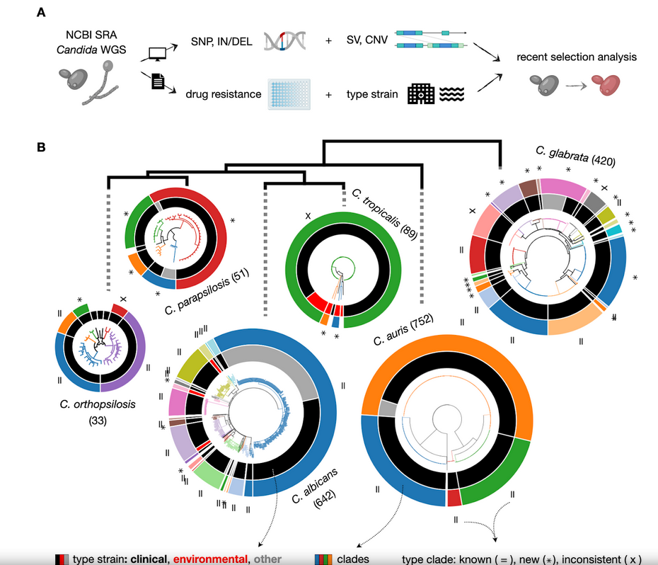
Schikora-Tamarit et. al. (2024)

Slide 40
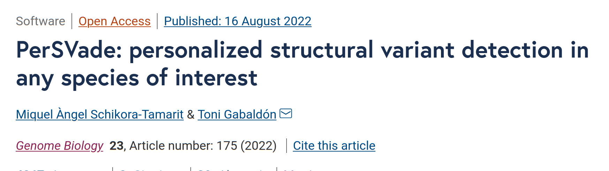
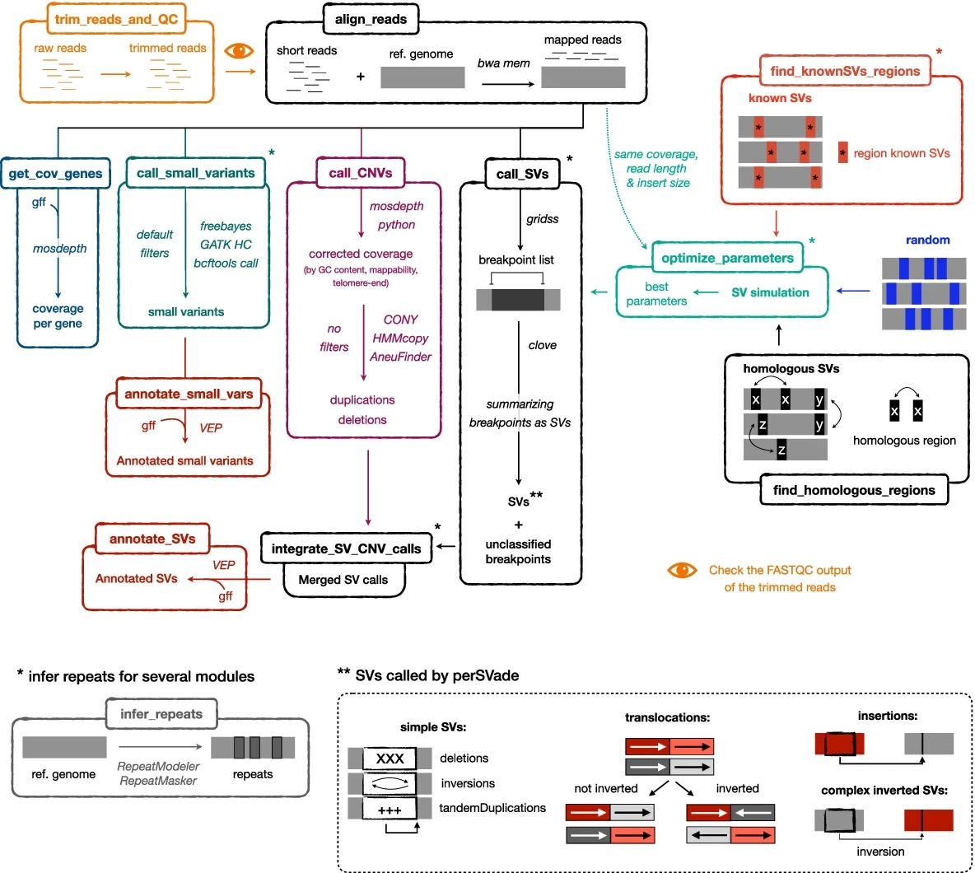

Slide 41
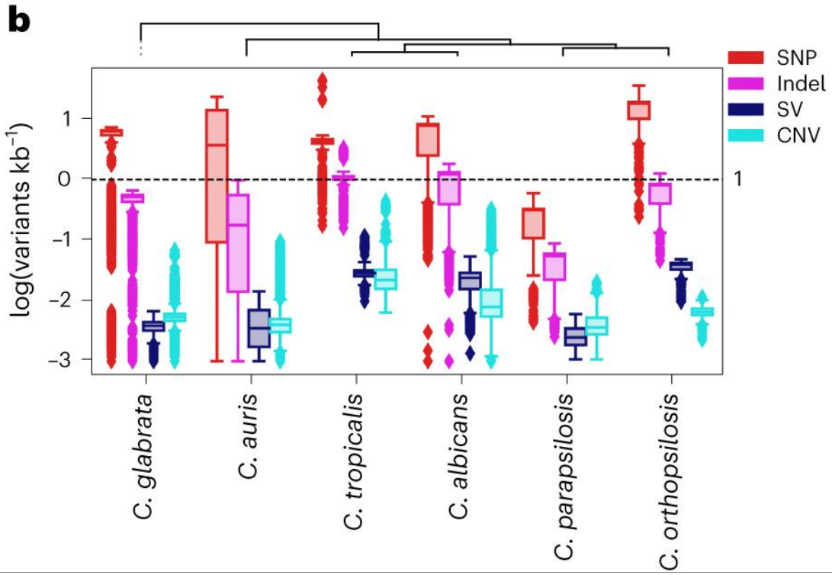
- Most species entail high diversity, distant strains as divergent as 1%, indicating
ancient origin (i.e. predating humans origins and implying multiple colonizations)
- C. parapsilosis is an exception, suggesting a more recent diversification
- Svs and CNVs represent a significant fraction of the genetic variation and should
not be overlooked

Slide 42



- Most variants unlikely to be related to clinical/human adaptation .
- We focused on those within monophyletic and highly related clusters of clinical strains

Slide 43

- Diverse pathways enriched in recent selection, mostly species-specific but also convergent pathways such as cell adhesion, and regulatory genes

Slide 44



Slide 45


Slide 46


- Known resistance mechanisms are detected
- But also new genes whose mutations correlate
similarly with resistance suggesting alternative
or complementary resistance mechanisms

Slide 47
The problem:
If Candida pathogens are only opportunistic colonizers of humans,
and their traits (including those useful to colonize/infect humans)
mostly result from adaptation to other niches….
Then…… evolutionary analysis will not necessarily inform on what signatures
are relevant to human colonization/infection
The solution:
Focus on recent mutations acquired within clinical isolates
Use in vitro evolution (e.g. to study drug adaptation)

Slide 48



In vitro evolution approach

Slide 49

- They all (independent of genetic background) adapted and acquired resistance
only concommitant use of drugs caused some population extinction
- They did so by acquiring few (<10) mutations

Slide 50
- They all (independent of genetic background) adapted and acquired resistance
only concommitant use of drugs caused some population extinction
- They did so by acquiring few (<10) mutations

Slide 51
The order of factors alters the product!!
First drug Second drug Outcome
Echinocandin Azole 50% will become MDR
Azole Echinocandin No cross-resistance
* Current clinical guidelines recommend Echinocandins as the first line for
Invasive fungal infections by Candida!!!

Slide 52

Rational design of treatments drug cycling

Slide 53




Slide 54

New mechanisms?
CDR1 Efflux pump
CNE1 (ER protein folding control)
EPA13 (cell wall adhesin)
ERG3/ERG4
Target of azoles
ERG3 mutations appeared during
ANI adaptation, and caused
cross-resistance to fluconazole!

Slide 55




Slide 56


Ongoing work:
Finding the Achiles heel of these superbugs

Slide 57



Slide 58




Platemaster putting the spots
Scanners system
Scanned plates
96 colonies in each plate
+
1 photo each 15’ during 48 h
+
2 scanners with 4 plates each
=
768 colonies and
147.456 analyzed areas
Notes:
Here we can see different types of replicators according to their diameter and the plates we use.
For this experiment we bought a special scanner for photography that would allow us to focus on the colonies on the plate. This scanner is introduced into the incubation oven so that the plates are at the right temperature. We connected it to a computer, which has installed a program that controls the scanner to take pictures for 15 minutes
In the last photograph, one of the images obtained with the scanner is shown where the different areas of growth can be observed
<number>

Slide 59



Slide 60
Conclusions
- Comparative genomics and increasing genomic resolution debunked all our assumptions on Candida pathogens
- Exaptation rather than adaptation seems to explain human pathogenic potential
- Some environments may promote traits that are useful to colonize/infect humans (adhesion, osmotic tolerance, stress resistance?)
- Candida easily adapt to drugs, and evolutionary insights can help rationalizing therapy

Slide 61





THANKS
Thanks to all Gabaldón group,
particularly
In theses projects:
Miki Schikora,
Valentina del Olmo
Juan Carlos Núñez,
Ester Saus
Marina Marcet
Past members:
Leszek Pryszcz, Verónica Mixao, Ewa Ksiezopolska
Laia Carreté
Collaborators: Teun Boekhout (WI),
www.cgenomics.org
Funding:

